Slide 1
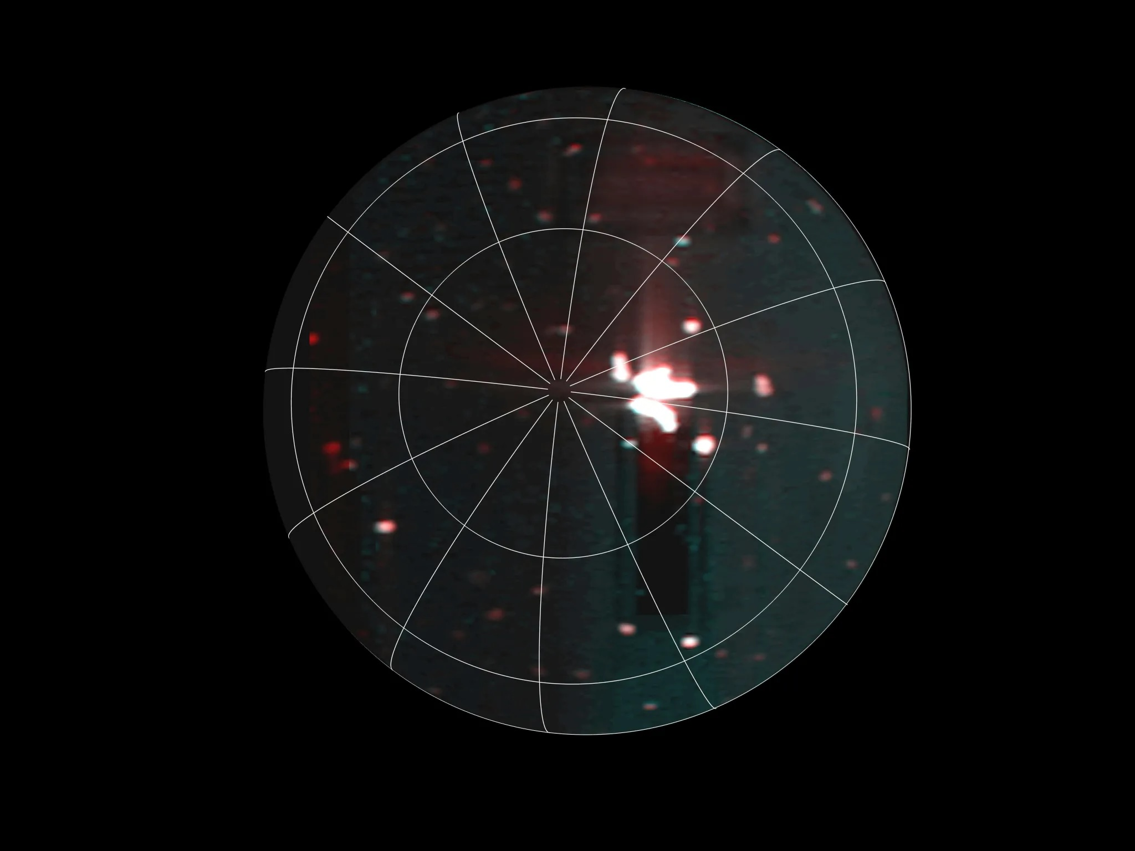
Notes:
NASA JUNO MISSION SPOTS MOST POWERFUL VOLCANIC ACTIVITY ON IO TO DATE
Scientists with NASA’s Juno mission have discovered a volcanic hot spot in the southern hemisphere of Jupiter’s moon Io. The hot spot is not only larger than Earth’s Lake Superior, but it also belches out eruptions six times the total energy of all the world’s power plants. The discovery of this massive feature comes courtesy of Juno’s Jovian Infrared Auroral Mapper (JIRAM) instrument, contributed by the Italian Space Agency.
“Juno had two really close flybys of Io during Juno’s extended mission,” said the mission’s principal investigator, Scott Bolton of the Southwest Research Institute in San Antonio. “And while each flyby provided data on the tormented moon that exceeded our expectations, the data from this latest — and more distant — flyby really blew our minds. This is the most powerful volcanic event ever recorded on the most volcanic world in our solar system — so that’s really saying something.”
For more information:
https://www.missionjuno.swri.edu/news/nasa-juno-mission-spot-powerful-volcanic-activity-io-to-date

Slide 2
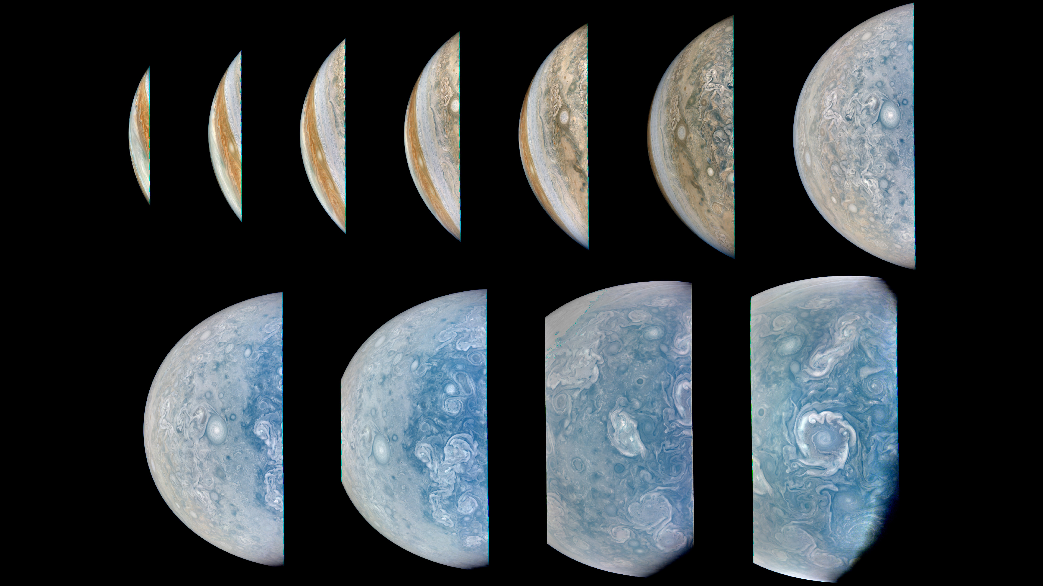
Notes:
NASA’S JUNO MISSION CAPTURES CLOSE-UPS OF POLAR STORMS ON JUPITER
During its 65th close flyby of Jupiter on Sept. 20, 2024, NASA’s Juno spacecraft captured this series of images as it approached the giant planet and swung low over its north polar region.
Juno’s recent orbits have provided exceptionally clear views of Jupiter’s circumpolar cyclones. At closest approach in this series of images, the Juno spacecraft was about 6,800 miles (11,000 kilometers) above the cloud tops, at a latitude of 82 degrees north of the equator.
Citizen scientist Brian Swift made this image using raw data from the JunoCam instrument, applying digital processing techniques to enhance color and clarity.
Image data: NASA/JPL-Caltech/SwRI/MSSS
Image processing by Brian Swift © CC BY
For more information:
https://www.missionjuno.swri.edu/news/nasa-s-juno-mission-captures-close-ups-of-polar-storms

Slide 3
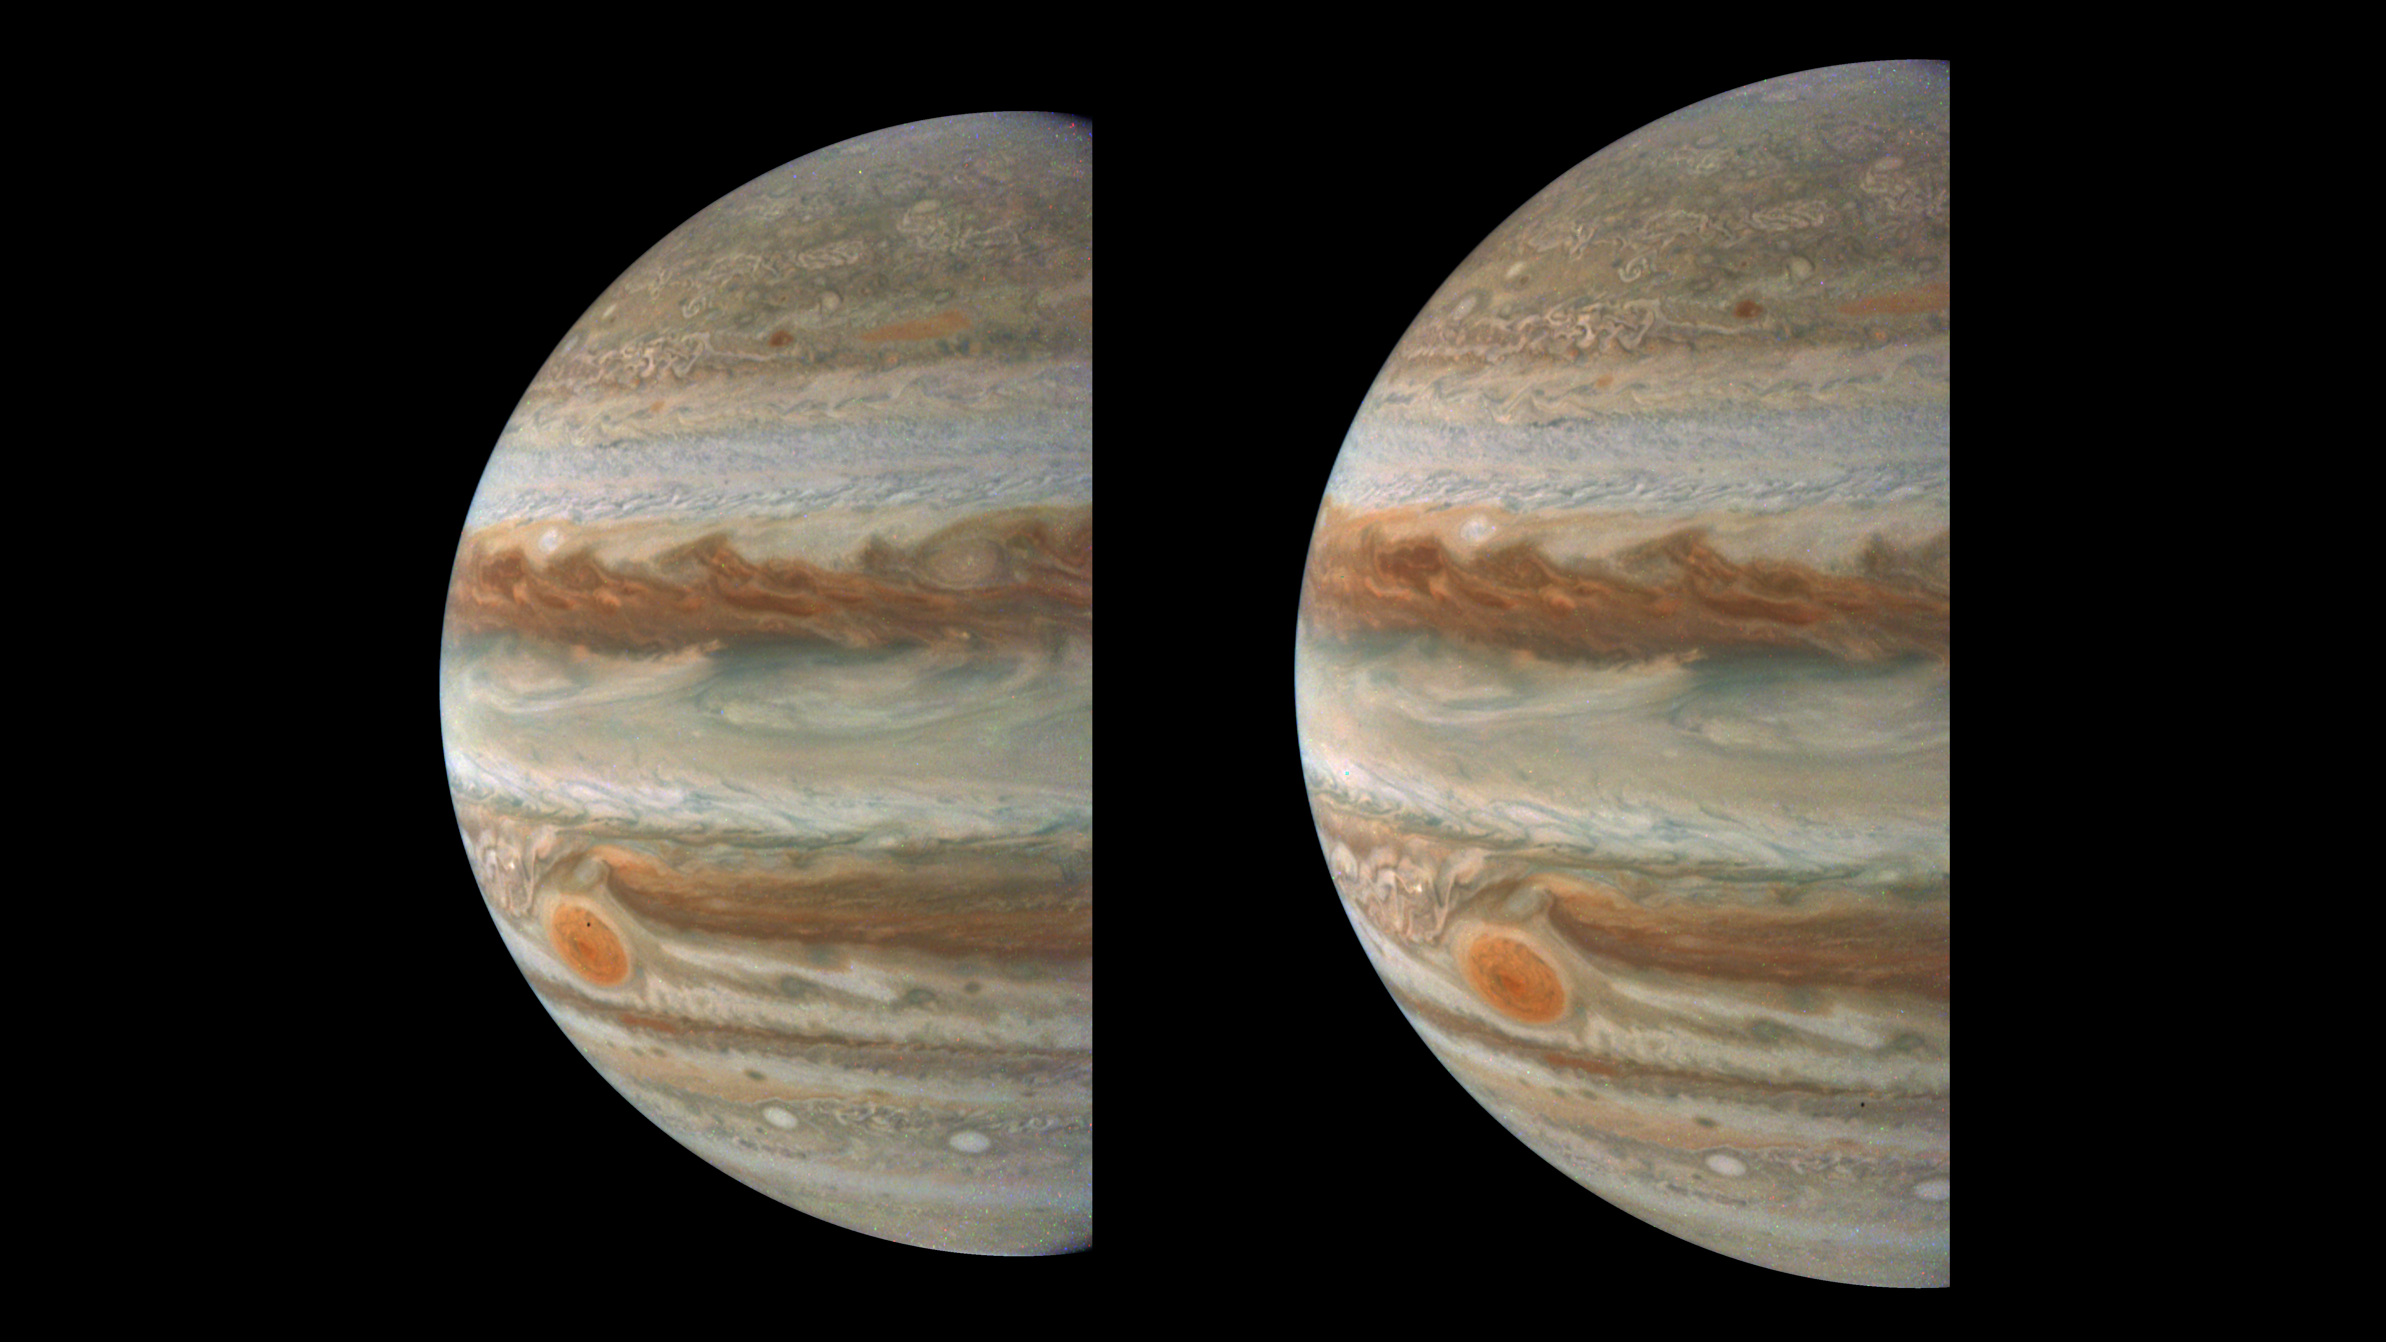
Amalthea
Amalthea
Notes:
NASA’S JUNO MISSION SPOTS JUPITER’S TINY MOON AMALTHEA
NASA’s Juno mission captured these views of Jupiter during its 59th close flyby of the giant planet on March 7, 2024. They provide a good look at Jupiter’s colorful belts and swirling storms, including the Great Red Spot. Close examination reveals something more: two glimpses of the tiny moon Amalthea.
With a radius of just 52 miles (84 kilometers), Amalthea has a potato-like shape, lacking the mass to pull itself into a sphere. In 2000, NASA’s Galileo spacecraft revealed some surface features, including impact craters, hills, and valleys. Amalthea circles Jupiter inside Io's orbit, which is the innermost of the planet’s four largest moons, taking 0.498 Earth days to complete one orbit.
Image data: NASA/JPL-Caltech/SwRI/MSSS. Image processing by Gerald Eichstädt
For more information:
https://www.missionjuno.swri.edu/news/nasa-s-juno-mission-spots-jupiter-s-tiny-moon-amalthea

