Slide 1
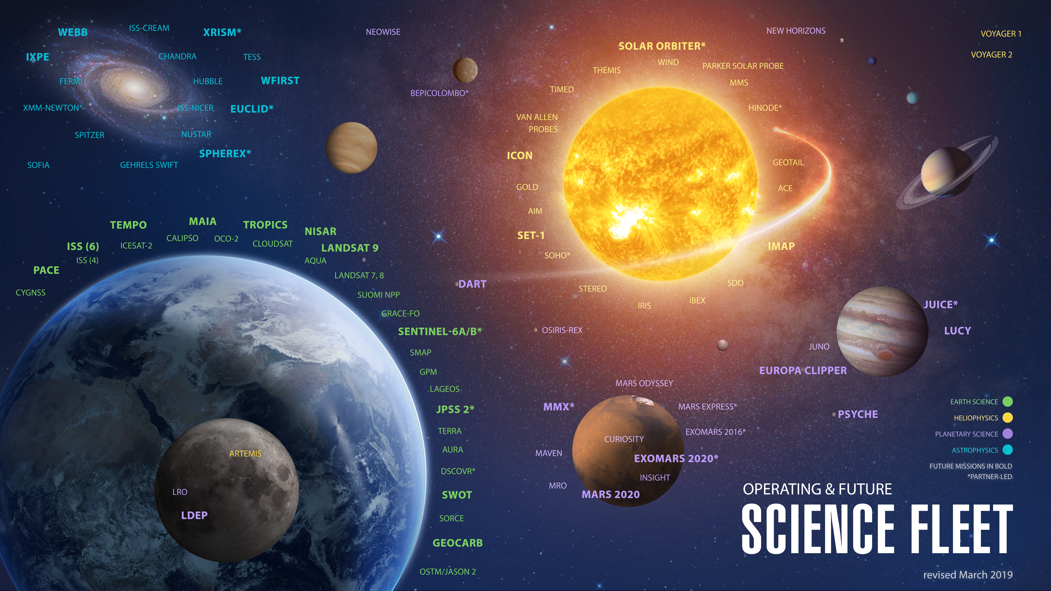
Notes:
SMD fleet
NASA Science missions circle the Earth, the Sun, the Moon, Mars, and many other destinations within our Solar System, including spacecraft that look out even further into our universe. The Science Fleet depicts the scope of NASA’s activity and how our missions have permeated throughout the solar system.

