Slide 1
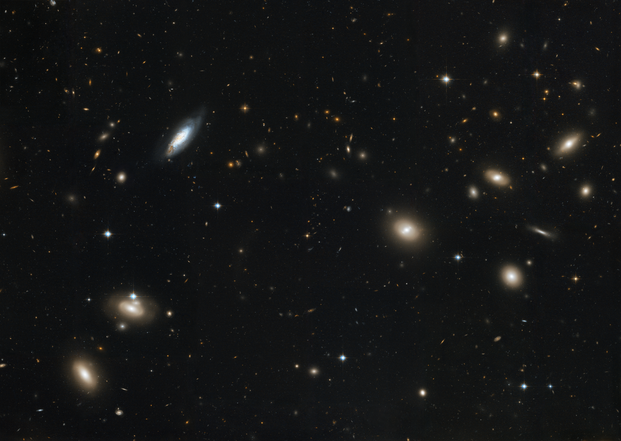
Notes:
Coma Cluster of Galaxies
NASA's Hubble Space Telescope captures the magnificent starry population of the Coma Cluster of galaxies, one of the densest known galaxy collections in the universe. The view covers a large portion near the center of the cluster, spanning several million light-years across, but the entire cluster stretches for more than 20 million light-years.
The image includes a variety of galaxy shapes and sizes from rounded ellipticals to pancake-like spirals. An in-between type, called lenticulars, are roughly elliptical, but show some disky features of sprials.

