Slide 1
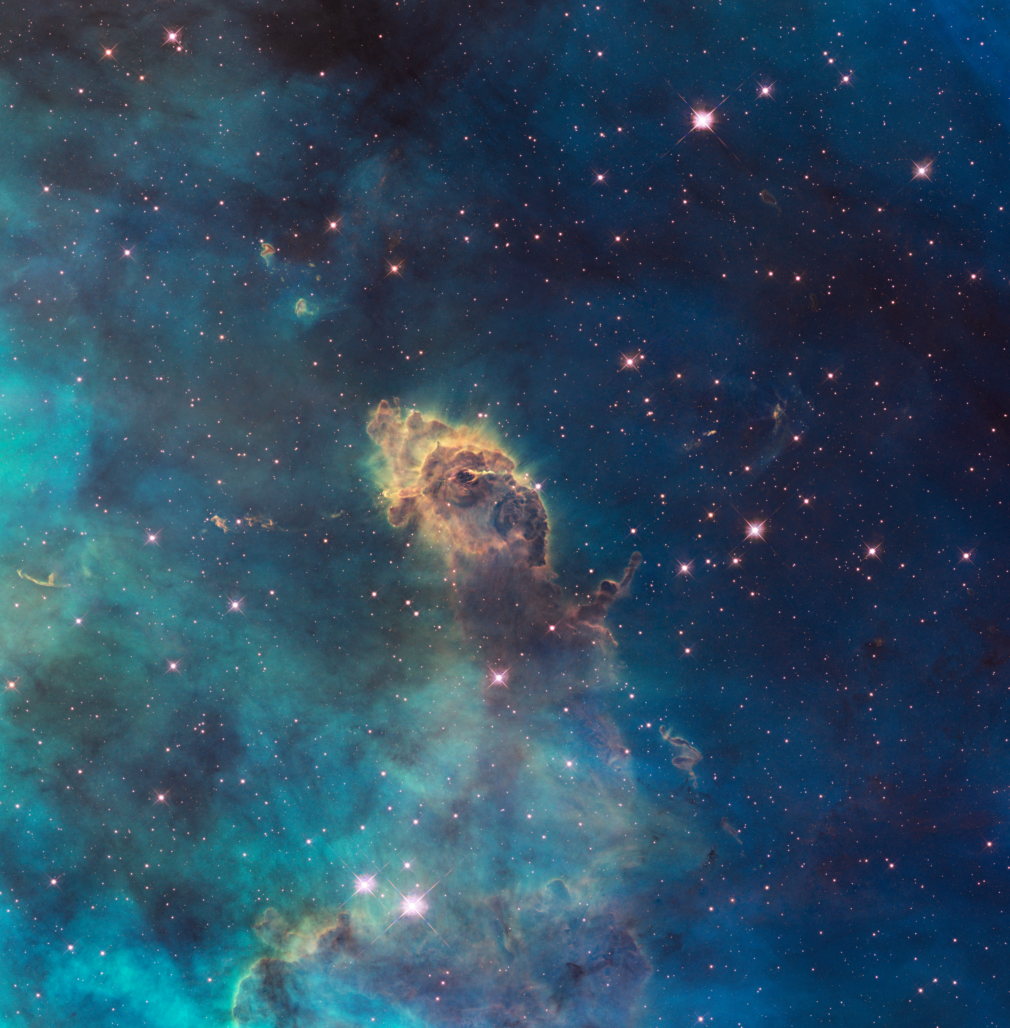
Notes:
Pillar in the Carina Nebula
The NASA Hubble Space Telescope captured this luminous pillar within a tempestuous stellar nursery 7,500 light-years away. Nestled inside this dense structure are fledgling stars. Most of the stars cannot be seen in this image because they are hidden by a wall of gas and dust. One particular star provides evidence of its existence via thin puffs of material traveling to the left and right of a dark notch in the center of the pillar. The matter is part of a stellar jet moving at speeds of up to 850,000 miles an hour and stretching about 10 light-years.

