Slide 1
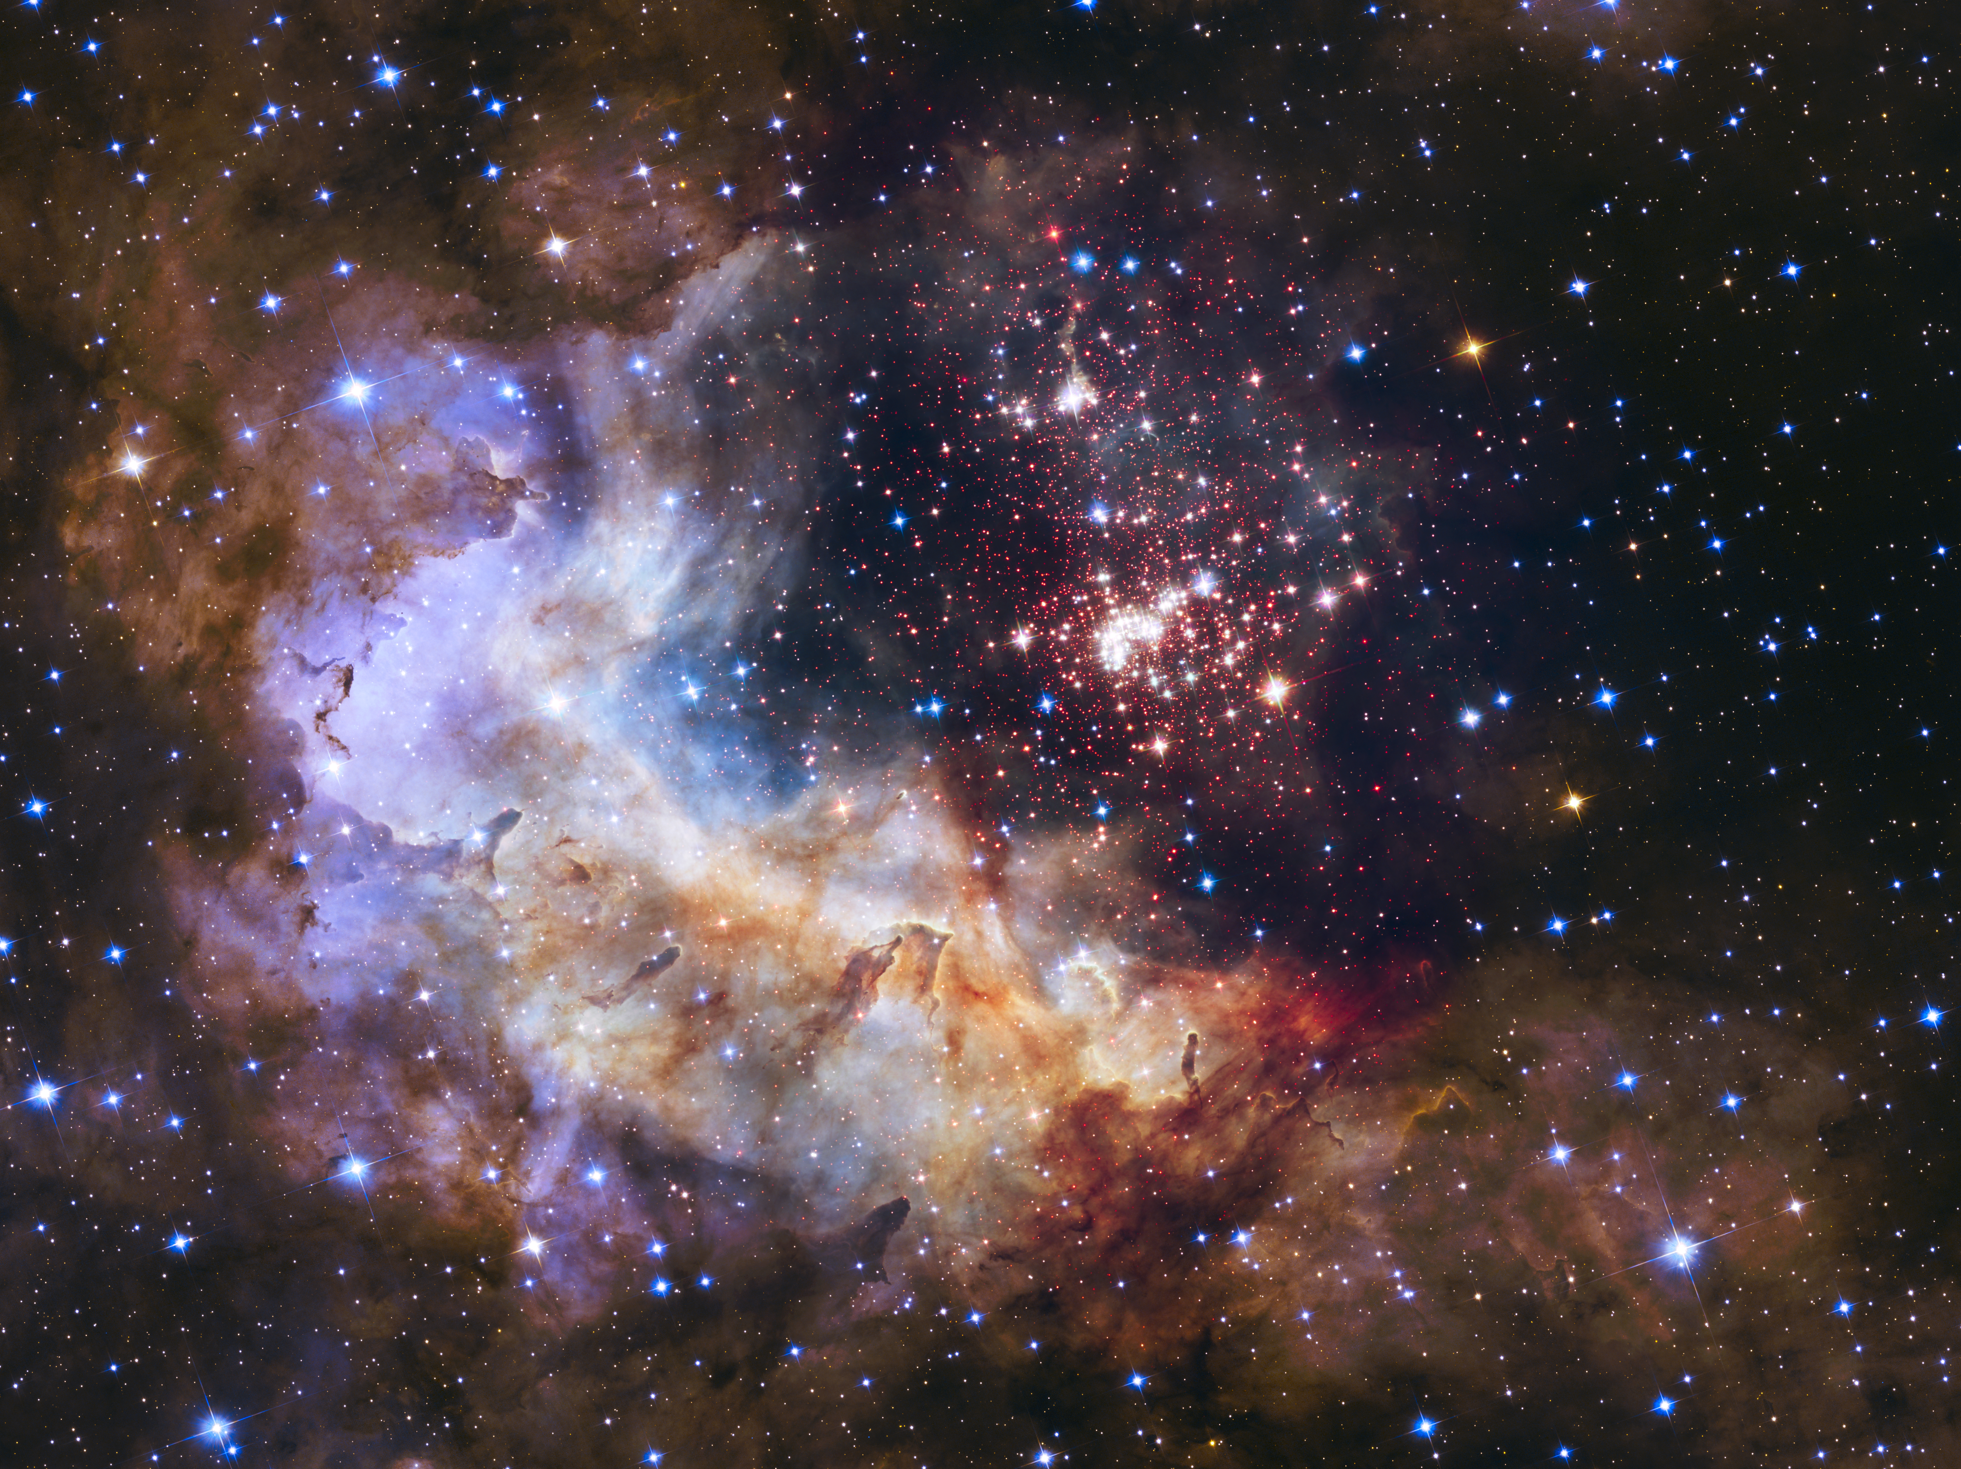
Notes:
Star Cluster Westerlund 2
The brilliant tapestry of young stars flaring to life resembles a glittering fireworks display at the heart of Nebula Gum 29. The giant cluster of about 3,000 stars is only about 2 million years old and contains some of our galaxy's hottest, brightest, and most massive stars. Some of its heftiest stars unleash torrents of ultraviolet light and hurricane-force winds of charged particles that etch at the enveloping hydrogen gas cloud. The nebula has been sculpted into a fantasy landscape of pillars, ridges, and valleys.

