Slide 1
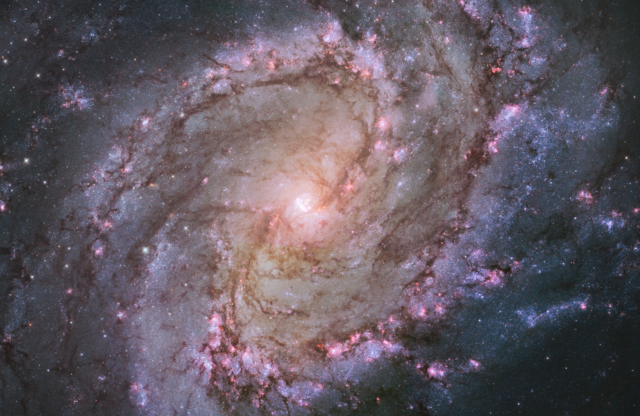
Notes:
Spiral Galaxy Messier 83
The vibrant magentas and blues in this NASA Hubble Space Telescope image of the spiral galaxy M83 reveal that the galaxy is ablaze with star formation. The newest generations of stars are forming largely in clusters on the edges of the dark spiral dust lanes. The intense ultraviolet radiation from these brilliant young stars heat the surrounding gas, which glows in pinkish hydrogen light. Eventually, the radiation and stellar winds blow away the surrounding gas to reveal bright blue star clusters.

