Slide 1
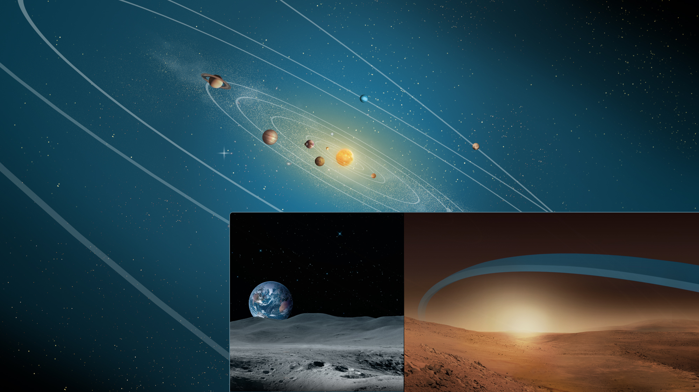
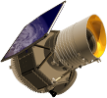
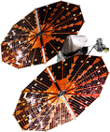
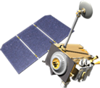
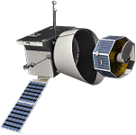
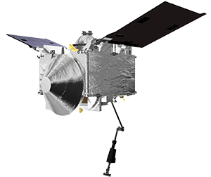
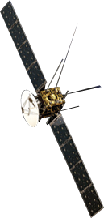
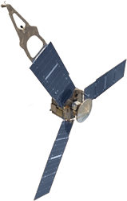
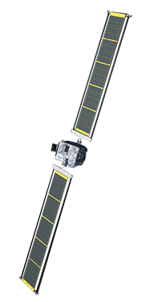
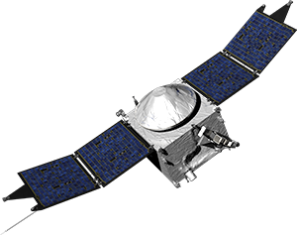
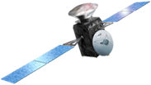
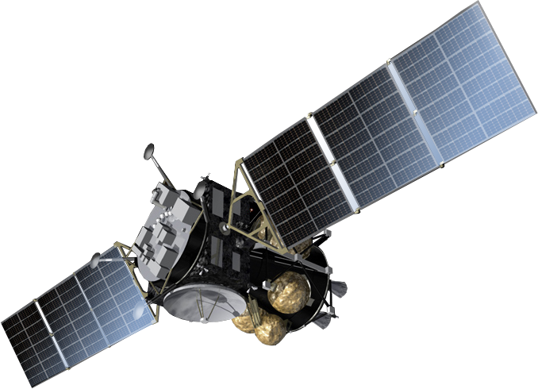
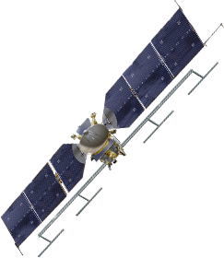
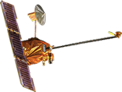
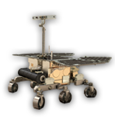
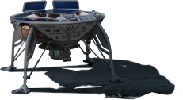
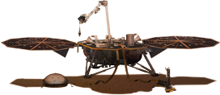
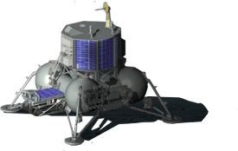
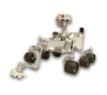
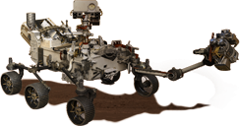
LUNAR
RECONNAISSANCE
ORBITER
FORMULATION
IMPLEMENTATION
NEOWISE
PRIMARY OPS
EXTENDED OPS
LUCY
BEPICOLOMBO (ESA)
OSIRIS-REX
JUICE (ESA)
NEW HORIZONS
PSYCHE
JUNO
MOON
MARS
MARS EXPRESS
(ESA)
MRO
MAVEN
EXOMARS 2016
(ESA)
MMX
(JAXA)
LUNAR
RECONNAISSANCE
ORBITER
MARS
ODYSSEY
BERESHEET (SPACE IL)
EXOMARS 2020 (ESA)
DART
CHANDRAYAAN-2 (ISRO)
CURIOSITY ROVER
MARS 2020 ROVER
EUROPA CLIPPER
INSIGHT
Updated March 2019
Notes:
NASA Science: Planetary
Planetary science is a grand human enterprise that seeks to understand the history of our solar system and the distribution of life within it. Planetary science missions inform us about our neighborhood and our own origin and evolution; they are necessary precursors to the expansion of humanity beyond Earth. Through five decades of planetary exploration, NASA has developed the capac­ity to explore all of the objects in our solar system. Future missions will bring back samples from some of these desti­nations, allowing iterative detailed study and analysis back on Earth. In the future, humans will return to the Moon, go to asteroids, Mars, and ultimately other solar system bodies to explore them, but only after they have been explored and understood using robotic missions.
For more information, please visit:
science.nasa.gov
Planetary Fleet (with Color Key) - editable
Updated February 21, 2019
Credit: NASA/J. Mottar

