Slide 1
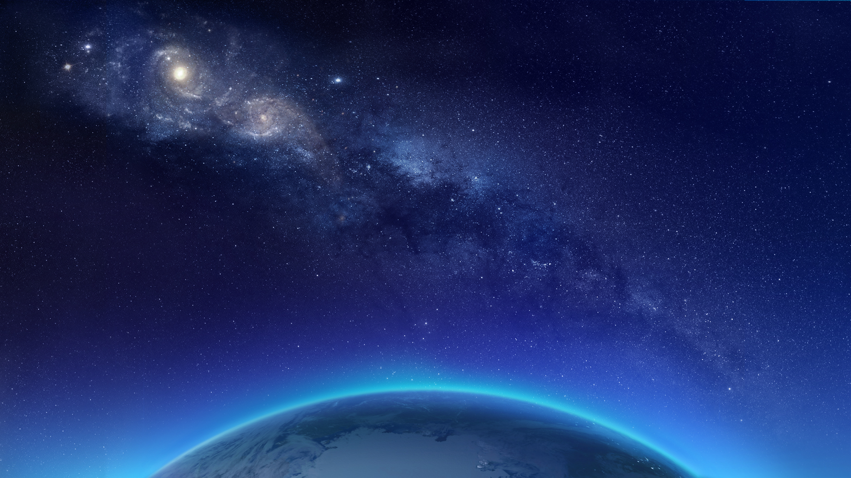
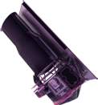
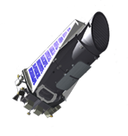
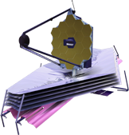
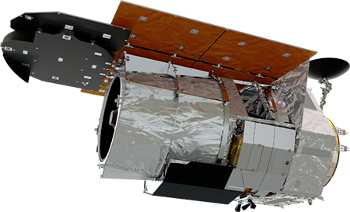
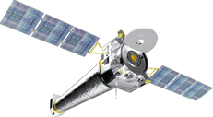
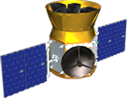
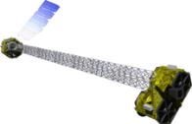
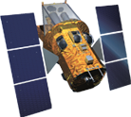
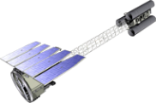
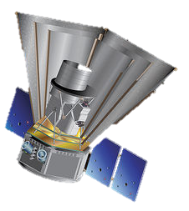
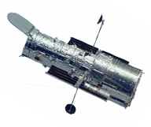
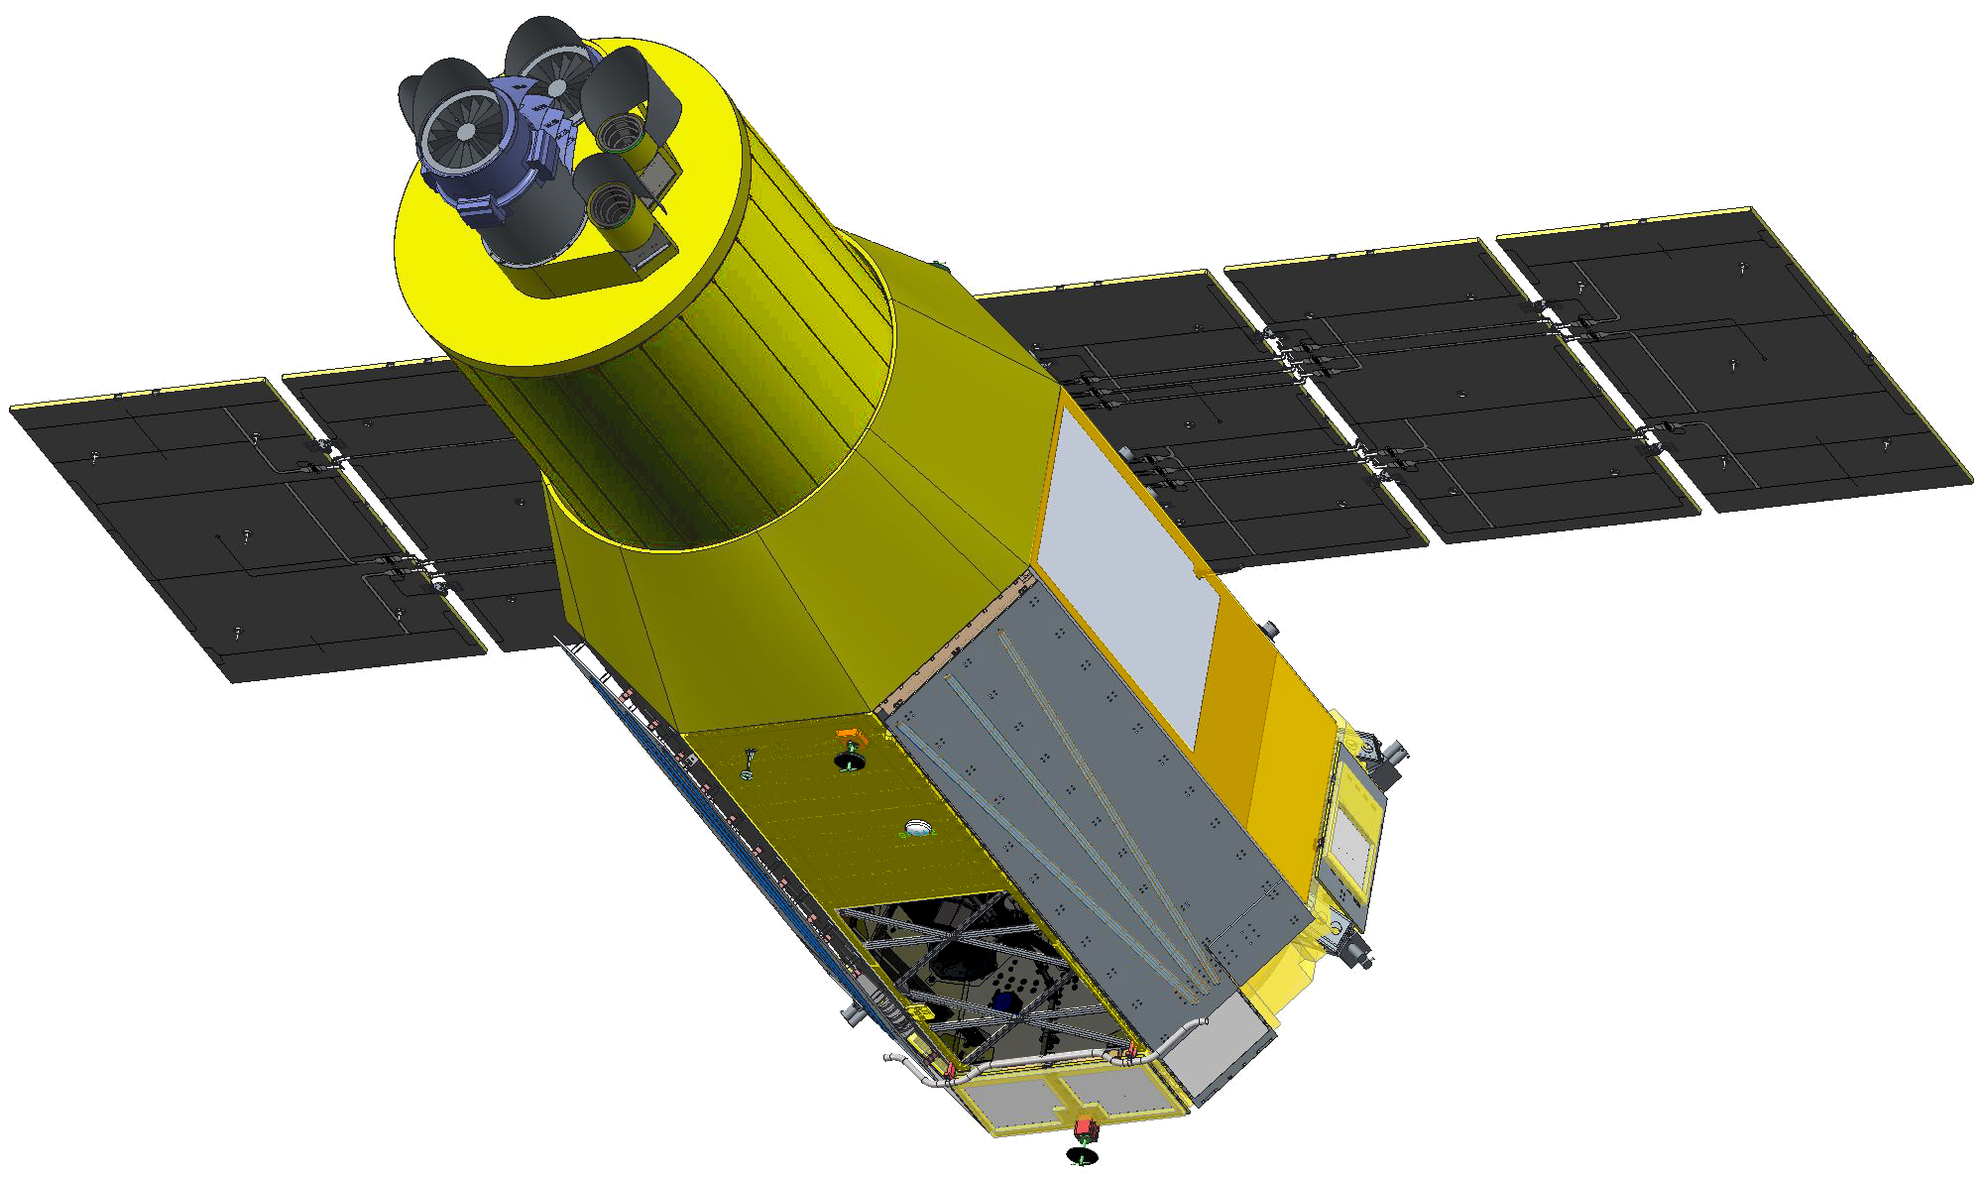
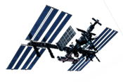
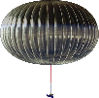
]
MIDEX/MO (2023),
SMEX/MO (2025), etc.
Spitzer
8/25/2003
Kepler
3/7/2009
10/30/2018 EOM
Formulation
Implementation
Primary Ops
Extended Ops
WFIRST
Mid 2020s
Webb
2021
Euclid (ESA)
2022
XMM—Newton (ESA)
12/10/1999
TESS
4/18/2018
Chandra
7/23/1999
NuSTAR
6/13/2012
IXPE
2021
Fermi
6/11/2008
Swift
11/20/2004
SPHEREx
2023
XRISM (XARM) (JAXA)
2022
Hubble
4/24/1990
ISS-NICER
6/3/2017
GUSTO
2021
Athena (late 2020s),
LISA (mid 2030s)
ISS-CREAM
8/14/2017
2/15/2019 EOM
SOFIA
Full Ops 5/2014
Revised
February 21, 2019
Notes:
Astrophysics is the study of phenomena occurring in the universe and of the physical principles that govern them. Astrophysics research encompasses a broad range of topics, from the birth of the universe and its evolution and composition, to the processes leading to the development of planets and stars and galaxies, to the physical conditions of matter in extreme gravitational fields, and to the search for life on planets orbiting other stars. In seeking to understand these phenomena, astrophysics science embodies some of the most enduring quests of humankind.

Slide 2
]
Spitzer
8/25/2003
Kepler
3/7/2009
10/30/2018 EOM
Formulation
Implementation
Primary Ops
Extended Ops
WFIRST
Mid 2020s
Webb
2021
Euclid (ESA)
2022
XMM—Newton (ESA)
12/10/1999
TESS
4/18/2018
Chandra
7/23/1999
NuSTAR
6/13/2012
Fermi
6/11/2008
IXPE
2021
Swift
11/20/2004
XRISM (XARM) (JAXA)
2022
ISS-NICER
6/3/2017
Hubble
4/24/1990
ISS-CREAM
8/14/2017
GUSTO
2021
SOFIA
Full Ops 5/2014
Revised
November 27, 2018
Consistent with FY18 Appropriation
Notes:
Revised July 18, 2018 with new WFIRST spacecraft

Slide 3
]
Spitzer
8/25/2003
Kepler
3/7/2009
Formulation
Implementation
Primary Ops
Extended Ops
WFIRST
Mid 2020s
Webb
2021
Euclid (ESA)
2022
XMM—Newton (ESA)
12/10/1999
TESS
4/18/2018
Chandra
7/23/1999
NuSTAR
6/13/2012
Fermi
6/11/2008
IXPE
2021
Swift
11/20/2004
XRISM (XARM) (JAXA)
2022
Hubble
4/24/1990
ISS-NICER
6/3/2017
ISS-CREAM
8/14/2017
GUSTO
2021
SOFIA
Full Ops 5/2014
Revised
July 18, 2018
Notes:
Revised July 18, 2018 with new WFIRST spacecraft

