Slide 1
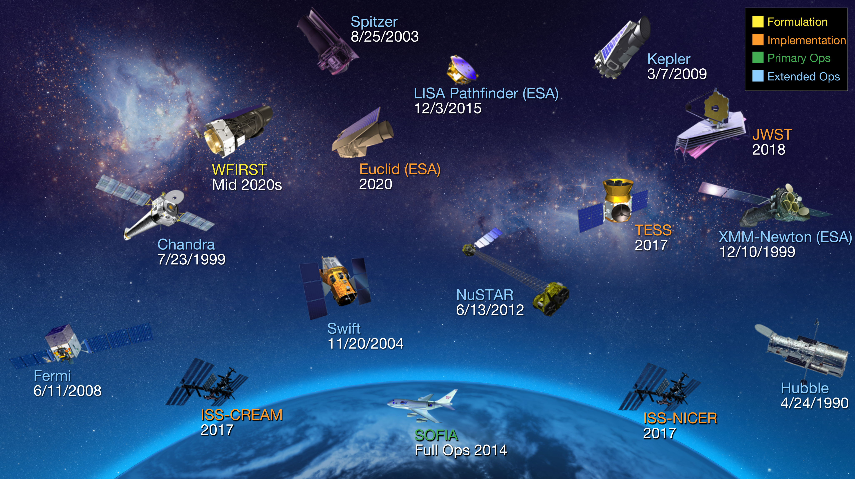
Notes:
NASA Science: Astrophysics
Astrophysics is the study of phenomena occurring in the universe and of the physical principles that govern them. Astrophysics research encompasses a broad range of topics, from the birth of the universe and its evolution and composition, to the processes leading to the development of planets and stars and galaxies, to the physical conditions of matter in extreme gravitational fields, and to the search for life on planets orbiting other stars. In seeking to understand these phenomena, astrophysics science embodies some of the most enduring quests of humankind.
For more information, please visit:
nasa.science.gov

