Slide 1
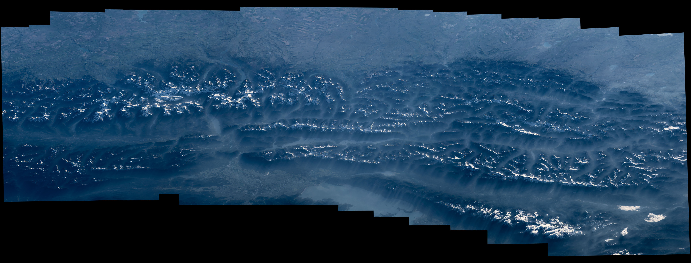
Notes:
Highlighting National Parks on the National Park Service Centennial
From low Earth orbit aboard the International Space Station, Jeff Williams of NASA photographed the northern Rockies and shared a composite image and video panorama to social media. Noting the centennial of the U.S. National Park Service, Williams wrote, “ Northern Rockies, Canada and Montana, including @glaciernps #FindYourPark #NPS100"
For more information:
www.nasa.gov/content/space-station-view-of-us-national-parks

