Slide 1
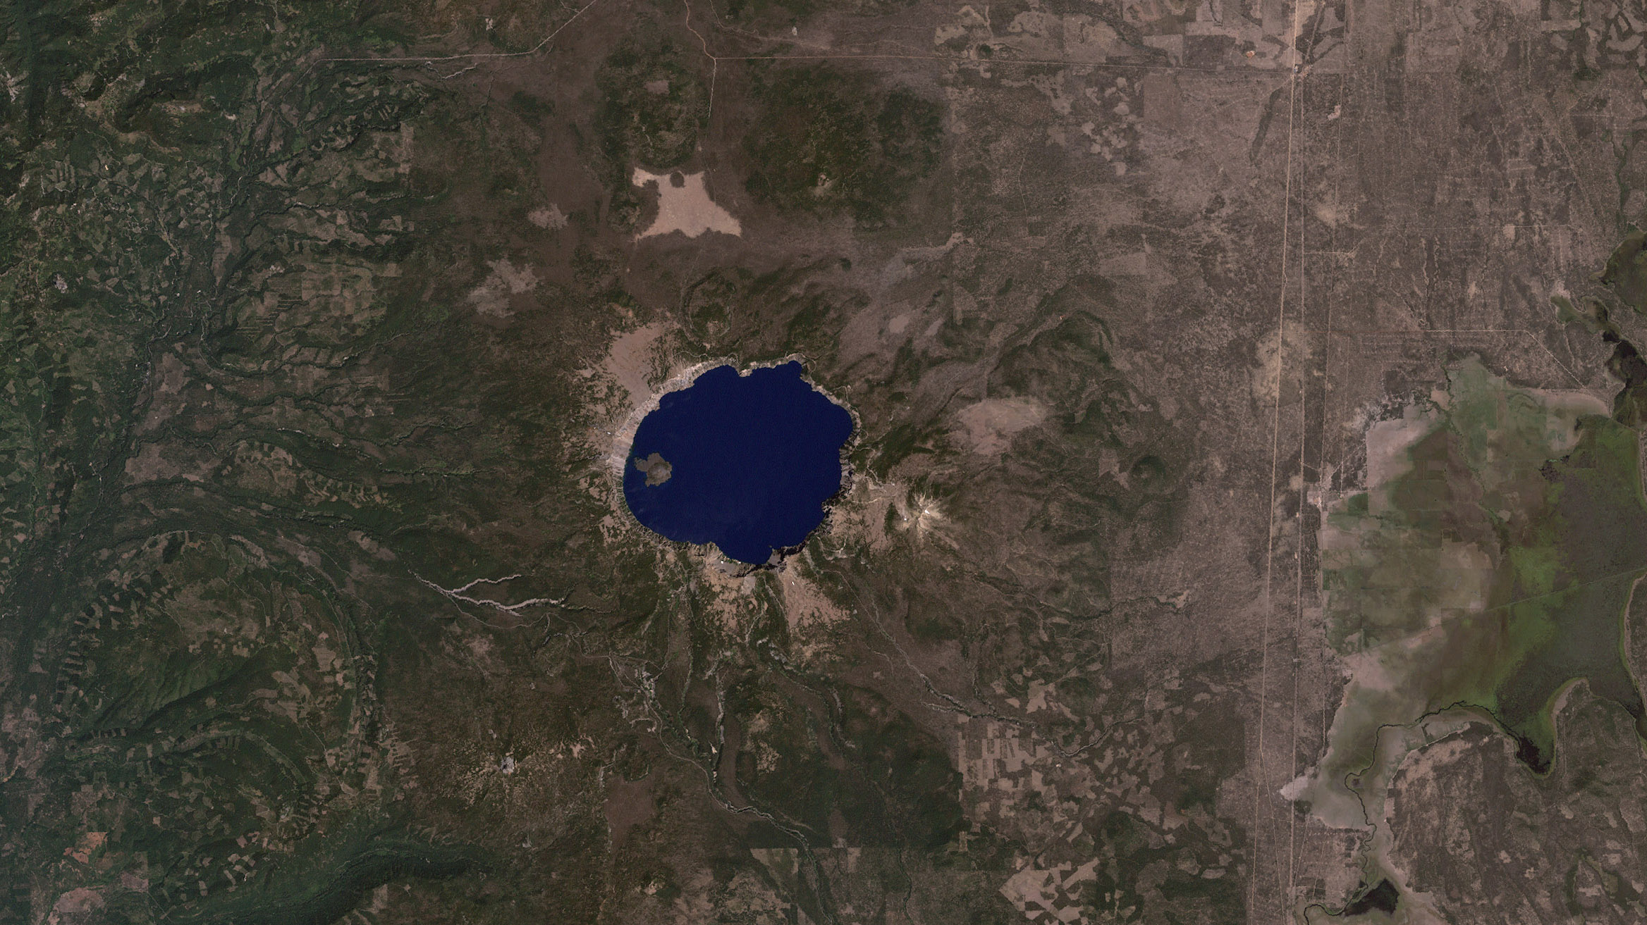
Notes:
Highlighting National Parks on the National Park Service Centennial
Crater Lake National Park, captured by Landsat 7 ETM+ on August 17, 2000
For more information:

