Slide 1
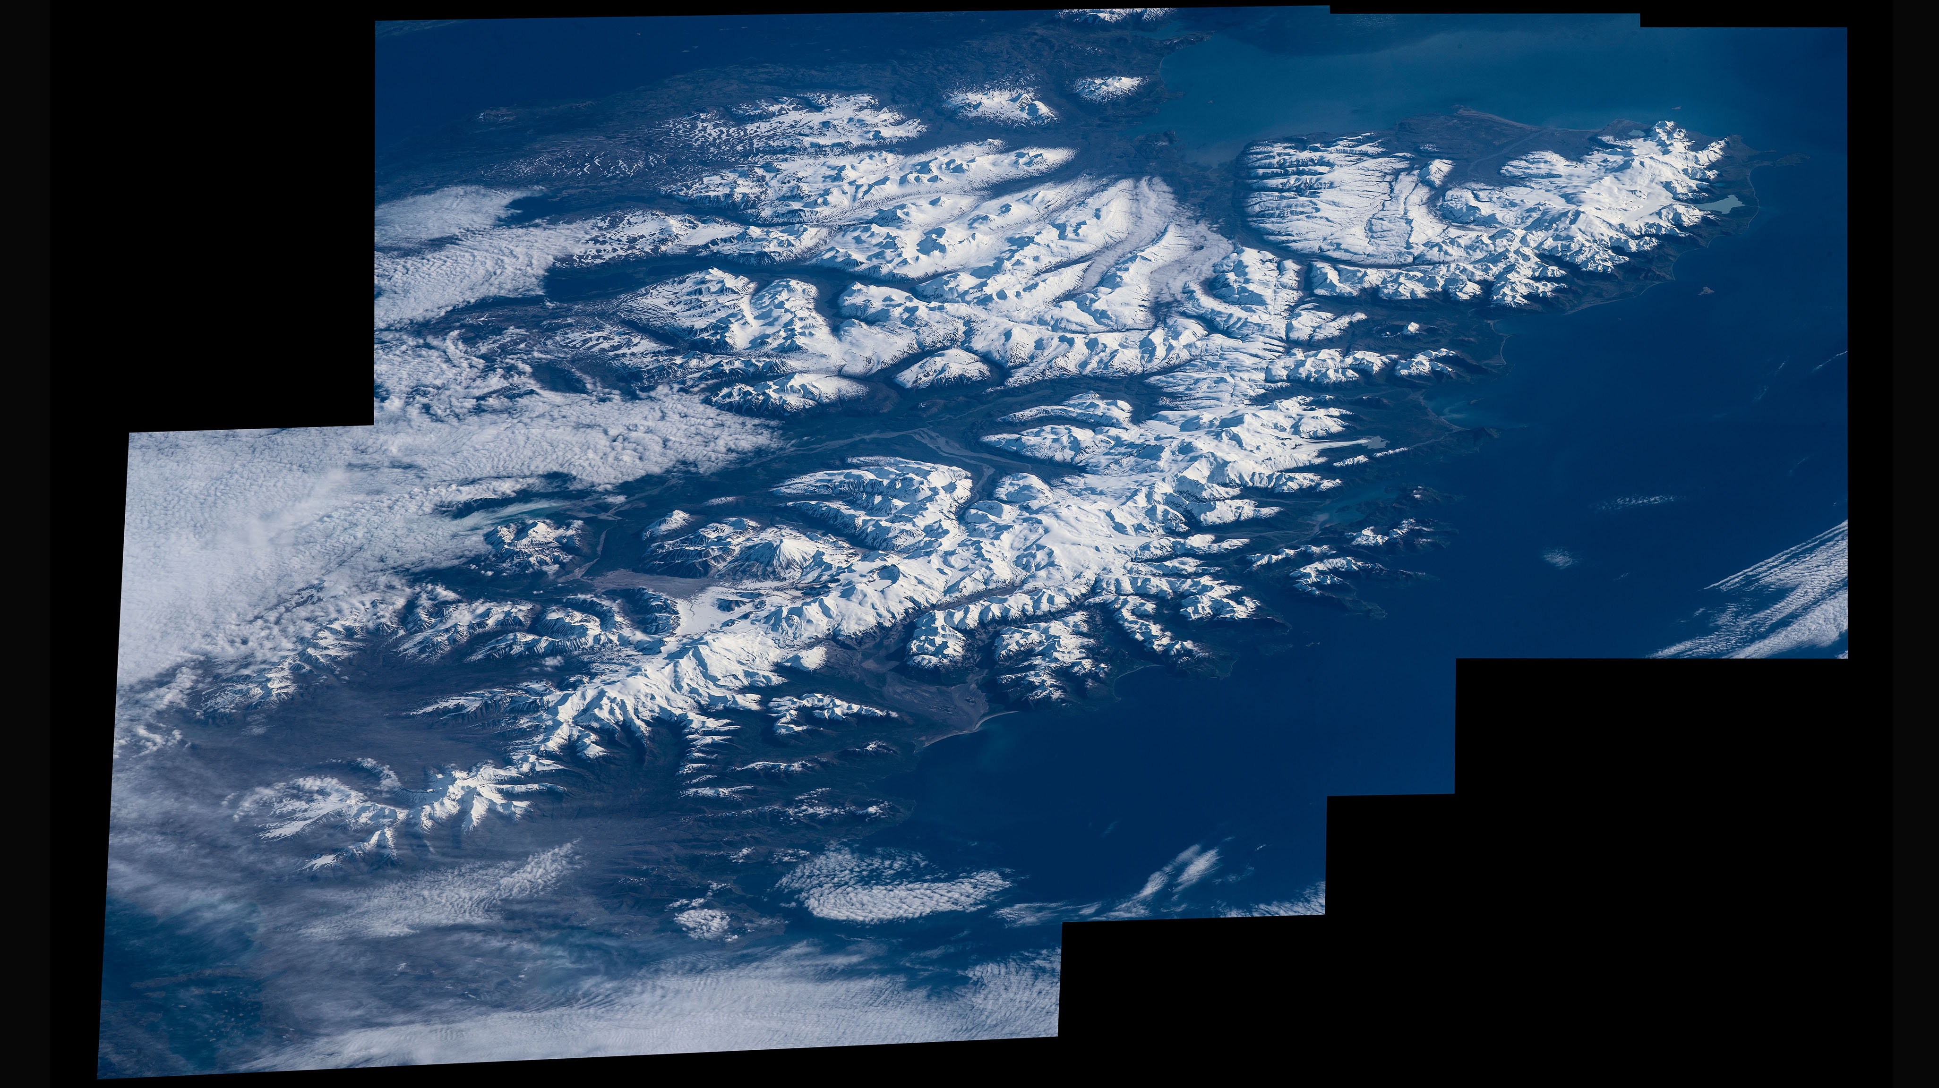
Notes:
Highlighting National Parks on the National Park Service Centennial
Katmai National Park, photo from the ISS by NASA astronaut Jeff Williams
For more information:
https://www.nasa.gov/image-feature/patterns-and-features-of-katmai-national-park

