Slide 1
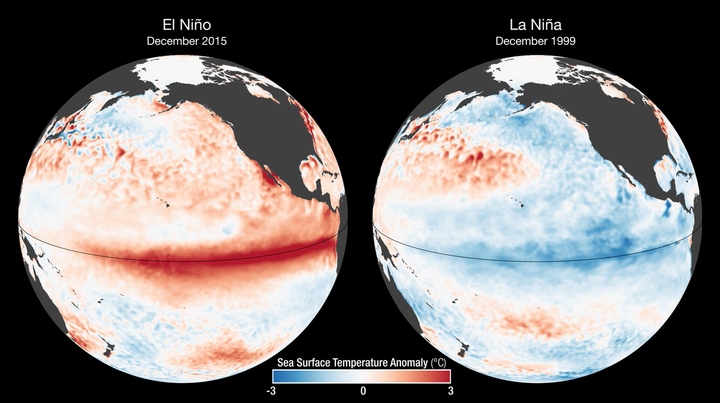
Notes:
2015 El Niño Disrupts Ocean Chlorophyll
These images compare monthly sea surface temperature anomalies (SSTA) and surface chlorophyll concentrations during El Niño (Dec. 2015) and La Niña (Dec. 1999). The SSTA images are derived from NOAA Optimum Interpolation Sea Surface Temperature (OISST) data, while the chlorophyll images are derived using MODIS (El Niño) and SeaWiFS (La Niña) data.
With the onset of El Niño, a drop in air pressure over the equatorial eastern Pacific causes the trade winds to weaken and sometimes even reverse, driving warm water eastward, towards South America. Below the ocean’s surface, the eastward migration of the warm pool deepens the thermocline and curtails the usual upwelling of deep-water nutrients to the surface, causing declining concentrations of surface chlorophyll, the green pigment that indicates the presence of phytoplankton. The opposite phase, La Niña, is characterized by strong trade winds, which causes upwelling to intensify. Cold, upwelled waters have more nutrients than the warmer surface waters; therefore, more intense upwelling coincides with higher chlorophyll and phytoplankton concentrations.
During the 1997-98 El Niño, there were large population declines within the eastern Pacific marine food web. However, the strong La Niña that followed in 1998–99 had the opposite impact: stronger east-to-west trade winds that increased nutrient upwelling and fertilized one of the biggest phytoplankton blooms detected in the satellite record. The bloom ignited a dramatic increase in fish populations.
For more information, visit
svs.gsfc.nasa.gov/goto?30747

