Slide 1
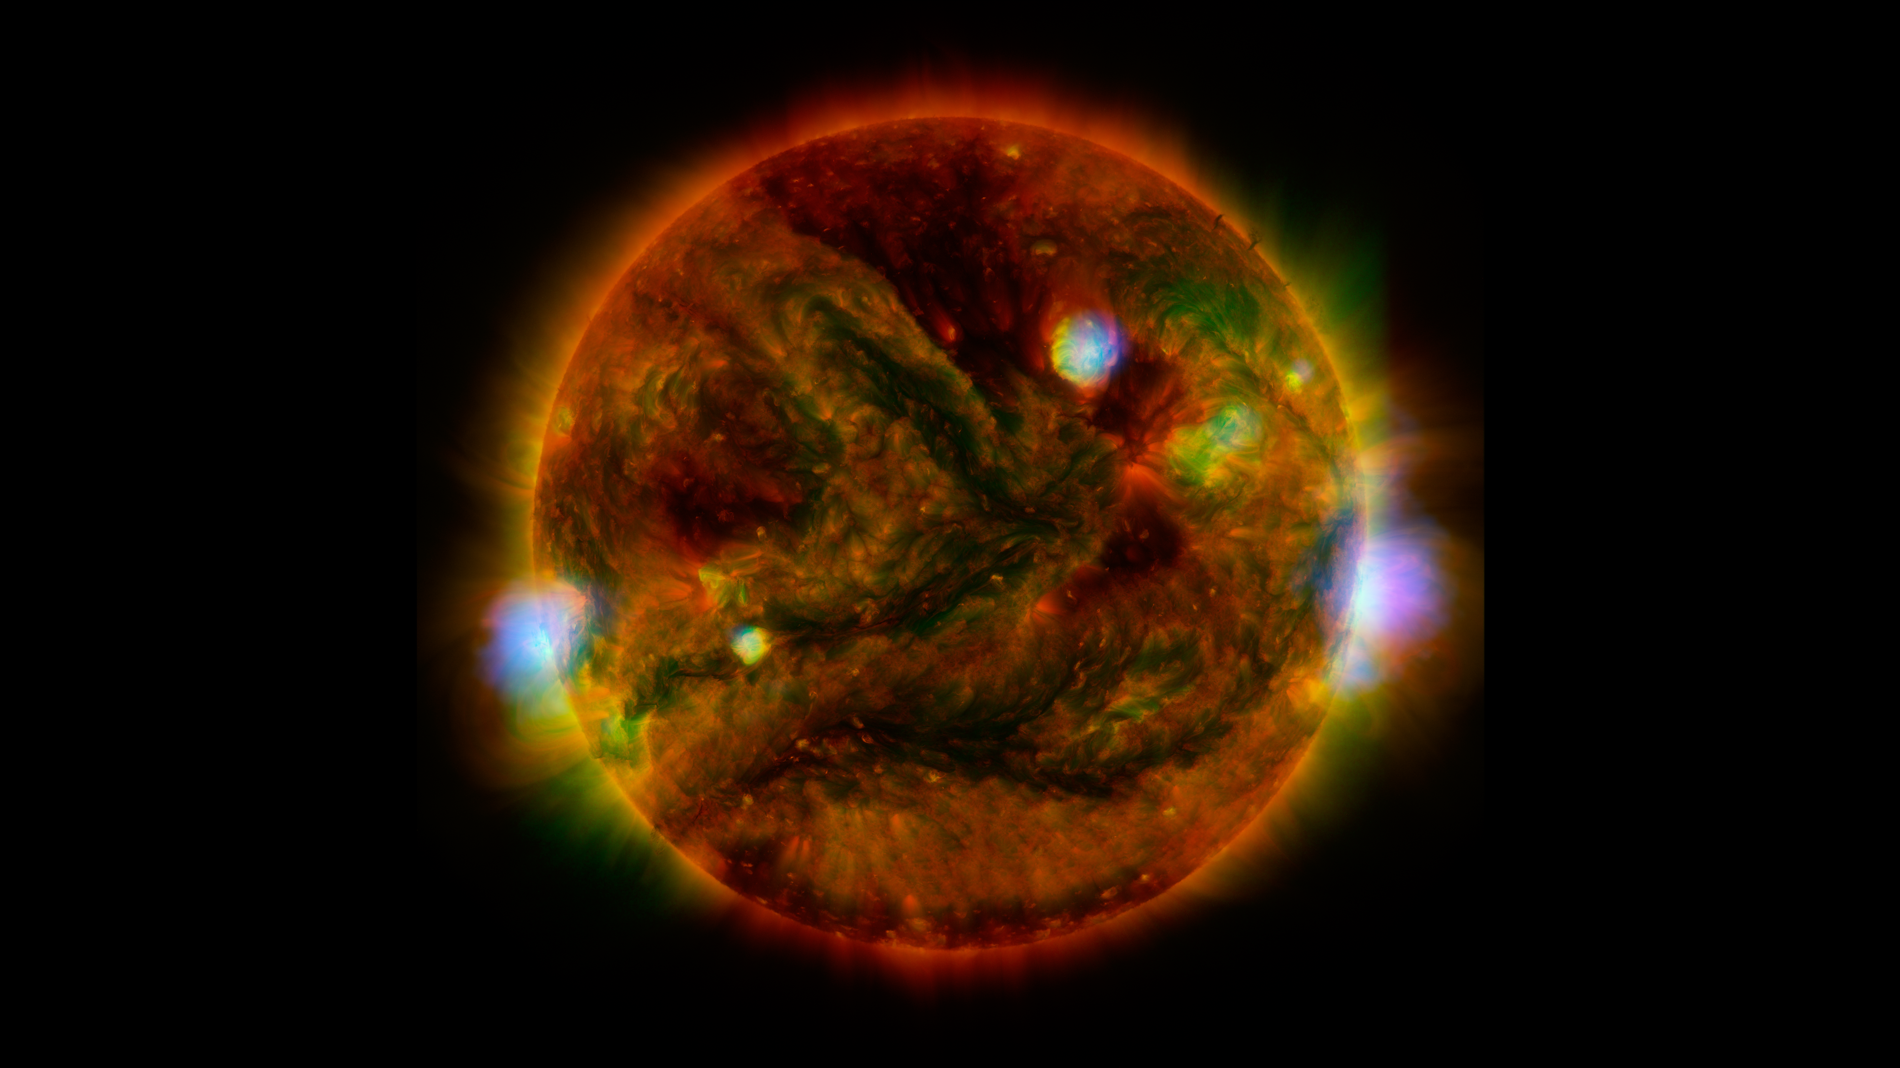
Notes:
NuSTAR Stares at the Sun
Flaring, active regions of our sun are highlighted in this image from April 29, 2015, combining observations from several telescopes. High-energy X-rays from NASA's Nuclear Spectroscopic Telescope Array (NuSTAR) are shown in blue; low-energy X-rays from Japan's Hinode spacecraft are green; and extreme ultraviolet light from NASA's Solar Dynamics Observatory (SDO) is yellow and red. The NuSTAR image is a mosaic made from combining smaller images.
The active regions across the sun's surface contain material heated to several millions of degrees. The blue-white areas showing the NuSTAR data pinpoint the most energetic spots. During the observations, microflares went off, which are smaller versions of the larger flares that also erupt from the sun's surface. The microflares rapidly release energy and heat the material in the active regions. Scientists plan to continue to study the sun with NuSTAR to learn more about microflares, as well as hypothesized nanoflares, which are even smaller.
For more information, see:
www.nustar.caltech.edu/image/nustar150708a

