Slide 1
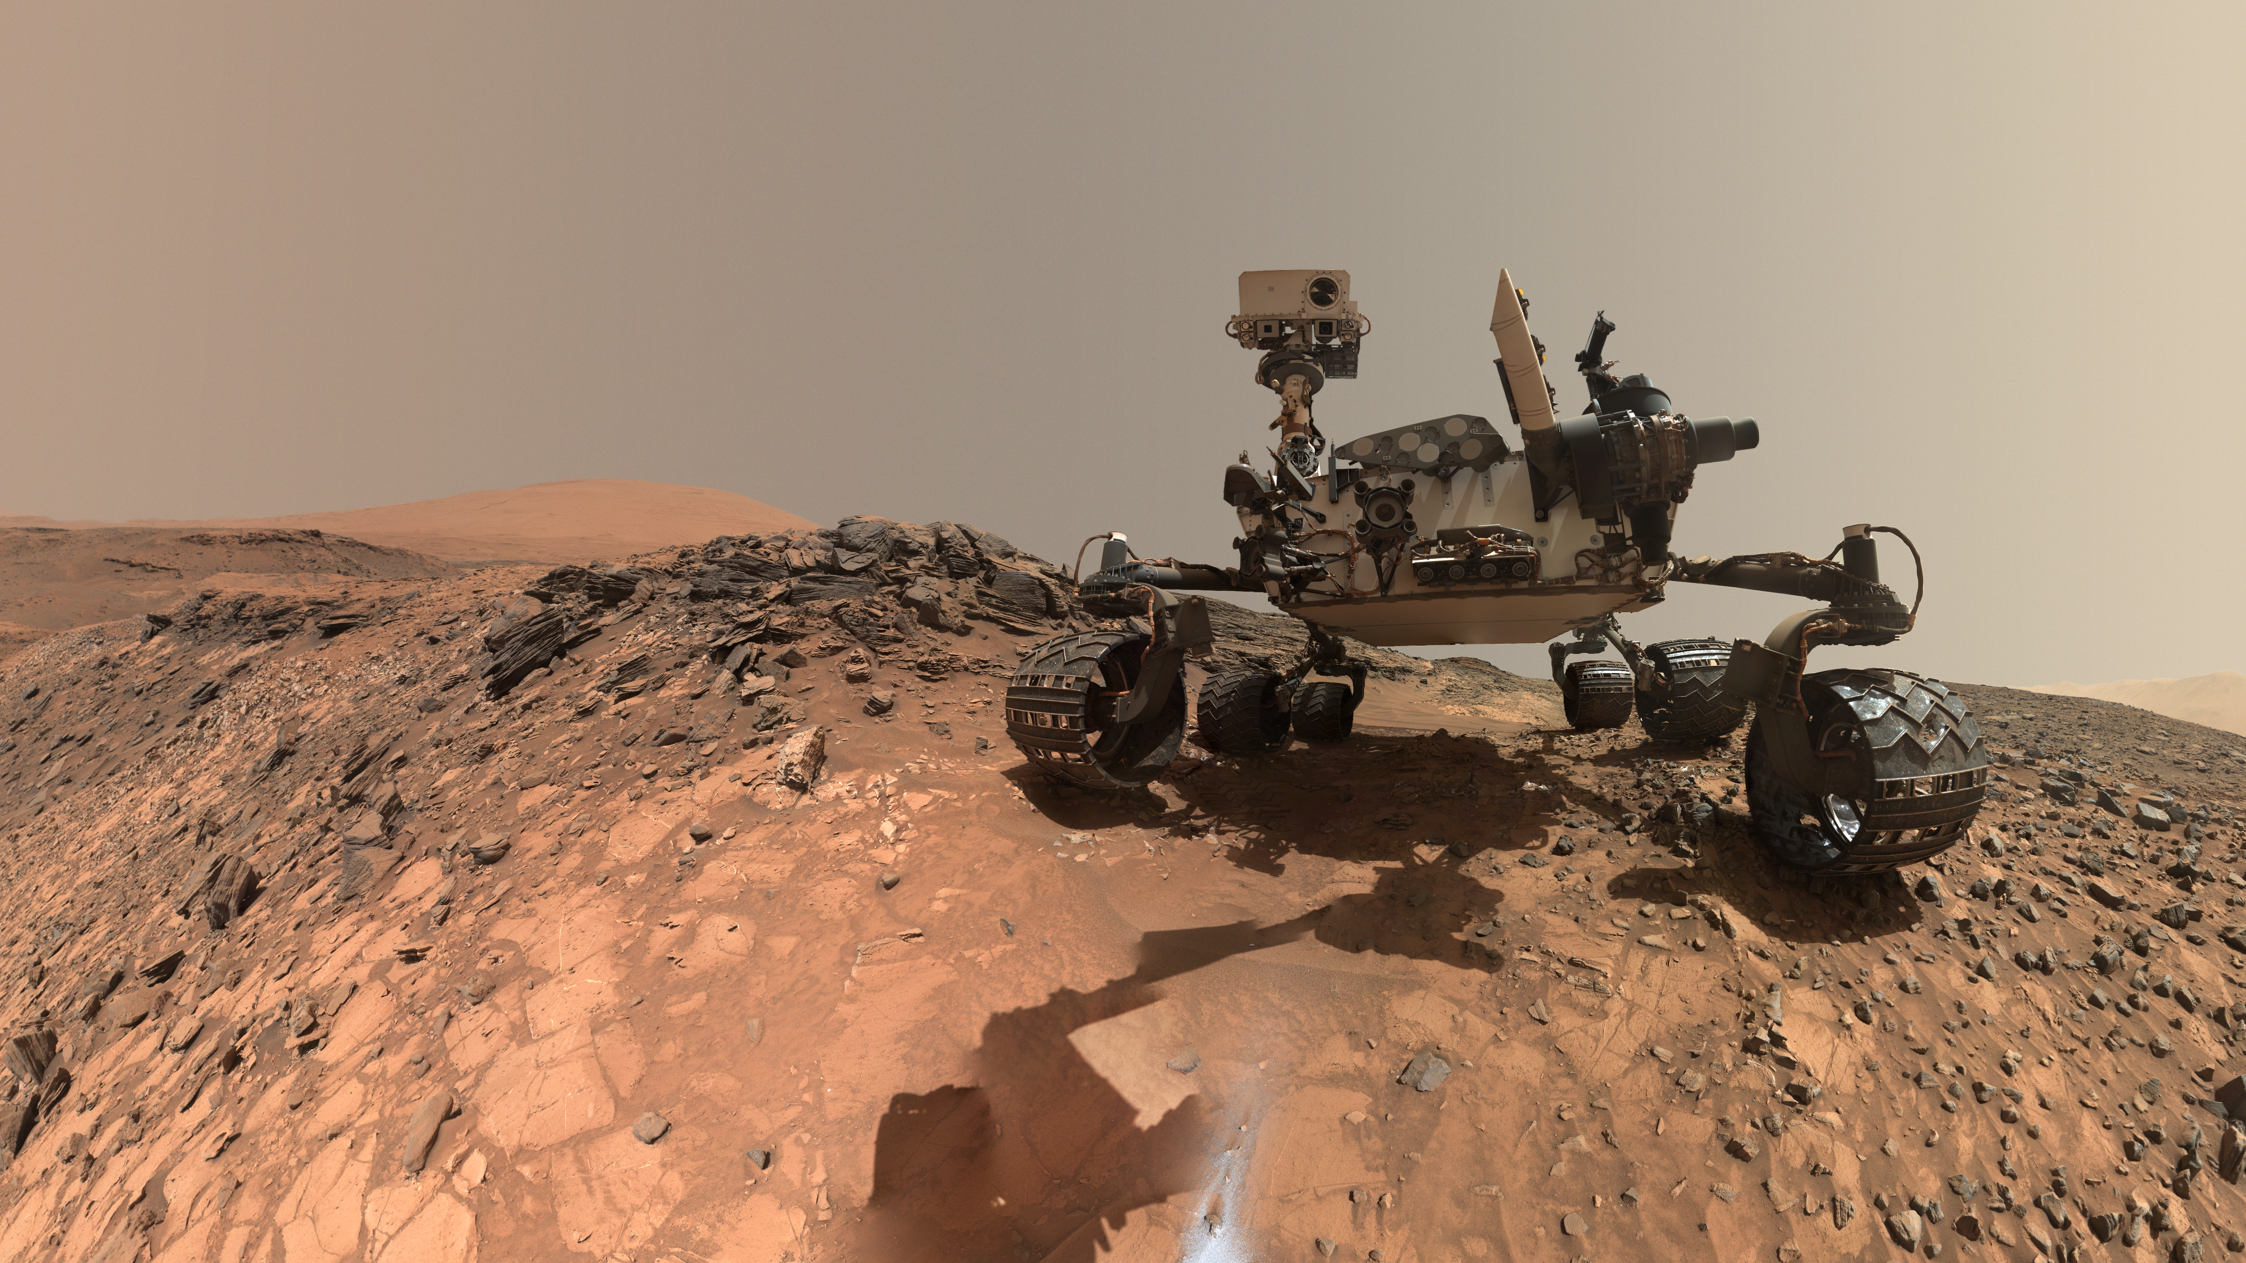
Notes:
Curiosity's Low-Angle Selfie, Aug 2015
On August 5, 2015, (the 1,065th Martian day, or sol) the Mars Science Laboratory’s Curiosity rover captured this low-angle self-portrait, or selfie. Curiosity used the Mars Hand Lens Imager (MAHLI) located at the end of its robotic arm to capture a set of thumbnail images that were then stitched together to create this full-color mosaic. The rover is located at "Buckskin” on lower Mount Sharp.
The rover’s robotic arm was positioned out of the shot in the images, or portions of images, used to create the mosaic and therefore, is not visible. Selfies like this one document the state of the rover and allow mission engineers to track changes over time, such as dust accumulation and wheel wear. For scale, the rover's wheels are 20 inches (50 centimeters) in diameter and about 16 inches (40 centimeters) wide. A close look reveals a small rock stuck onto Curiosity's left middle wheel (on the right in this head-on view). The rock had been seen previously during periodic monitoring of wheel condition about three weeks earlier. Only MAHLI (among the rover's 17 cameras) is able to image some parts of the craft, including the portside wheels.
For more information, visit
svs.gsfc.nasa.gov/goto?30707

