Slide 1
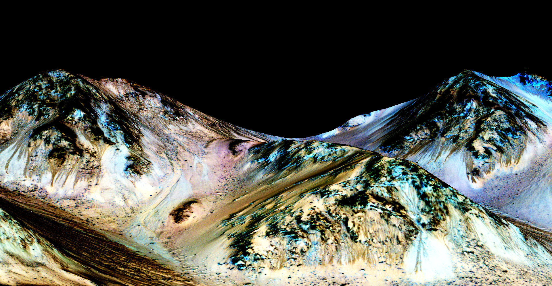
Notes:
Recurring Slope Lineae in Hale Crater.
These dark, narrow, 100 meter-long streaks called recurring slope lineae flowing downhill on Mars are inferred to have been formed by contemporary flowing water. Recently, planetary scientists detected hydrated salts on these slopes at Hale crater, corroborating their original hypothesis that the streaks are indeed formed by liquid water. The blue color seen upslope of the dark streaks are thought not to be related to their formation, but instead are from the presence of the mineral pyroxene. The image is produced by draping a false color image made from Infrared, Red, and Blue/Green bands on a Digital Terrain Model of the same site produced by High Resolution Imaging Science Experiment (HiRISE). Vertical exaggeration is 1.5.
For more information, see:
www.uahirise.org/releases/rsl/

