Slide 1
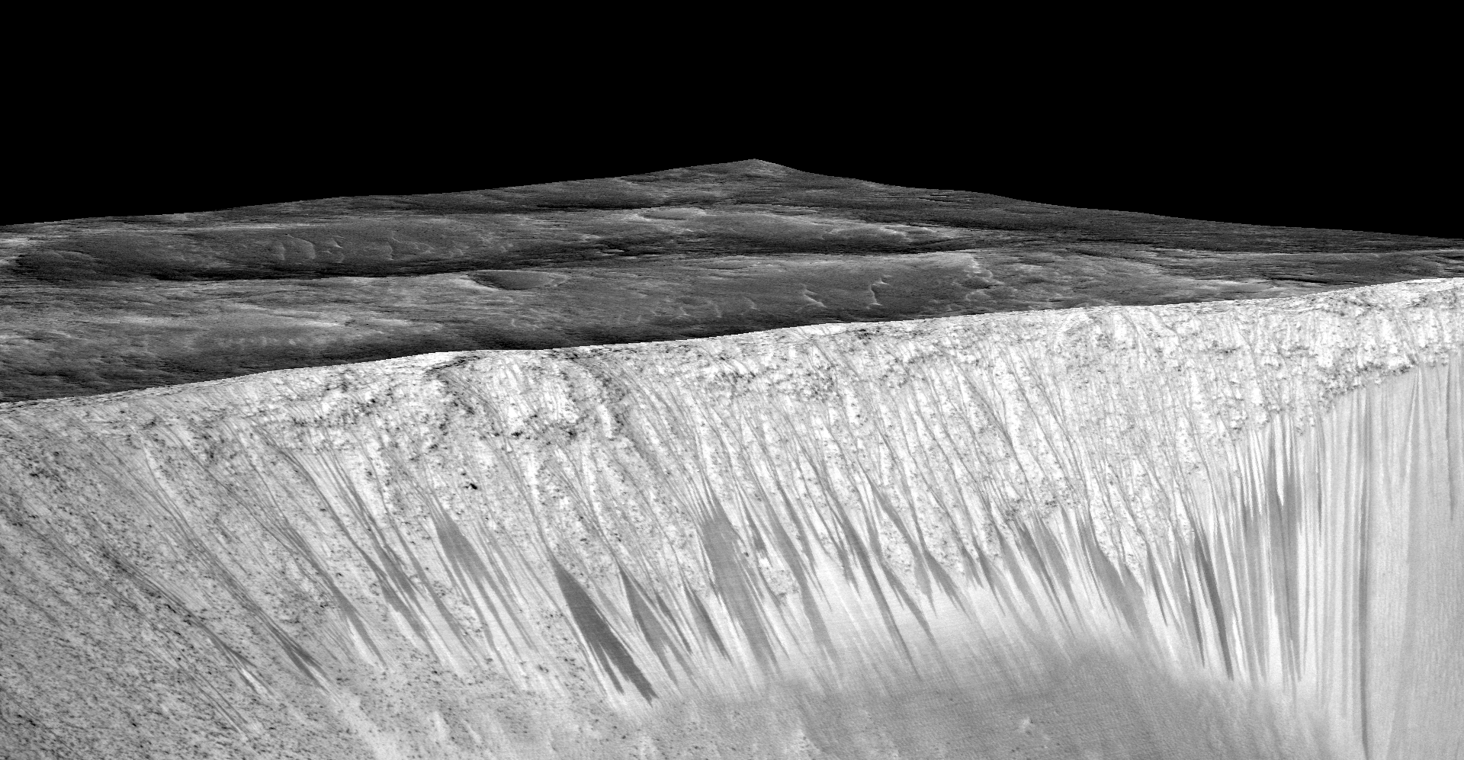
Notes:
Seasonal Water in GaRni Crater
Dark narrow streaks called recurring slope lineae emanating out of the walls of Garni crater on Mars. The dark streaks here are up to few hundred meters in length. They are hypothesized to be formed by flow of briny liquid water on Mars. The image is produced by draping an image on a Digital Terrain Model of the same site produced by High Resolution Imaging Science Experiment (HiRISE). Vertical exaggeration is 1.5.
For more information, see:
www.uahirise.org/releases/rsl/

