Slide 1
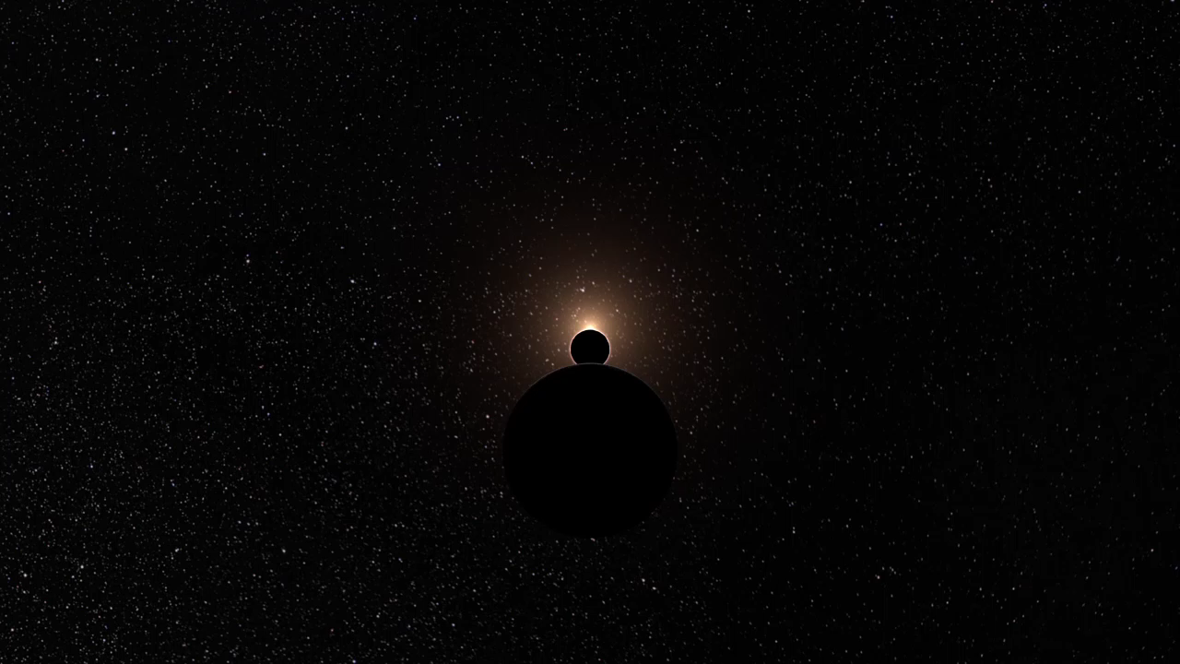
Notes:
James Webb Space Telescope Flyby
This animation flies by and circles around a model of JWST at its observing location of the second LaGrange point (L2). The opening of the sequence illustrates the L2 location, showing the Moon in the foreground, Earth in the mid-ground, and the Sun in the background.

