Slide 1
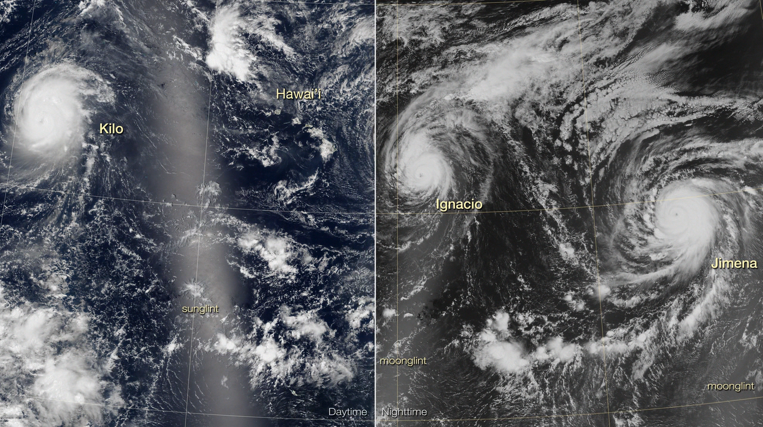
Notes:
Trio of Hurricanes Over the Pacific Ocean
Hurricanes traversing the Pacific Ocean are often solitary storms. Occasionally they show up in pairs. But according to meteorologists, August 2015 marked the first time in recorded history that three Category 4 storms simultaneously paraded over the central and eastern Pacific.
This image pair shows hurricanes Kilo, Ignacio, and Jimena (from west to east) at night, and about 12 hours later during daylight hours. The nighttime image is a mosaic, based on data collected during three orbital passes of the Visible Infrared Imaging Radiometer Suite (VIIRS) on the Suomi National Polar-orbiting Partnership (NPP) satellite, acquired between 11:30 PM and 3:00 AM Hawaii Standard Time on August 29-30. The second natural-color image is also a mosaic, acquired by VIIRS between about 11:00 AM and 2:00 PM Hawaii Standard Time on August 30. At the time, all three hurricanes were Category 4 storms. Hurricane Kilo had maximum sustained winds of 215 km (135 mi) per hour, according to the Central Pacific Hurricane Center. Meanwhile, Hurricane Ignacio had similar sustained wind speeds that measured 220 km (140 mi) per hour. Huricane Jimena, the easternmost of the three storms, carried maximum sustained winds of about 210 km (130 mi) per hour, according to the National Hurricane Center.
For more information, visit
earthobservatory.nasa.gov/IOTD/view.php?id=86512

