Slide 1
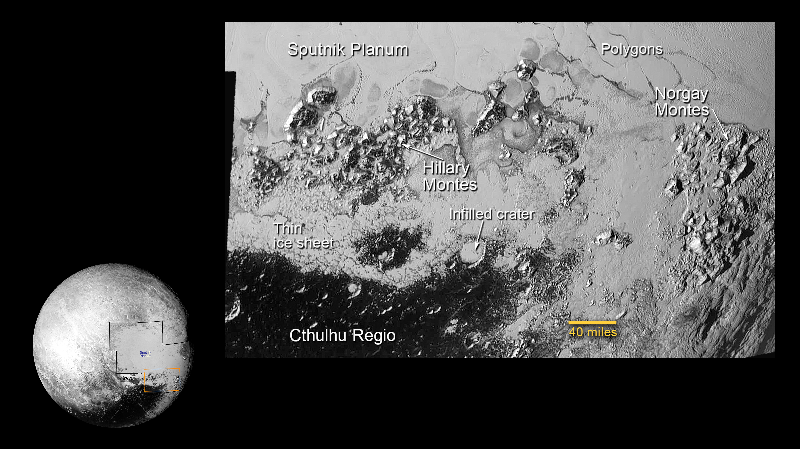
Notes:
Mountains on Pluto
The southern region of Pluto's Sputnik Planum contains newly discovered ranges of mountains that have been informally named Hillary Montes (Hillary Mountains) and Norgay Montes (Norgay Mountains) for Sir Edmund Hillary and Tenzing Norgay, the first two humans to reach the summit of Mount Everest in 1953.
The large crater highlighted in the image is about 30 miles (50 kilometers) wide, approximately the size of the greater Washington, DC area.
For more information, see:
pluto.jhuapl.edu

