Slide 1
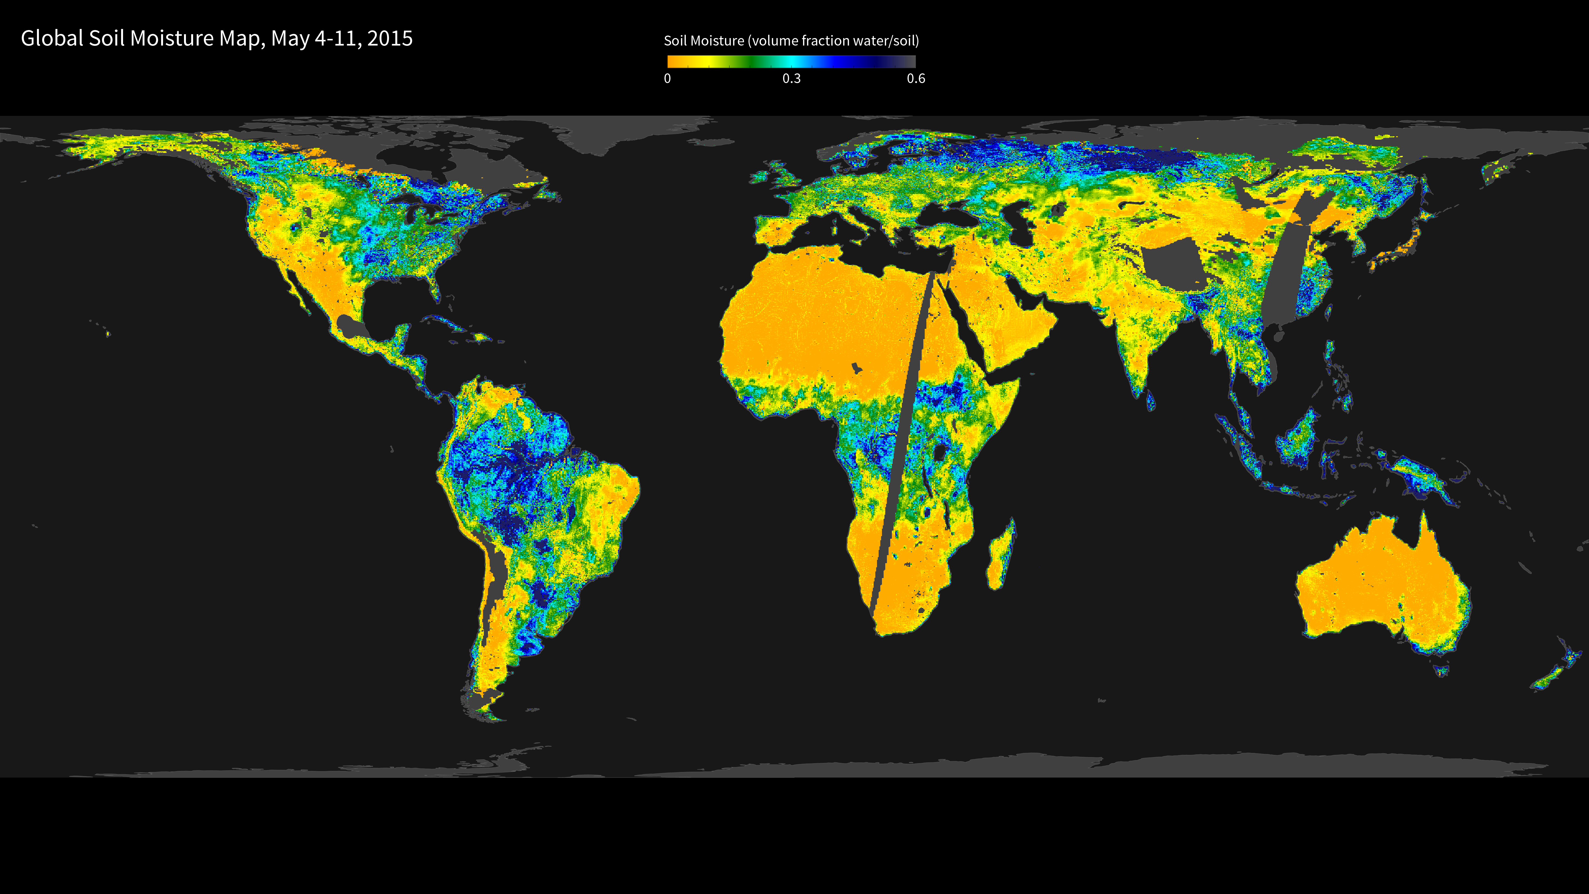
Notes:
SMAP's First High-Resolution Global Soil Moisture Map
Launched in January 2015, the Soil Moisture Active Passive (SMAP) mission is NASA’s first Earth-observing satellite mission designed to collect continuous global observations of surface soil moisture and freeze/thaw state. This map combines radar and radiometer data from the SMAP satellite to show soil moisture estimates in the top 5 centimeters (~2 inches) of soil at 9-kilometer (~6 mile) resolution. The data were acquired May 4-11, 2015, during SMAP’s commissioning phase. Orange and yellow shades represent dry soil moisture conditions, while green and blue shades indicate wet soil moisture conditions. Gray areas over land indicate no data, due to the instruments turning on and off during testing.
The ability to measure global soil moisture from space with unprecedented accuracy and spatial resolution allows scientists to better understand the processes that link the Earth’s water, energy, and carbon cycles, as well as enhance the predictive skills of weather and climate models. In addition, scientists can use these data to develop improved flood prediction and drought monitoring capabilities. Societal benefits include improved water-resource management, agricultural productivity, and wildfire and landslide predictions.
For more information, visit:
smap.jpl.nasa.gov

