Slide 1
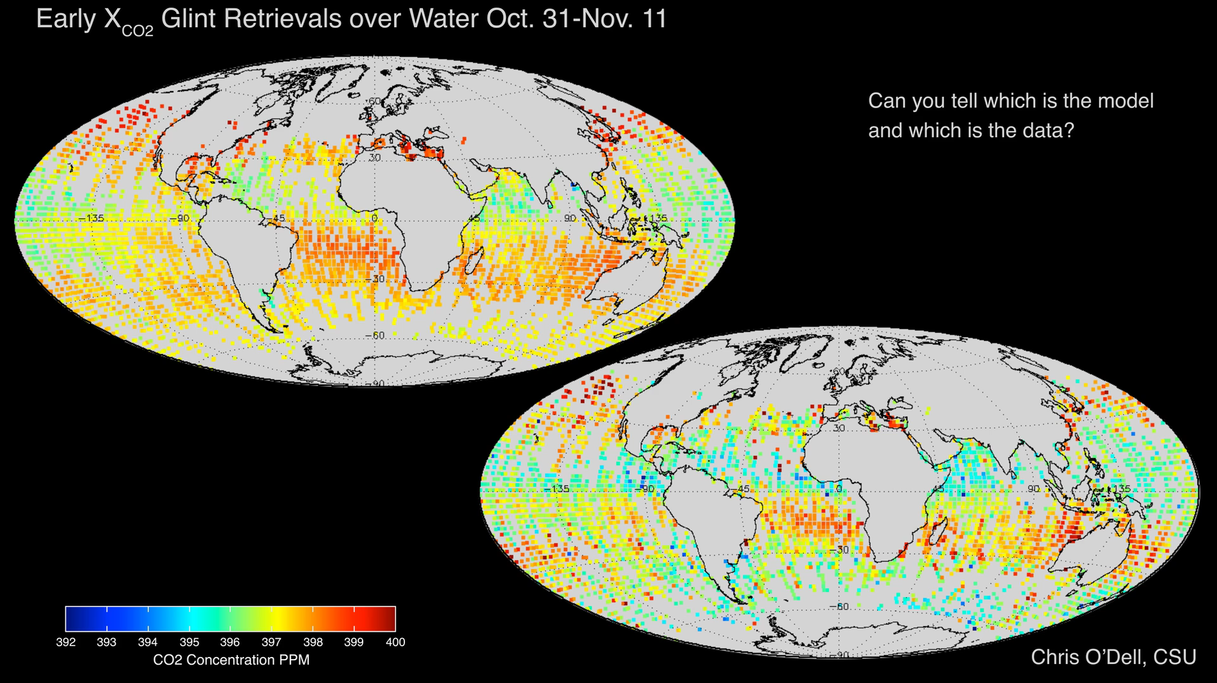
Notes:
Early X_{CO2} Glint Retrievals Over Water
Launched on July 2, 2014, the second Orbiting Carbon Observatory (OCO-2) is the first NASA Earth-observing satellite designed to study atmospheric carbon dioxide (CO2) from space. Measurements from OCO-2 will be used to find the human and natural sources that are emitting CO2 into the atmosphere and the natural sinks that are absorbing this gas at the Earth’s surface.
This pair of images compares preliminary estimates of column-averaged volume mixing ratios of carbon dioxide, or X_{CO2}, from OCO-2 glint observations over the ocean to those generated by the NASA Goddard Earth Observing System Model, Version 5 (GEOS-5). The large scale features are quite similar, but there are subtle differences that are being studied to determine whether they indicate biases in these early OCO-2 X_{CO2} estimates or limitations of the model. Over time, these comparisons are expected to substantially improve the accuracy and reliability of both the measurements and the models.
Fore more information, visit:
oco.jpl.nasa.gov

