Slide 1
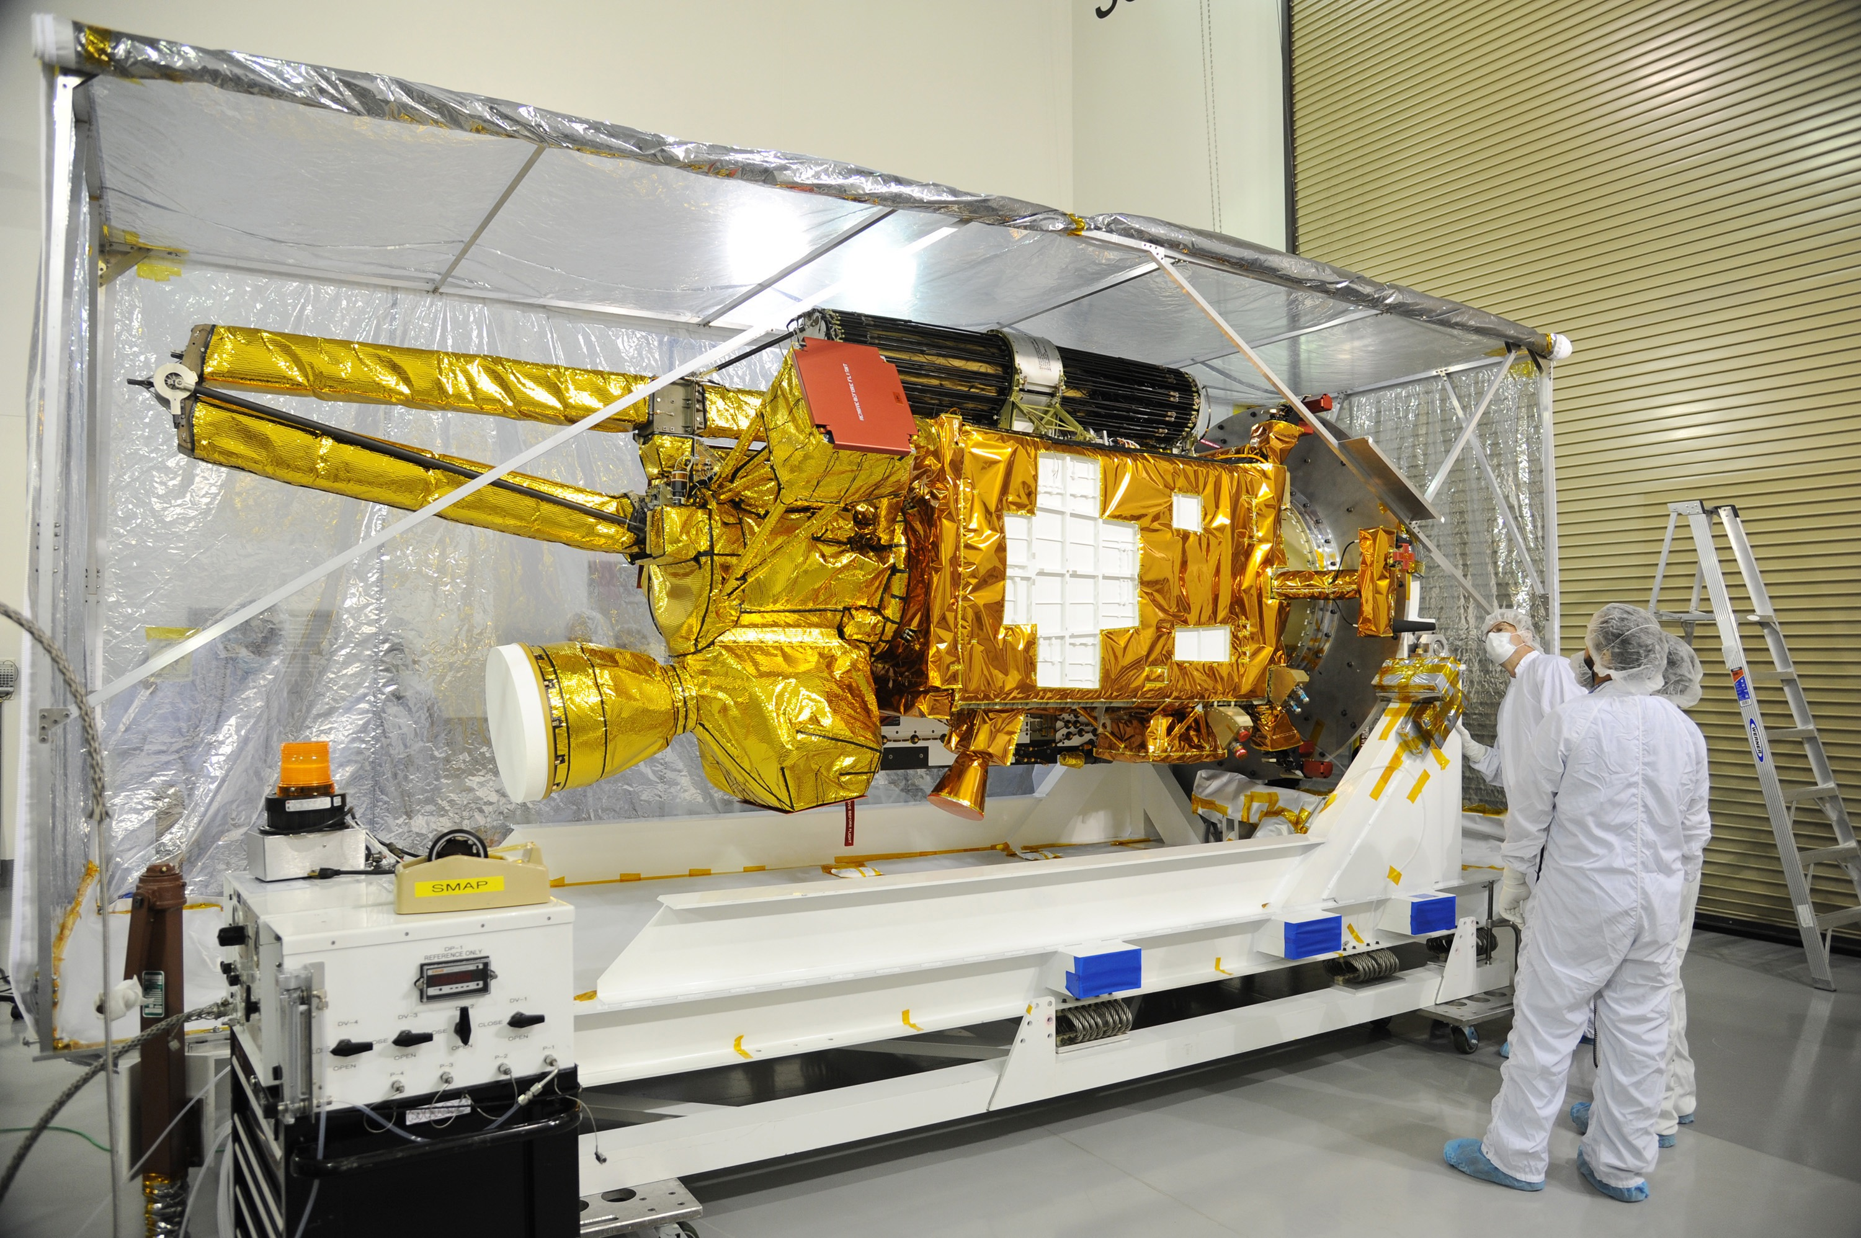
Notes:
SMAP post shipment inspection
NASA's Soil Moisture Active Passive, or SMAP, spacecraft comes into view as the protective covering is removed in the Astrotech payload processing facility on Vandenberg Air Force Base in California during a post-shipment inspection. The covering protected the spacecraft from static-charge buildup and contamination while it was in transit from NASA's Jet Propulsion Laboratory in Pasadena, California. SMAP will launch on a Delta II 7320 configuration vehicle featuring a United Launch Alliance first stage booster powered by an Aerojet Rocketdyne RS-27A main engine and three Alliant Techsystems, or ATK, strap-on solid rocket motors. Once on station in Earth orbit, SMAP will provide global measurements of soil moisture and its freeze/thaw state. These measurements will be used to enhance understanding of processes that link the water, energy and carbon cycles, and to extend the capabilities of weather and climate prediction models. SMAP data also will be used to quantify net carbon flux in boreal landscapes and to develop improved flood prediction and drought monitoring capabilities. Launch from Space Launch Complex 2 is targeted for Jan. 29, 2015.
For more infromation:
http://smap.jpl.nasa.gov

