Slide 1
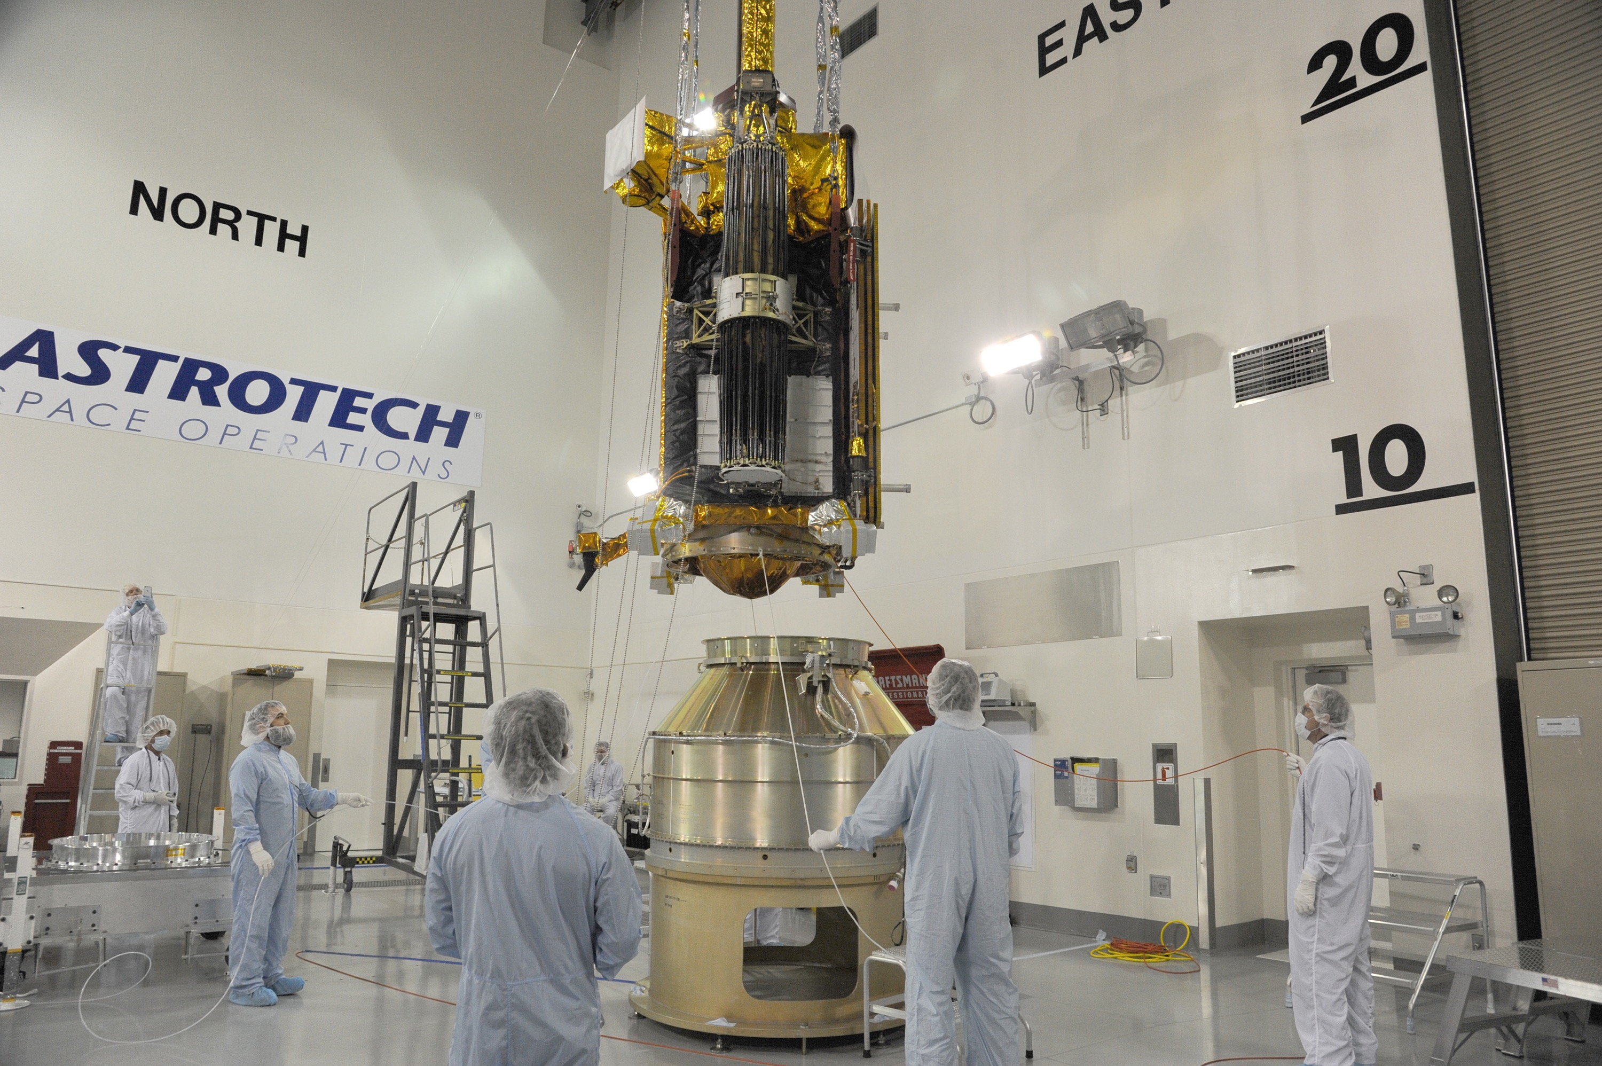
Notes:
SMAP attached to Delta II rocket
NASA's Soil Moisture Active Passive spacecraft is lowered onto the Delta II payload attach structure in the Astrotech payload processing facility at Vandenberg Air Force Base, California. The structure will secure the spacecraft to the rocket's second stage. SMAP will launch on a Delta II 7320 configuration vehicle featuring a United Launch Alliance first stage booster powered by an Aerojet Rocketdyne RS-27A main engine and three Alliant Techsystems, or ATK, strap-on solid rocket motors. Launch from Space Launch Complex 2 is targeted for Jan. 29. SMAP will provide global measurements of soil moisture and its freeze/thaw state. These measurements will be used to enhance understanding of processes that link the water, energy and carbon cycles; to extend the capabilities of weather and climate prediction models; and to develop improved flood prediction and drought monitoring capabilities.
For more information:
http://smap.jpl.nasa.gov

