Slide 1
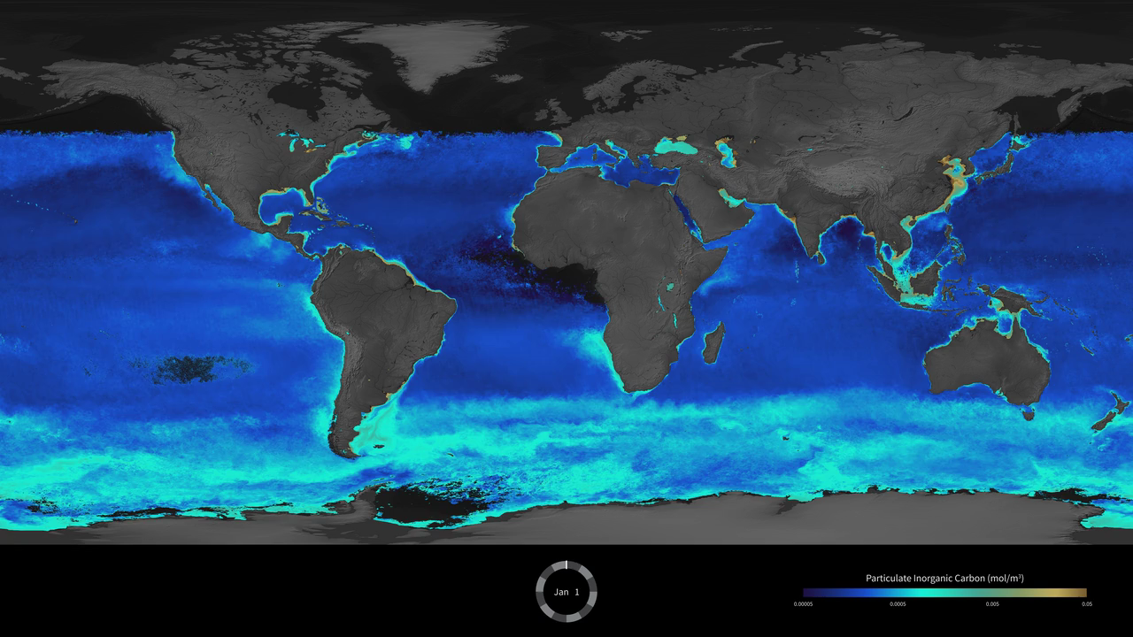
Notes:
Bright Waters of the Southern Ocean
Phytoplankton are microscopic organisms that live in watery environments, forming the foundation of the aquatic and marine food webs. Phytoplankton populations can grow explosively creating bright green and blue marble swirls, or blooms, near the surface. This visualization shows global daily averages of suspended particulate inorganic carbon (PIC, known as calcium carbonate or limestone) from July 4, 2002 to May 26, 2014, made with data from Aqua/MODIS. One can see shades of bright turquoise circling the Southern Ocean, a unique and consistent feature characterized by the presence of elevated PIC concentrations near the Sub-Tropical, Sub-Antarctic, and Polar Fronts. Referred to as the "Great Calcite Belt," high PIC concentrations result from large numbers of highly reflective microscopic PIC plates called “coccoliths,” released from calcifying coccolithophores. Such regions of elevated reflectance have been observed each year during austral summer with minor variations from year to year. Many sectors of the Southern Ocean are generally characterized by low concentrations of potentially growth limiting iron (Fe) concentrations. Studies suggest, however, that coccolithophores are well adapted to growth under low ambient iron conditions.
Satellite: Aqua
Instrument: MODIS

