Slide 1
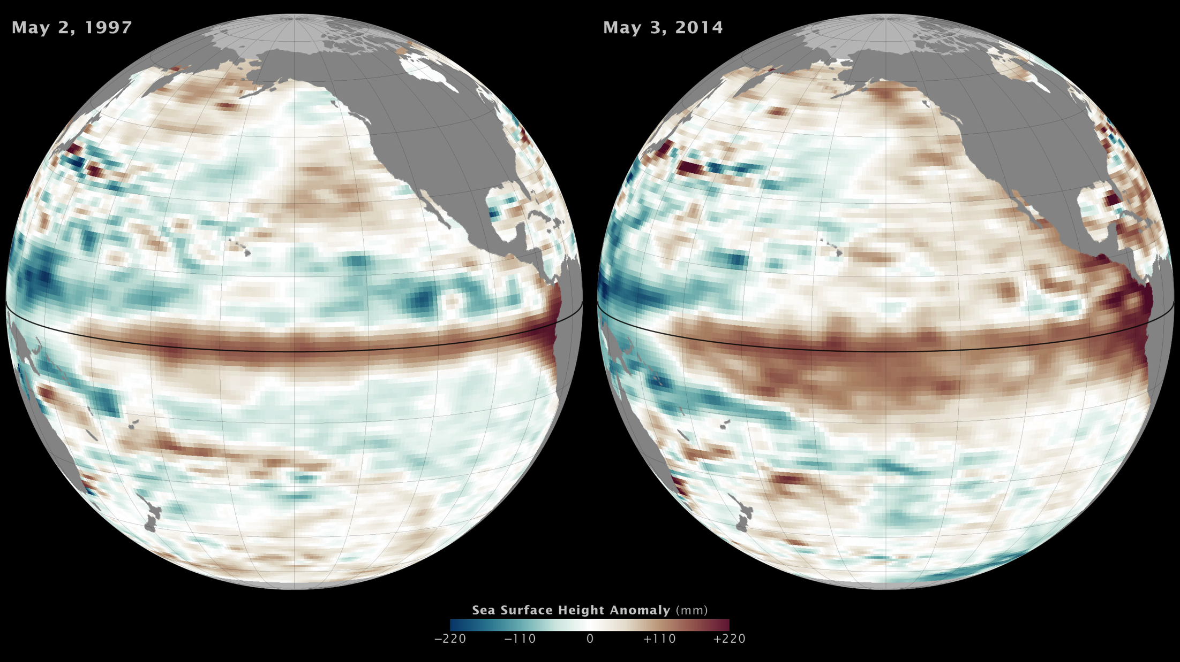
Notes:
Is El Niño Developing?
Data from ocean-observing satellites and other ocean sensors indicate that El Niño conditions appear to be developing in the equatorial Pacific Ocean. Conditions in May 2014 bear some similarities to those of May 1997, a year that brought one of the most potent El Niño events of the twentieth century. During an El Niño, surface waters in the central and eastern Pacific become significantly warmer than normal, altering weather patterns and affecting fisheries along the west coasts of the Americas. El Niño also can have a significant influence on weather and climate far from the tropics. As the ocean warms, the surface rises due to thermal expansion. Therefore, above-normal sea surface heights in the equatorial Pacific indicate El Niño conditions.
These maps show the ten-day average of sea surface height centered on May 2, 1997 [left], and May 3, 2014 [right]. Reddish-brown shades indicate where the water is warmer and above normal sea level, while shades of blue-green show where sea level and temperatures are lower than average. Normal sea-level conditions appear in white. The 1997 map was assembled from data collected by the TOPEX/Poseidon satellite, while the 2014 data comes from the Ocean Surface Topography Mission/Jason 2 satellite.

