Slide 1
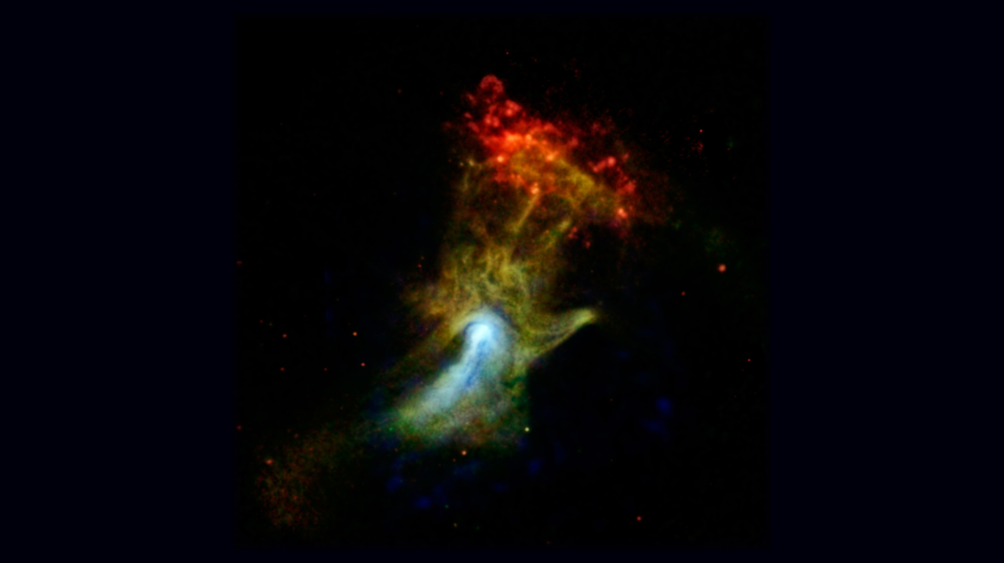
Notes:
High-energy X-ray View of “Hand of God”
For the first time, NASA’s Nuclear Spectroscopic Telescope Array, or NuSTAR, has imaged a structure in high-energy X-rays (in blue). The object may look to some like a hand X-rayed at the doctor's office, but it is actually a cloud of material ejected from a star that exploded.
Nicknamed the "Hand of God," this object is called a pulsar wind nebula. It's powered by the leftover, dense core of a star that blew up in a supernova explosion. The stellar corpse, called PSR B1509-58, is a pulsar. It rapidly spins around, seven times per second, firing out a particle wind into the material around it — material that was ejected in the star's explosion. These particles are interacting with magnetic fields around the material, causing it to glow with X-rays.
Lower-energy X-ray light previously detected by NASA's Chandra X-ray Observatory is shown in green and red. The red cloud at the end of the finger region is a different structure, called RCW 89. Astronomers think the pulsar's wind is heating the cloud, causing it to glow with lower-energy X-ray light.
Credit: NASA/JPL-Caltech/McGill
Source: http://www.nasa.gov/jpl/nustar/B1509-pia17566/#.UvEGPfbw-mE
Posted: January 9, 2014

