Slide 1
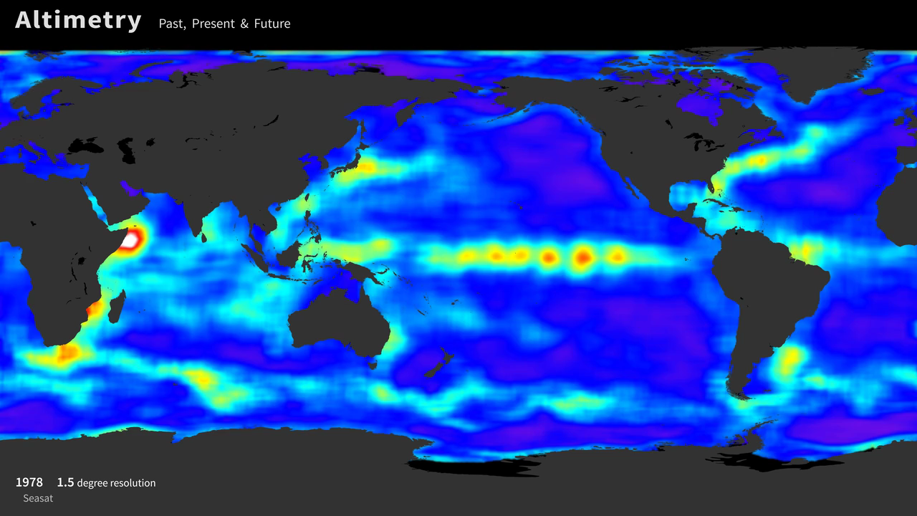
Notes:
Altimetry: Past, Present, and Future
Launched in 1978, Seasat was the first NASA Earth-orbiting satellite mission designed to observe the world’s ocean. Seasat carried five major instruments, including a radar altimeter that measured the distance between the satellite and sea surface, indicating global sea surface height and the topography of the ocean surface. This visualization shows the progression of improved data resolution from satellite altimeters in the past, present, and future, beginning with 1.5-degree resolution data in 1978 from Seasat and ending with 0.05-degree resolution data from NASA’s Surface Water and Ocean Topography (SWOT) mission planned to launch in 2020. A single satellite (Geosat) provided 0.5-degree resolution data from 1986 to 1990, while numerous international satellite missions (ERS-1, TOPEX/Poseidon, ERS-2, Jason-1, Envisat, and Jason-2) have provided 0.25-degree resolution data from 1992 until now. These measurements and their continuity are important for monitoring large-scale features such as Rossby and Kelvin waves, the evolution of El Niño and La Niña events, and variation of global sea level in relation to climate change. SWOT (with 0.05-degree-resolution) will offer an unprecedented combination of spatial and temporal resolution while continuing and extending the ocean altimeter data record for years to come, with a wide variety of practical applications in oceanography and hydrology.
podaac.jpl.nasa.gov/AnimationsImages/Animations

