Slide 1
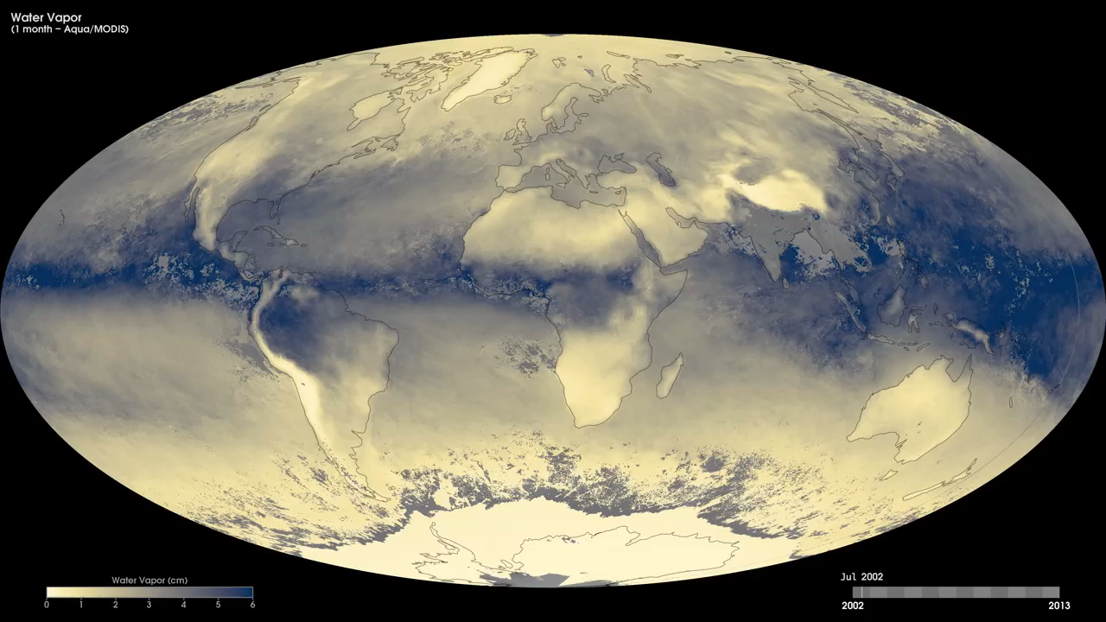
Notes:
Water vapor is the most abundant greenhouse gas in the atmosphere as it traps heat near the surface of the Earth making our planet warm enough to support life. Scientists monitor water vapor in the atmosphere because it influences Earth's weather patterns, and because it is a very important component of Earth's climate system. These maps show a monthly water vapor product from July 2002 to the present, derived using data from the Moderate Resolution Imaging Spectroradiometer (MODIS) instrument onboard NASA's Aqua satellite. The water vapor product reveals the total amount of water vapor in a 1-kilometer by 1-kilometer column of the atmosphere. Dark blue shades indicate areas with high water vapor content, while light yellow shades indicate areas with little or no water vapor content.
Satellite:Aqua
Instrument: MODIS

