Slide 1
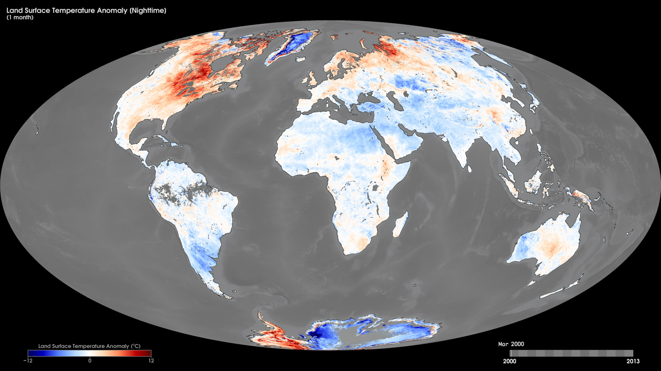
Notes:
Land-surface temperature is how hot the surface of the Earth would feel to touch. From a satellite’s perspective, the “surface” is whatever it sees when it looks through the atmosphere to the ground. It could be snow and ice, the grass, a rooftop, or the treetops in a forest. An anomaly is when something is different from normal, or average.
These maps show monthly nighttime land-surface-temperature anomalies from March 2000 to the present, compared to the average monthly temperatures from 2001-2010 as derived using data from the Moderate Resolution Imaging Spectroradiometer (MODIS) instrument onboard NASA’s Terra satellite. Places that are warmer than average are red, places that are near-normal are white, and places that are cooler than average are blue. Black means there is no data. Some land-surface-temperature anomalies are simply transient weather phenomena, not part of a specific pattern or trend. Others anomalies are more meaningful. Widespread cold anomalies may be an indication of a harsh winter with lots of snow on the ground. Many urban areas show up as hot spots in these maps because developed areas are often warmer at night than surrounding natural ecosystem or farmland.
Satellite: Terra
Instrument: MODIS

