Slide 1
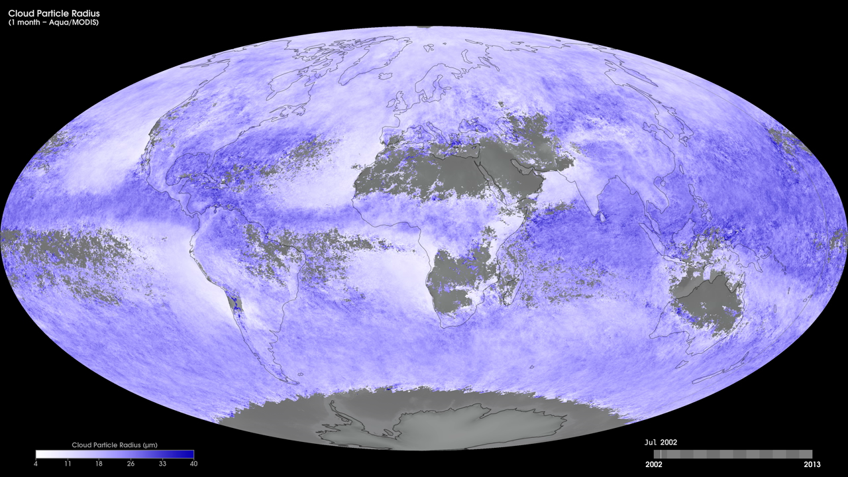
Notes:
To better understand the role of clouds in the Earth's climate system, scientists need two important measurements: cloud optical thickness and cloud particle size. The size of cloud particles is important. In general, smaller particles produce brighter, more reflective clouds, which bounce more sunlight back into space and cool the planet. By carefully quantifying how much shortwave infrared sunlight clouds absorb, scientists can determine the size of the individual particles within clouds. Clouds with larger particles absorb more shortwave infrared light and, conversely, clouds with smaller particles absorb less shortwave infrared light. These maps show monthly cloud particle radius from January 2005 to the present, produced using data from the Moderate Resolution Imaging Spectroradiometer (MODIS) instrument onboard NASA’s Terra satellite. White shades show where there are smaller cloud particles (between 4 and 11 micrometers in radius), while purple shades show where there are larger cloud particles (between 33 and 40 micrometers).
Satellite: Terra
Instrument: MODIS

