Slide 1
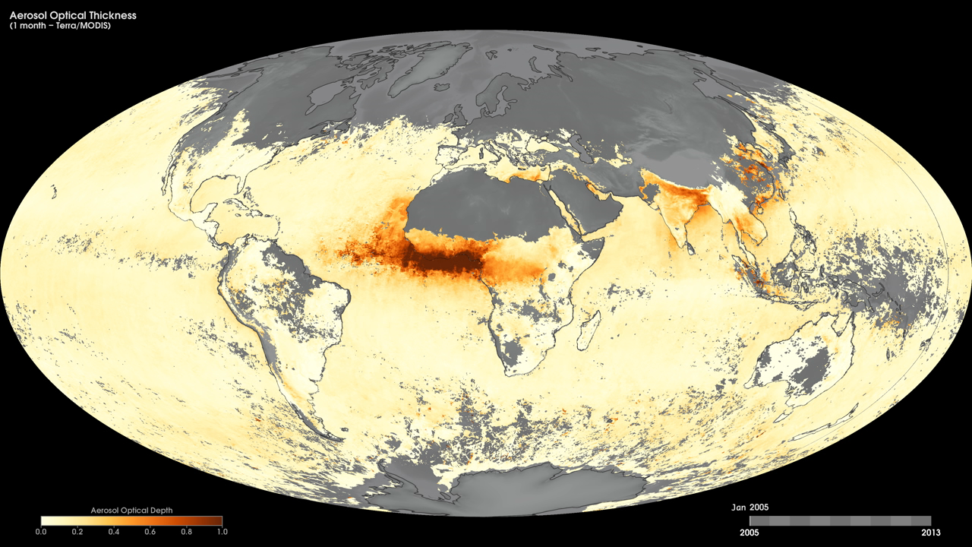
Notes:
Tiny solid and liquid particles suspended in the atmosphere are called aerosols. These particles are important to scientists because they represent an area of great uncertainty in their efforts to understand Earth's climate system.
These maps show monthly aerosol optical thickness, derived using measurements from the Moderate Resolution Imaging Spectroradiometer (MODIS) sensor onboard NASA’s Terra satellite, from January 2005 to the present. Aerosol optical thickness is a measure of how much light the airborne particles prevent from traveling through the atmosphere. Aerosols absorb and scatter incoming sunlight, thus reducing visibility and increasing optical thickness. Dark orange pixels show high aerosol concentrations, while light orange pixels show lower concentrations, and light yellow areas show little or no aerosols. Black shows where the sensor could not make its measurement. An optical thickness of less than 0.1 (light yellow) indicates a crystal clear sky with maximum visibility, whereas a value of 1 (dark orange) indicates the presence of aerosols so dense that people would have difficulty seeing the sun.
Satellite: Terra
Instrument: MODIS

