Slide 1
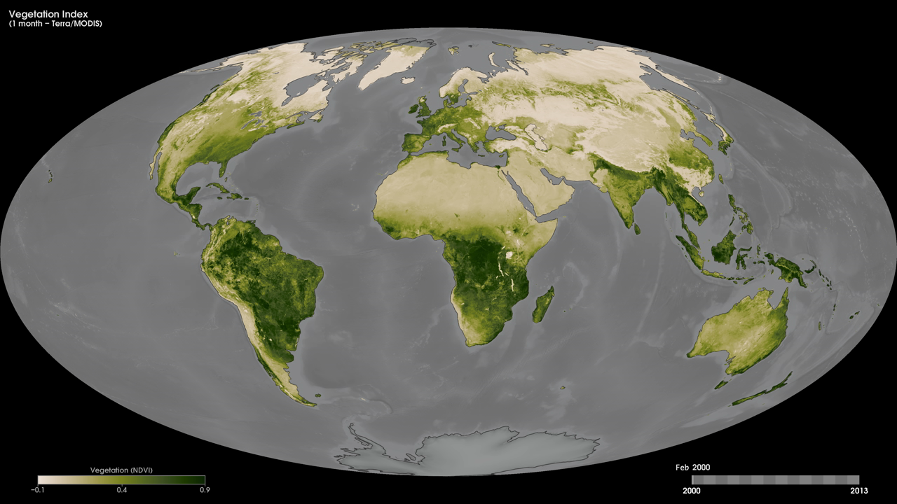
Notes:
One of the primary interests of NASA's Earth Sciences Program is to study the role of terrestrial vegetation in large-scale processes with the goal of understanding how our world functions as a system.
These maps show monthly Normalized Difference Vegetation Index (NDVI) values—a measure of the "greenness" of Earth's landscapes—from February 2000 to the present. The values, derived using data collected by the Moderate Resolution Imaging Spectroradiometer (MODIS) onboard NASA's Terra satellite, range from -0.1 to 0.9 and have no unit. Rather, they are index values in which higher values (0.4 to 0.9) show lands covered by green, leafy vegetation and lower values (0 to 0.4) show lands where there is little or no vegetation. Dark green areas show where there was a lot of green leaf growth; light greens show where there was some green leaf growth; and tan areas show little or no growth. Black means no data.
Satellite: Terra
Instrument: MODIS

