Slide 1
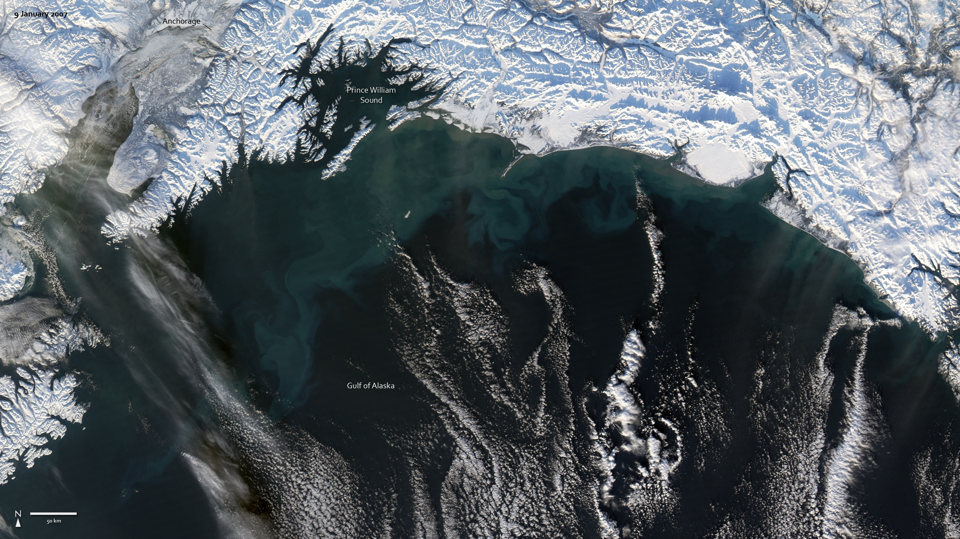
Notes:
The winter-white Alaska shoreline provides a vivid contrast to the turquoise swirls in the waters of the Gulf of Alaska. This burst of color in an otherwise black-and-white scene is caused by sediment, ground into fine powder by mountain glaciers and carried into the Gulf of Alaska through many waterways. The largest contributor of sediment shown in this image is the Copper River, immediately east of Prince William Sound. The ocean water near the mouth of the river is tan. As the clouds of sediment disperse in the water, they turn blue-green.
Sediment is not the only thing that gives water this color in satellite images: a dense bloom of tiny ocean plants can also lend the water a blue-green tint. Called phytoplankton, these microscopic, surface-dwelling plants thrive in cool, nutrient-laden water such as the Gulf of Alaska. Dense concentrations of the plants can color large swaths of ocean water, and it may be that phytoplankton are also contributing to the color seen here.
Satellite: Aqua
Instrument: MODIS

