Slide 1
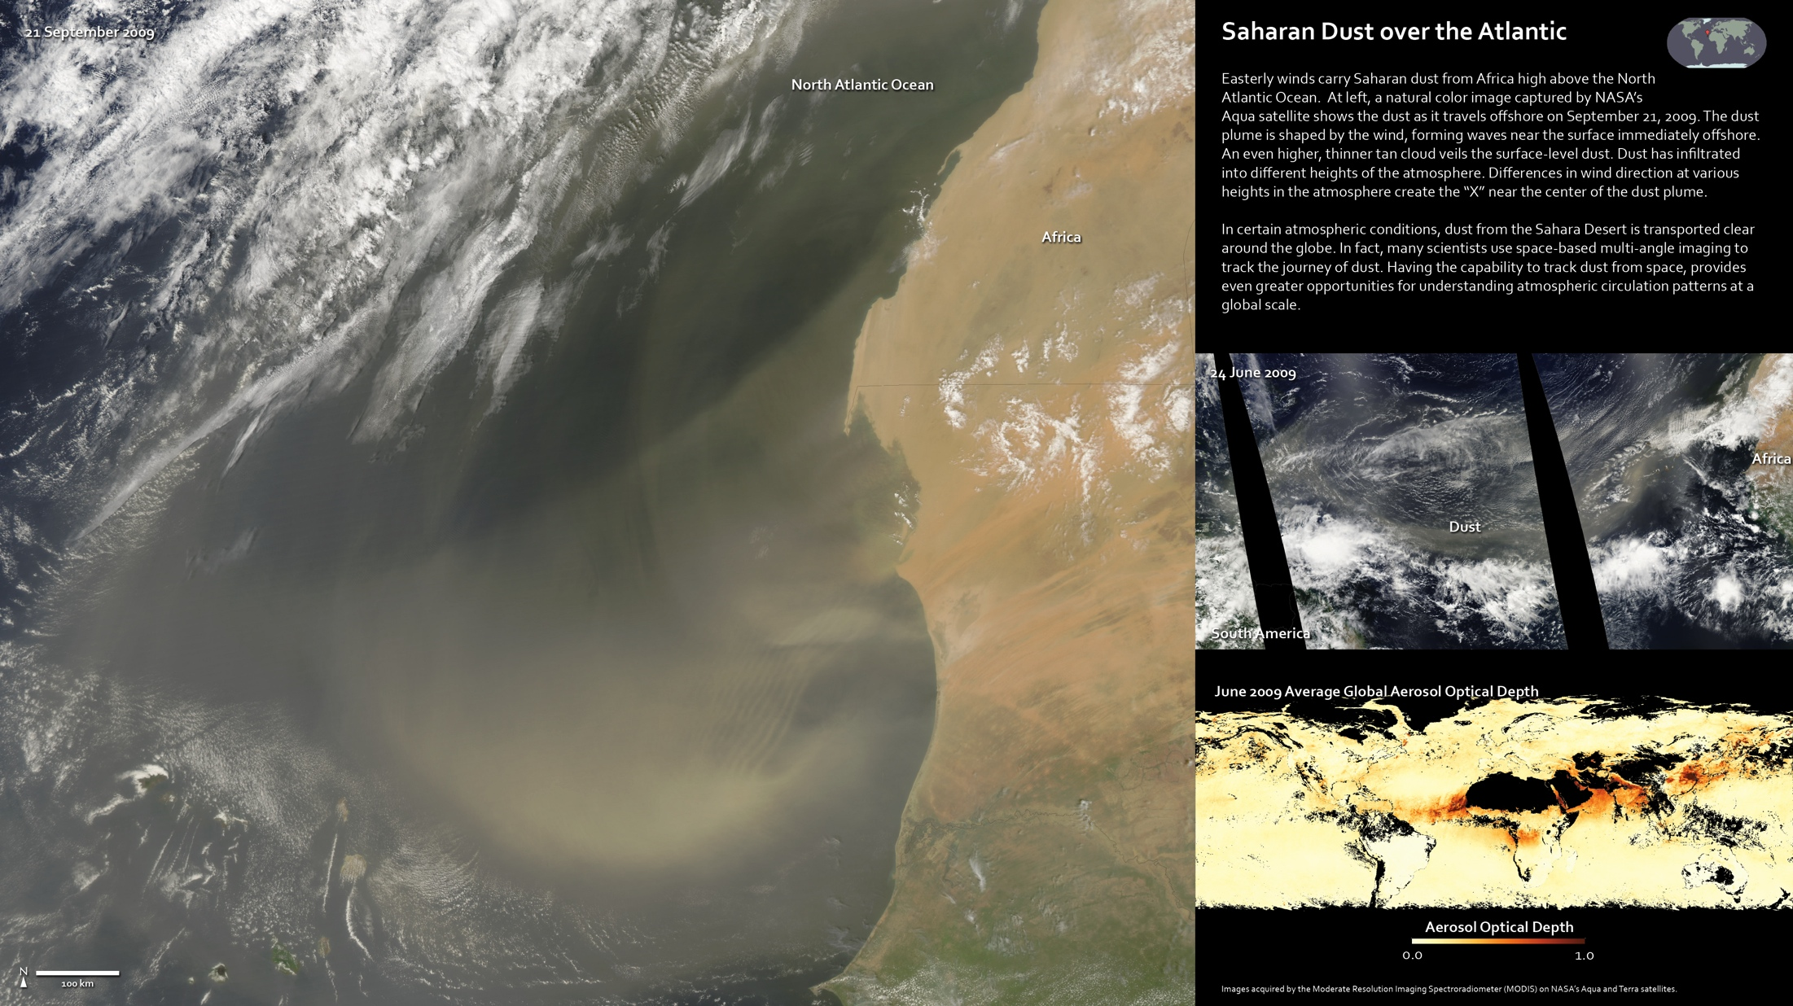
Notes:
Saharan Dust Over the Atlantic
Easterly winds carry Saharan dust from Africa high above the North Atlantic Ocean. At left, a natural color image captured by NASA’s Aqua satellite shows the dust as it travels offshore on September 21, 2009. The dust plume is shaped by the wind, forming waves near the surface immediately offshore. An even higher, thinner tan cloud veils the surface-level dust. Dust has infiltrated into different heights of the atmosphere. Differences in wind direction at various heights in the atmosphere create the “X” near the center of the dust plume.
In certain atmospheric conditions, dust from the Sahara Desert is transported clear around the globe. In fact, many scientists use space-based multi-angle imaging to track the journey of dust. Having the capability to track dust from space, provides even greater opportunities for understanding atmospheric circulation patterns at a global scale.
Satellite: Aqua, Terra
Instrument: MODIS

