Slide 1
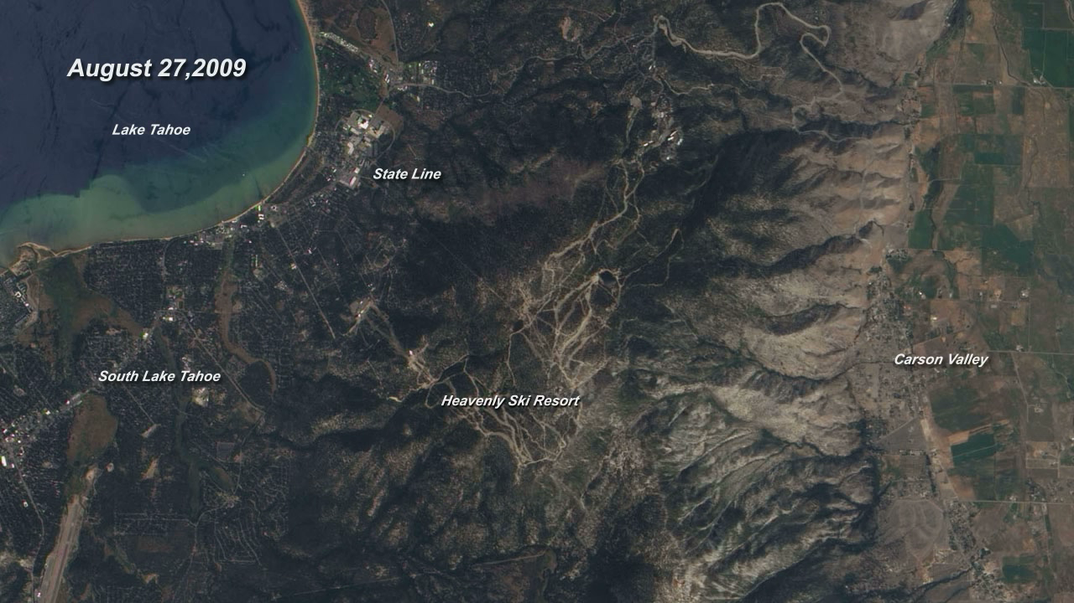
Notes:
Perhaps the most familiar change in our changing world is the annual swing of the seasons. This series of images shows the changes around Lake Tahoe, on the border between California and Nevada, from August 27, 2009, to September 7, 2010.
Snow, plants, light, and the lake itself all shift in accordance with the seasons. One of the most obvious signals in the Lake Tahoe region is snow, a commodity that draws skiing vacationers. The groomed trails are among the first places to turn white when the first snow arrives in October, and they are among the last places to lose snow in June. Apart from snow cover, the other clear indicator of seasonal change is the lighting. The seasonal shift in light is evident in the shadows that play across the images. During the height of summer, direct light illuminates the mountaintops and valley floors. Moving into the fall, shadows paint the western side of the mountains. By December, shadows dominate, with only eastern mountain faces reflecting bright light.
Satellite: EQ-1
Instrument: ALI

