Slide 1
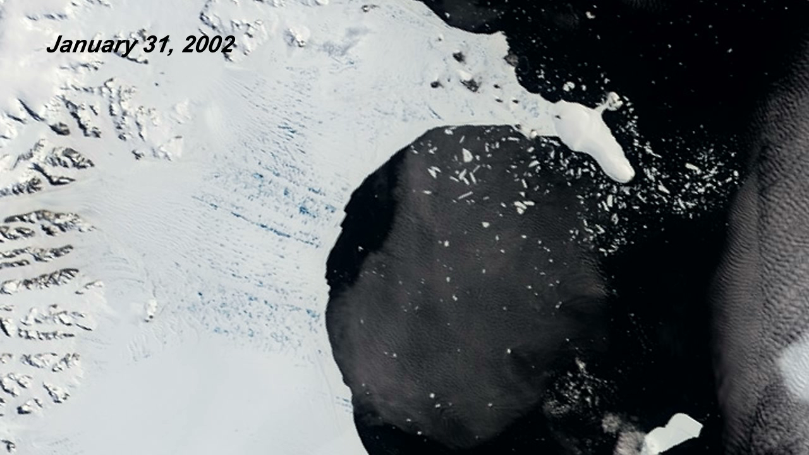
Notes:
Collapse of the Larsen-B Ice Shelf
In the Southern Hemisphere summer of 2002, scientists monitoring daily satellite images of the Antarctic Peninsula watched almost the entire Larsen-B Ice Shelf splinter and collapse in just over one month. They had never witnessed such a large area—1250 square miles (~3237 square kilometers)—disintegrate so rapidly.
The collapse of the Larsen-B Ice Shelf was captured in this series of images between January 31 and April 13, 2002. At the start of the series, the ice shelf (left) is tattooed with pools of meltwater (blue). By February 17, the leading edge of the C-shaped shelf had retreated about 6 miles (~10 kilometers). By March 7, the shelf had disintegrated into a blue-tinged mixture, or mélange, of slush and icebergs. The collapse appears to have been due to a series of warm summers on the Antarctic Peninsula, which culminated with an exceptionally warm summer in 2002. Warm ocean temperatures in the Weddell Sea that occurred during the same period might have caused thinning and melting on the underside of the ice shelf.
Satellite: Terra
Instrument: MODIS

