Slide 1
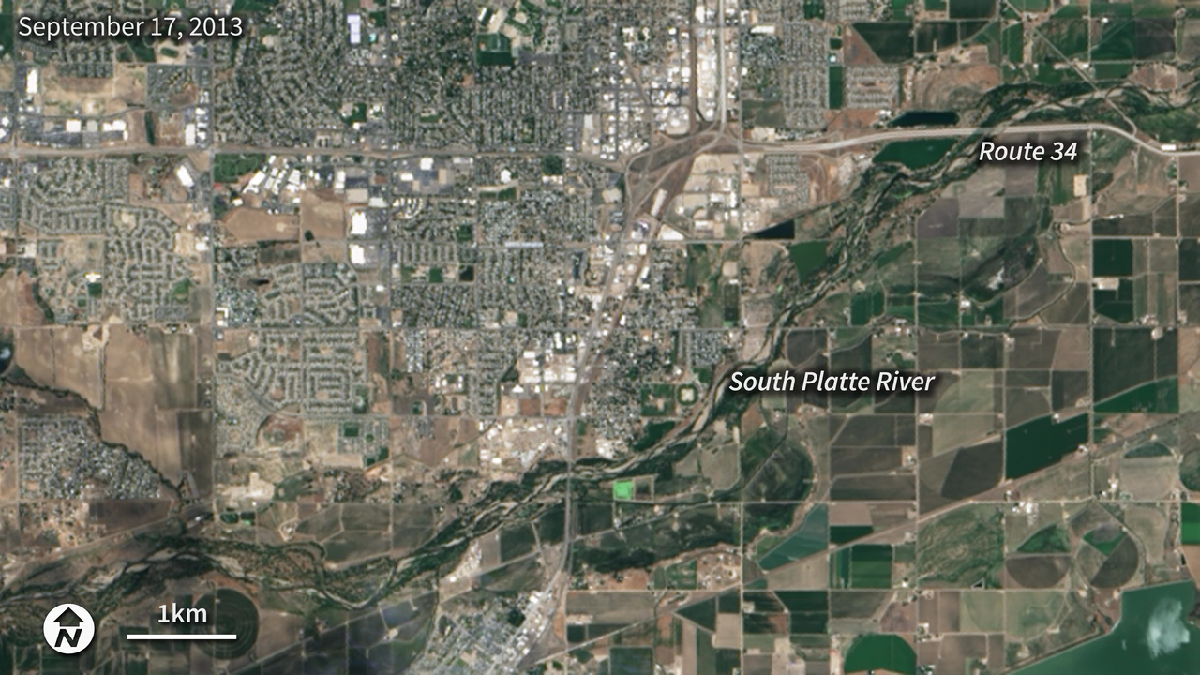
Notes:
Intense rainfall in northern and eastern Colorado brought widespread, destructive flooding in mid-September 2013. This pair of images from the Operational Land Imager on the Landsat 8 satellite shows the South Platte River near Greely, Colorado on June 29, 2013 and September 17, 2013. At the time of the latter image, the river was more than six feet above flood stage, down from more than eight feet above flood stage.
The September image shows that the flood has washed away roads, including sections of U.S. Highway 34. Farmland and a few developed areas are under water. Heavy rain caused flooding across the Front Range of the Rocky Mountains starting on September 11, and much of that water made its way into the South Platte River. The river reached a record 18.79 feet in the early morning hours of September 14. The previous record crest was 11.73 feet. Flood stage is 10 feet.

