Slide 1
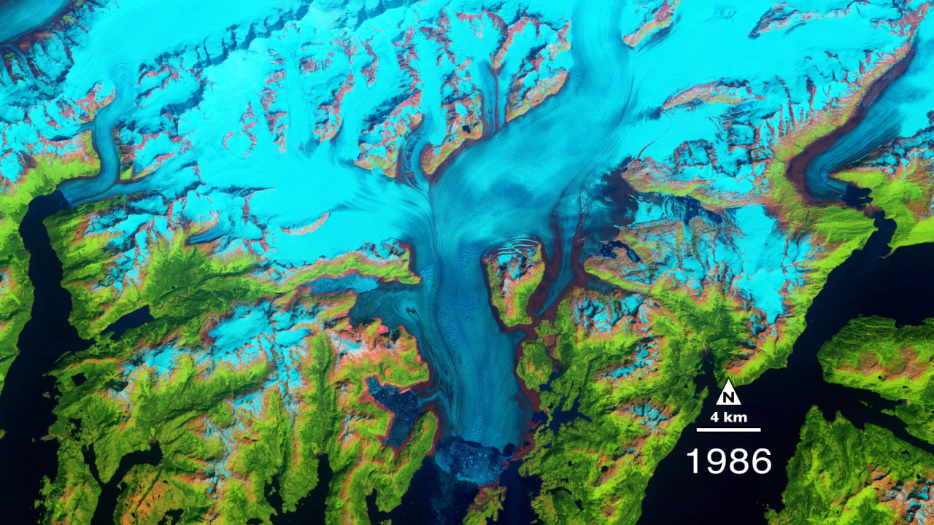
Notes:
The Columbia Glacier in Alaska is one of the most rapidly changing glaciers in the world. These false-color images show how the glacier and the surrounding landscape has changed since 1986. Snow and ice appears bright cyan, vegetation is green, clouds are white or light orange, and the open ocean is dark blue. Exposed bedrock is brown, while rocky debris on the glacier’s surface is gray.
By 2011, the terminus had retreated more than 20 kilometers (12 miles) to the north. Since the 1980s, the glacier has lost about half of its total thickness and volume. The retreat of the Columbia contributes to global sea-level rise, mostly through iceberg calving. This one glacier accounts for nearly half of the ice loss in the Chugach Mountains. However, the ice losses are not exclusively tied to increasing air and water temperatures. Climate change may have given the Columbia an initial nudge, but it has more to do with mechanical processes. In fact, when the Columbia reaches the shoreline, its retreat will likely slow down. The more stable surface will cause the rate of calving to decline, making it possible for the glacier to start rebuilding a moraine and advancing once again.

