Slide 1
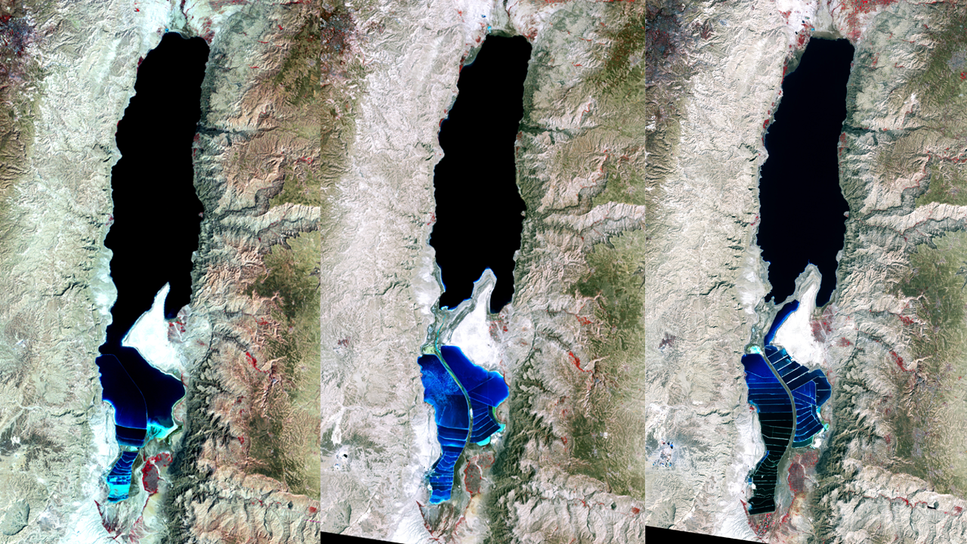
Notes:
The Dead Sea is so named because its high salinity discourages the growth of fish, plants, and other wildlife. It is the lowest surface feature on Earth, sitting roughly 1,300 feet below sea level. On a hot, dry summer day, the water level can drop as much as one inch because of evaporation.
These three false-color images were captured in 1972, 1989, and 2011 by Landsat satellites. Deep waters are blue or dark blue, while brighter blues indicate shallow waters or salt ponds. Green indicates sparsely vegetated lands. Denser vegetation appears bright red.
The ancient Egyptians used salts from the Dead Sea for mummification, fertilizers, and potash (a potassium-based salt). In the modern age, sodium chloride and potassium salts culled from the sea are used for water conditioning, road de-icing, and the manufacturing of polyvinyl chloride (PVC) plastics. The expansions of massive salt evaporation projects are clearly visible over the span of 39 years.

