Slide 1
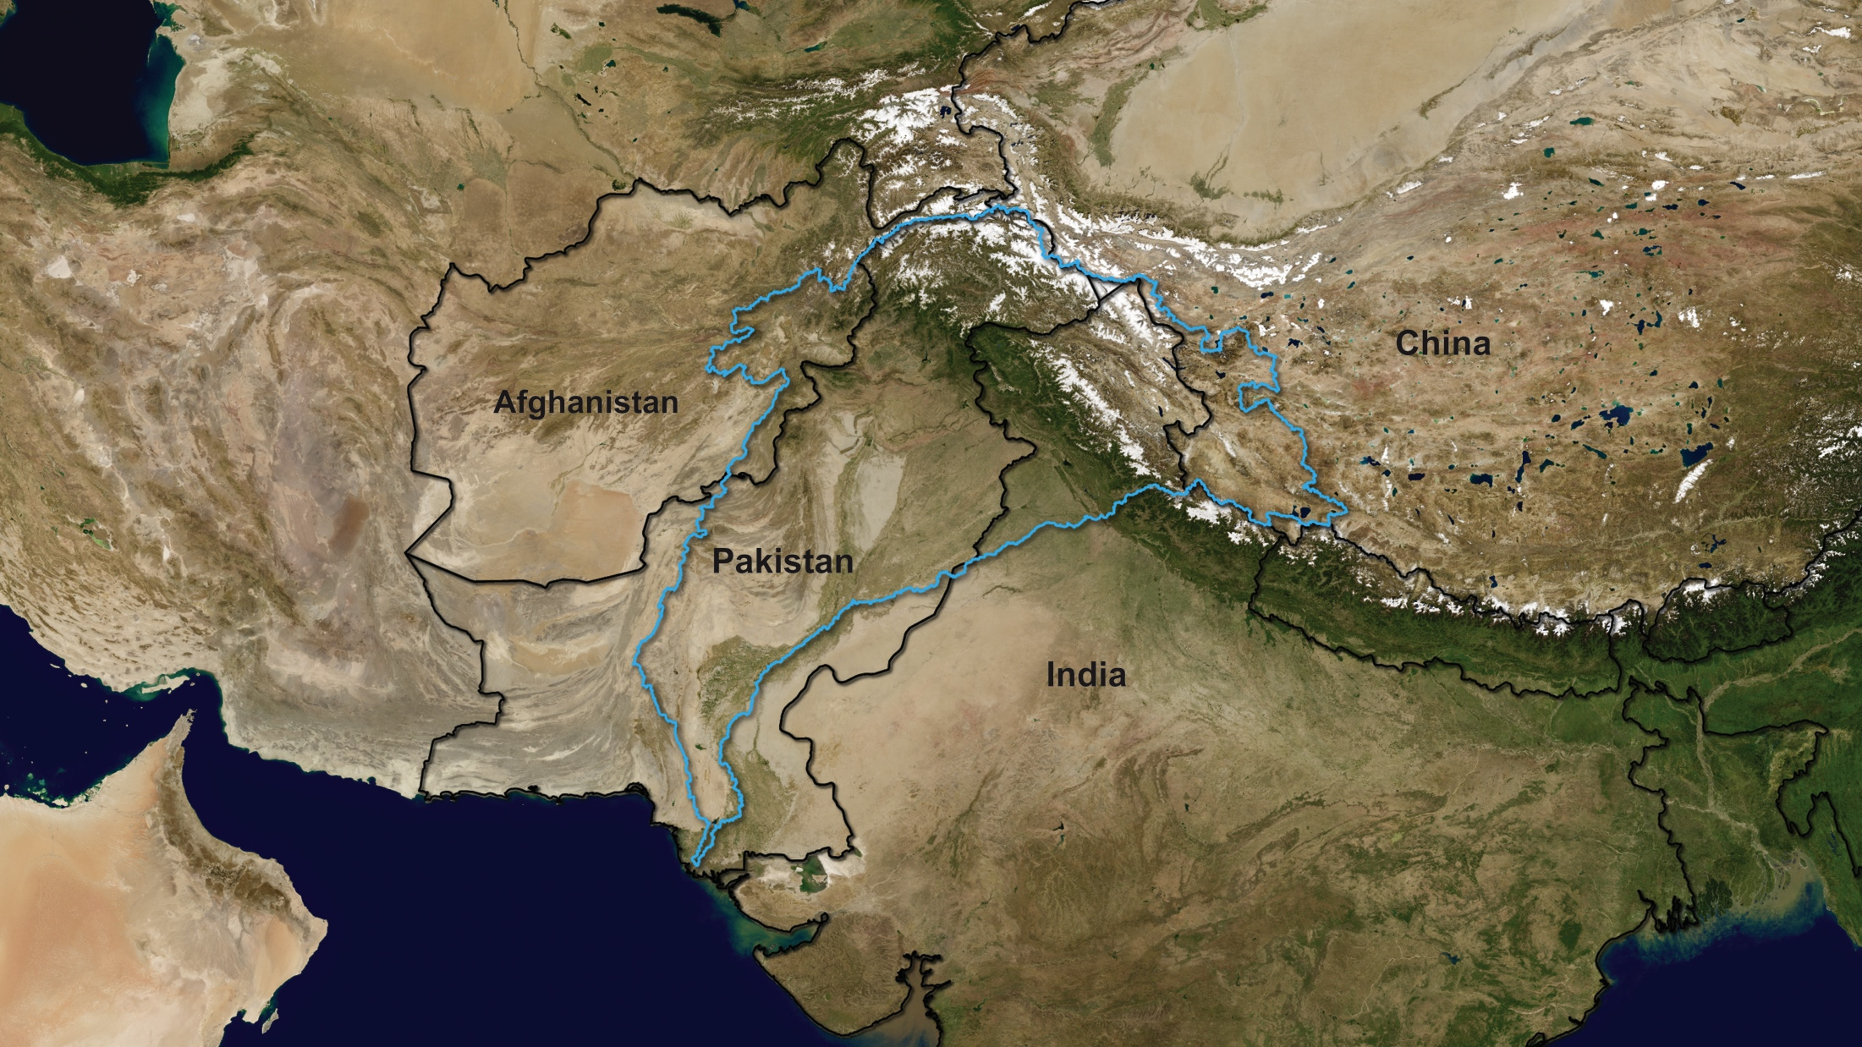
Notes:
2010 Pakistan Floods
Indus River Basin
The Indus River Basin (i.e., watershed) covers approximately 860,000 square kilometers (332,000 square miles) and includes much of Pakistan as well as portions of India, China, and Afghanistan. Its headwaters begin in one of the highest regions on Earth—the Tibetan Plateau. Meltwater from nearby Himalayan glaciers mixes with various types of precipitation while flowing towards the Indus—Pakistan’s longest river. Converging with waters from four other major rivers—Jhelum, Chenab, Ravi, and Sutlej—the Indus gently slopes southward before emptying out to the Arabian Sea.

Slide 2
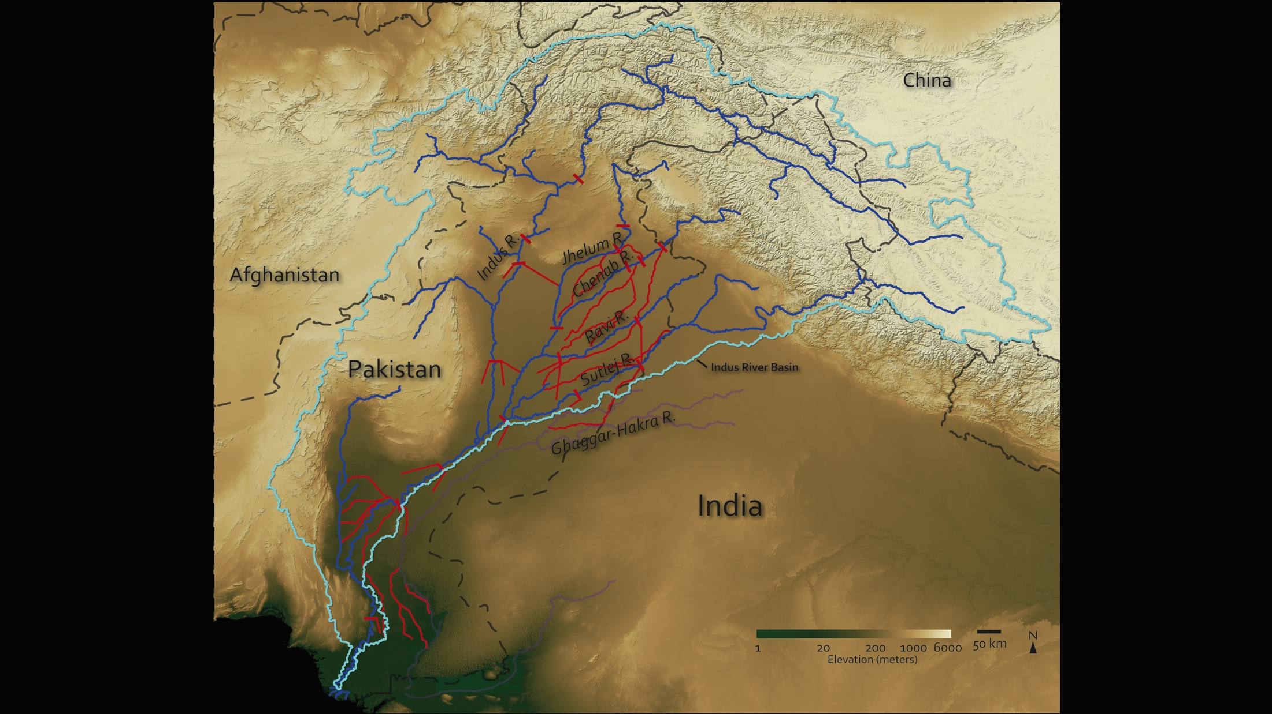
Notes:
Indus River Basin Cont.
This image depicts elevation in various shades from dark green to a pale beige color, revealing changes in elevation from 1-6,000+ meters. The vast beige-colored area generally coincides with the region’s arid plateau, much of which is above 2,000 meters. In contrast, the land neighboring the lower part of the Indus River and its tributaries—at elevations between ~1-200 meters—is very fertile, and sustains nearly all of Pakistan’s agriculture.
To facilitate irrigation to areas beyond the limits placed by natural river flows, hydro engineers constructed a number of manmade irrigation structures. Depicted in red, these manmade irrigation structures—barrages, dams, and canals—divert water to various locations and promote agricultural production. The Indus River and its tributaries have undoubtedly allowed civilizations to thrive within its basin for thousands of years.
Image based on elevation data derived from the Advanced Spaceborne Thermal Emission and Reflection Radiometer (ASTER) instrument onboard the Terra satellite. ASTER data provided courtesy of NASA/GSFC/METI/ERSDAC/JAROS and U.S./Japan ASTER Science Team.
River and basin data from Hydrosheds (hydrosheds.cr.usgs.gov).

Slide 3
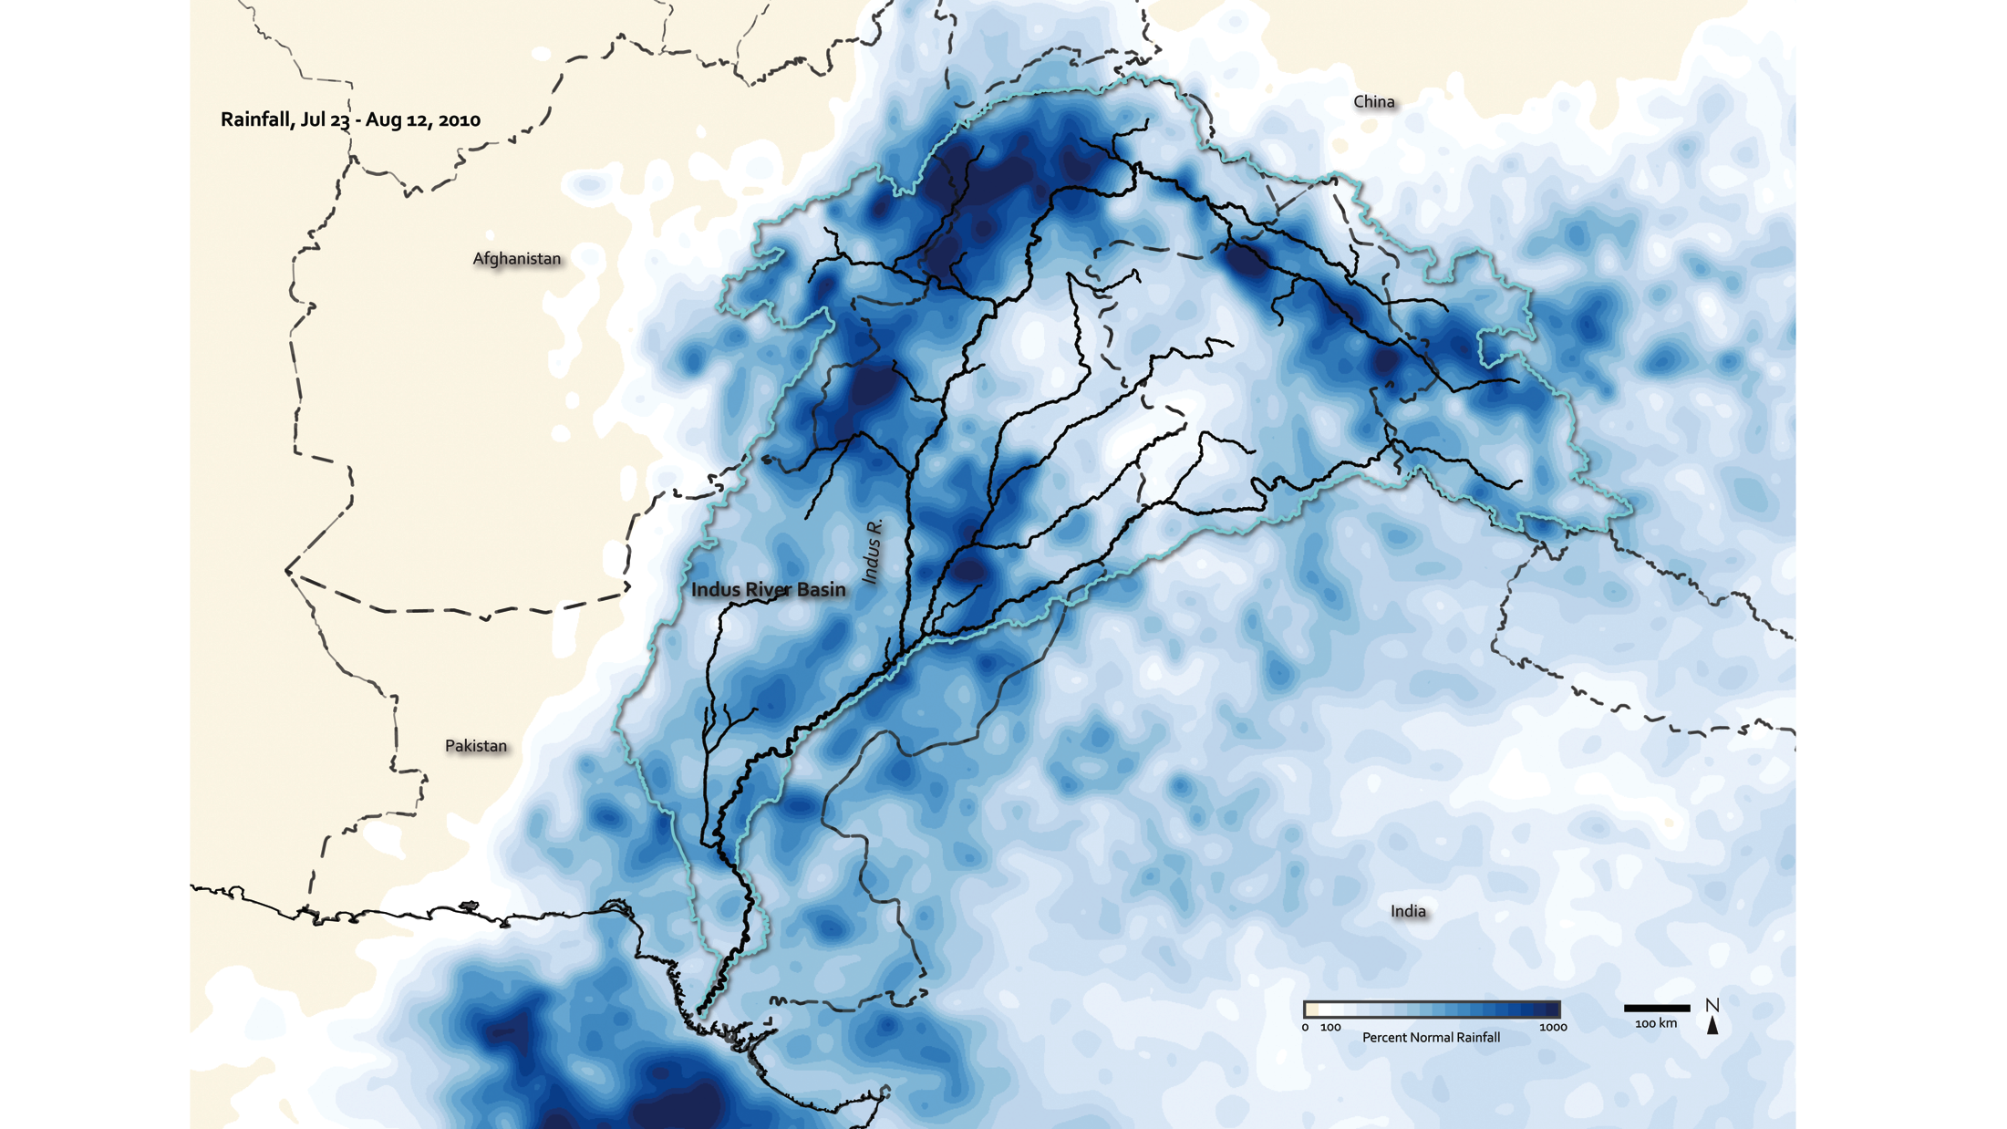
Notes:
Indus River Basin, 2010 Monsoon Rains
Water—the main reason for life on Earth—continually cycles through one of Earth’s most powerful systems, the water cycle. Water moves endlessly between the oceans, atmosphere, and land. Civilizations have lived for thousands of years trying to figure out the intricate balance of water, oscillating between the avoidance of too much or too less (i.e., flood and drought).
The 2010 Pakistan Floods demonstrate the severity and un-avoidance of rising water levels. Unprecedented monsoon rains drenched the region’s arid surface beginning in July 2010. Rainfall totals rapidly exceeded average amounts in July and August, with some areas topping totals 10 times their normal percentages, as seen in regions depicted in the darkest shades of blue.

Slide 4
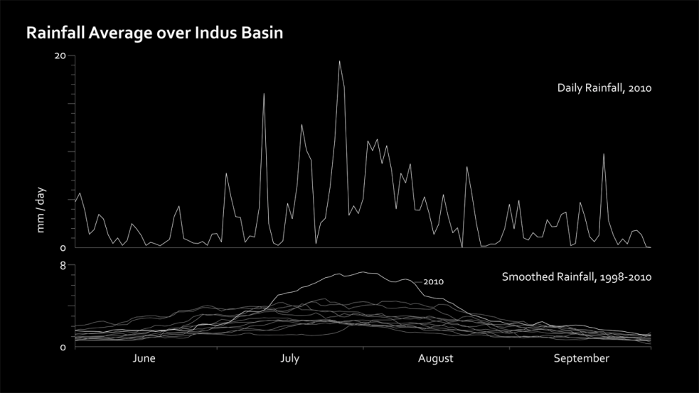
Notes:
Relatively high water levels along rivers are expected during the monsoon season (June-September); but this time, water levels exceeded expectations. Flooding along the Indus River and its tributaries was catastrophic, leaving millions of Pakistanis without food, shelter, and even fresh drinking water.
Image created with the Tropical Rainfall Measuring Mission (TRMM) daily precipitation data (3B42).
Reference: U.S. Library of Congress; The International Disaster Database

Slide 5
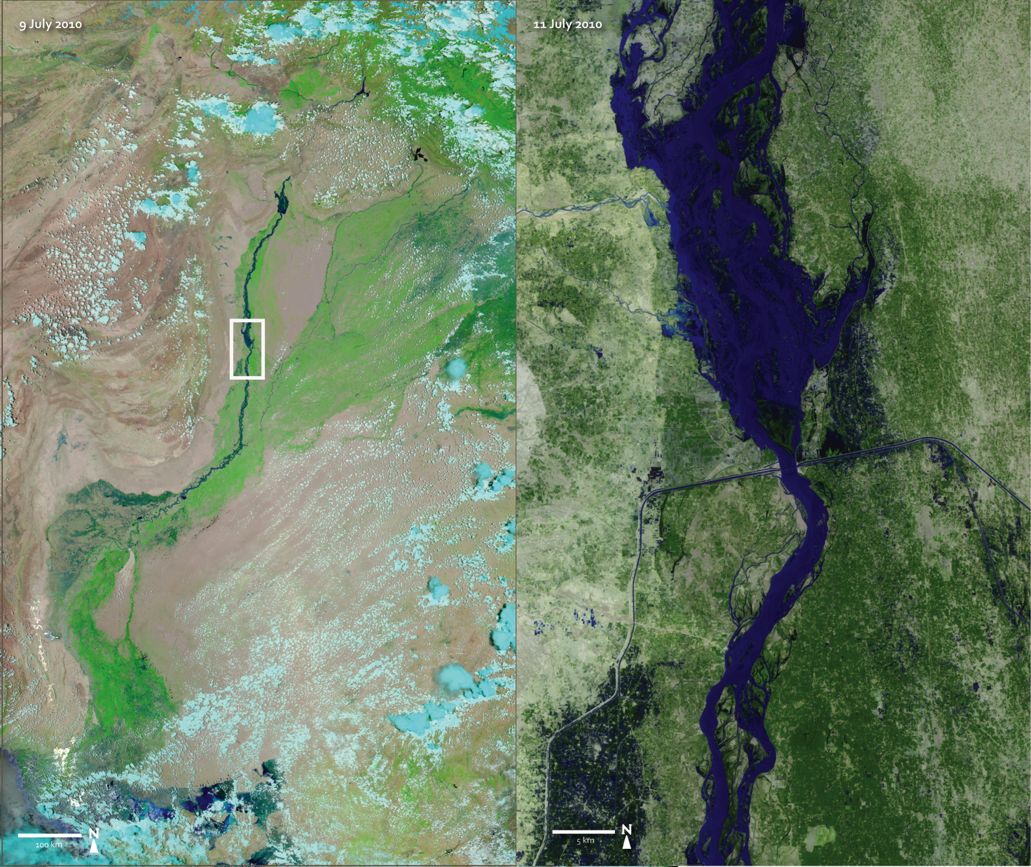
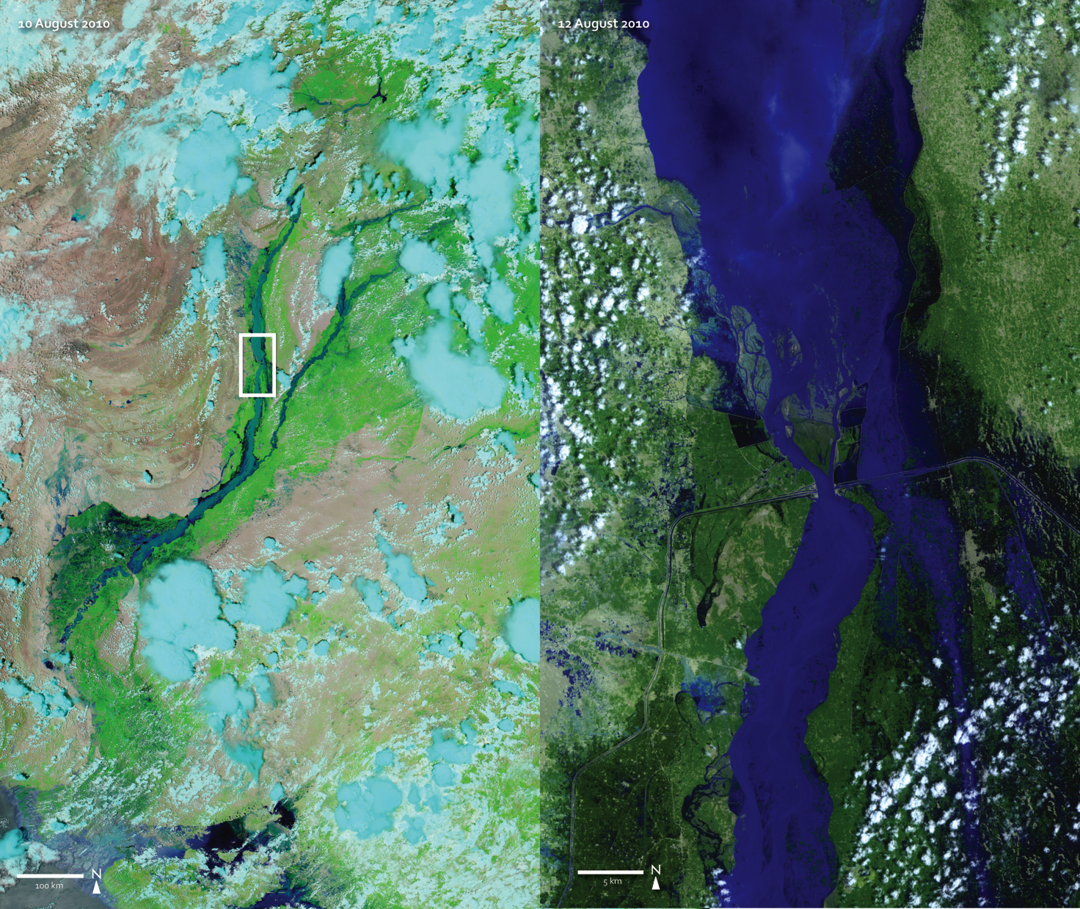
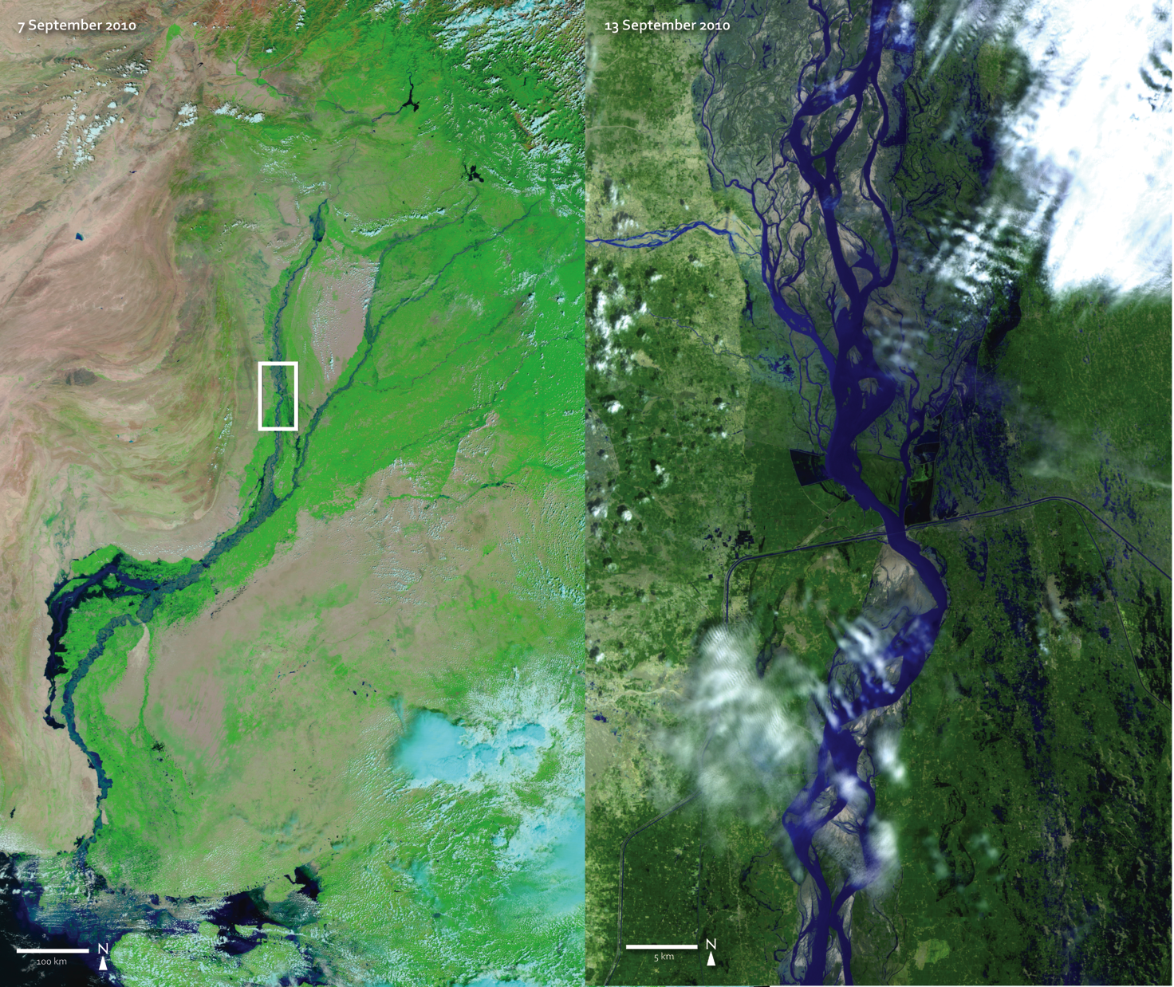
Notes:
Indus River Flooding, Taunsa Barrage
Nearly every living organism on Earth has been or will be affected by drought, heavy rains, or flooding. Flooding—a common natural disaster—is one of the most costly disasters, worldwide.
This time series reveals the oscillation between water levels along the Indus River and its tributaries from July-September 2010. Satellite imagery captured by the Moderate Resolution Imaging Spectroradiometer (MODIS) instrument onboard the Aqua and Terra satellites (left image) unveils changes in water levels along the rivers, flowing north-south through much of Pakistan, while Landsat satellite imagery (right image) provides a more detailed view of the area surrounding the Taunsa Barrage—a manmade barrier built to facilitate irrigation to arid regions and promote agricultural production.
The highest concentrations of vegetation, depicted in green (left image), hug the rivers as they meander through the visibly less-vegetated surrounding areas. While hydro engineering in Pakistan has certainly increased agricultural capabilities, it has also confined rivers to one path, abandoning old ones. The depressions from old river paths remain nearby, leaving numerous places for water to spill over to in the event of rising water levels, making this region particularly vulnerable to flooding.
As heavy monsoon rains began in July 2010, rivers quickly breached their banks north and south of the Taunsa Barrage (right image), flooding adjacent areas. By September, water levels had retreated and the Indus River and its tributaries took to their original braided shapes. Conversely, many previously flooded areas, particularly depressions from old river paths, remained underwater. In the end, nearly three billion dollars in agricultural damage was estimated as a result of the floods.
Images acquired by the Landsat-5 satellite and Moderate Resolution Imaging Spectroradiometer (MODIS) instruments onboard the Terra and Aqua satellites.
Reference: Daily Finance, An AOL Money & Finance site (www.daily finance.com)

Slide 6
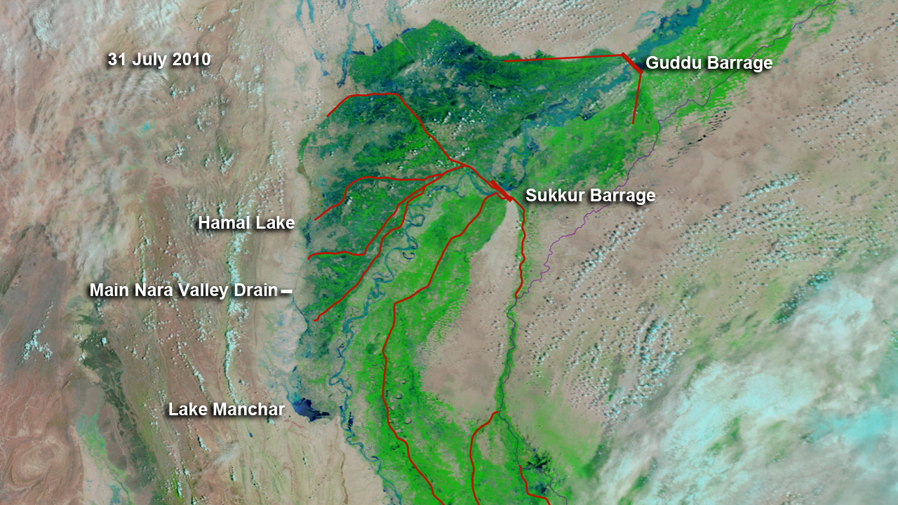
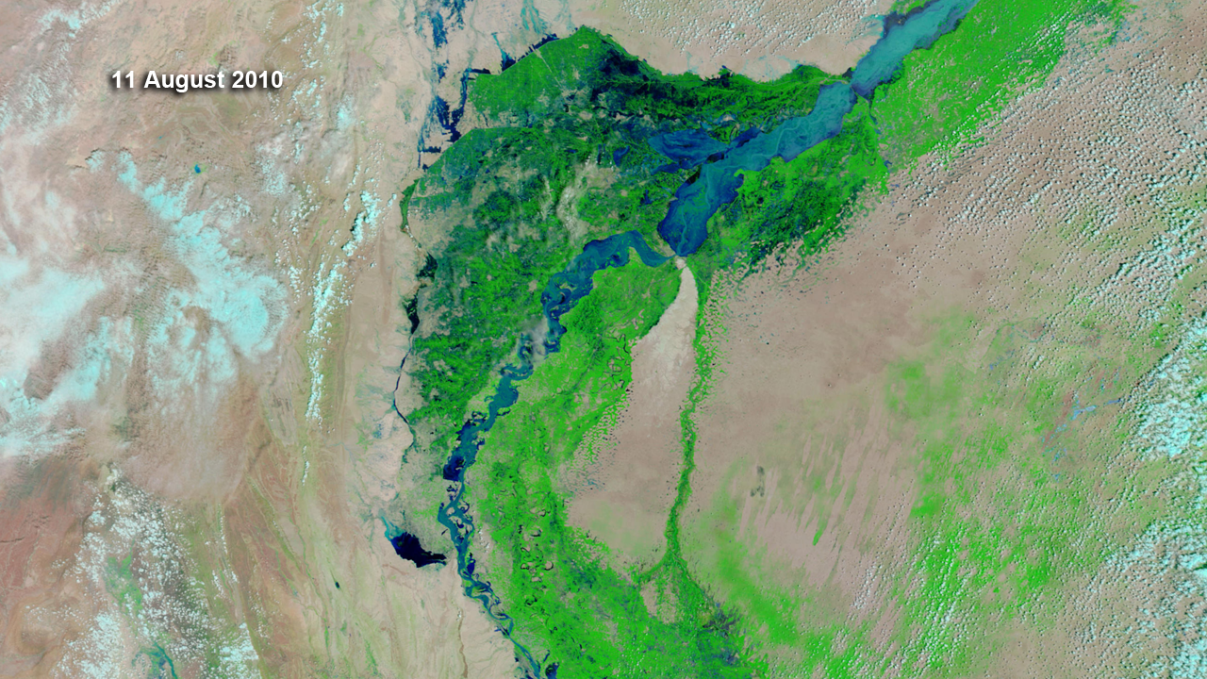
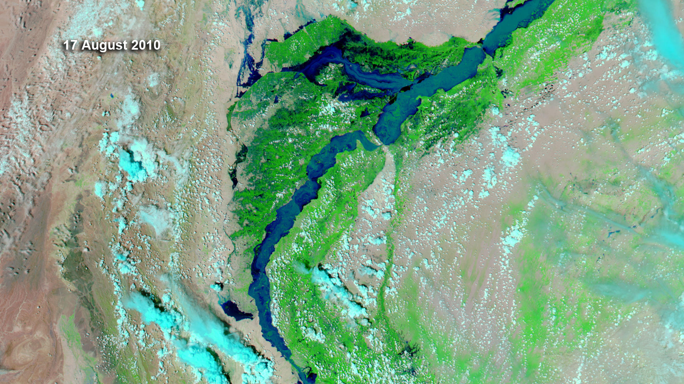
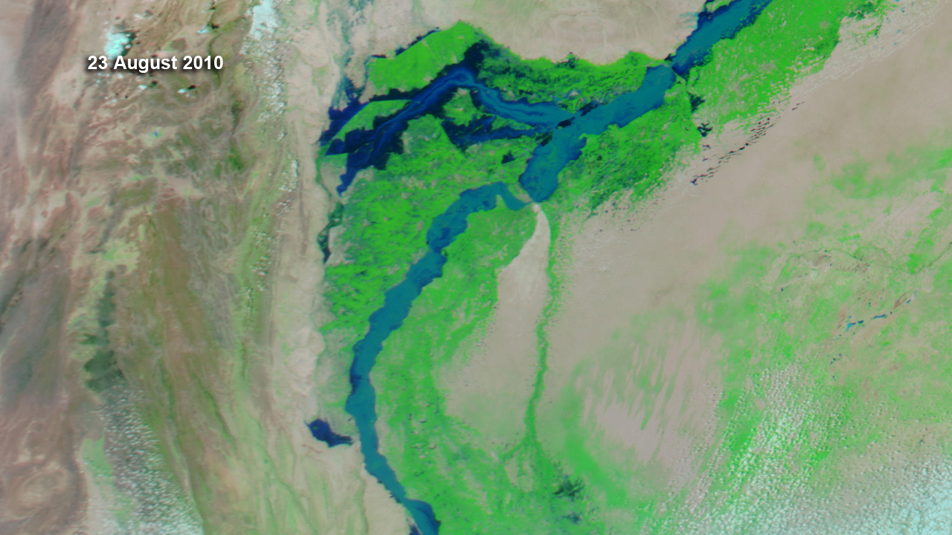
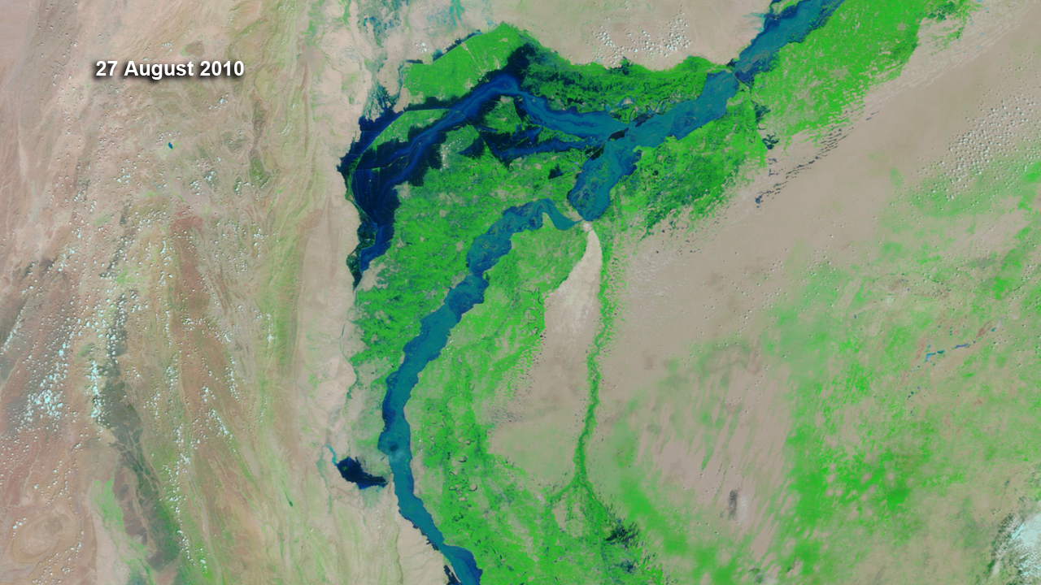
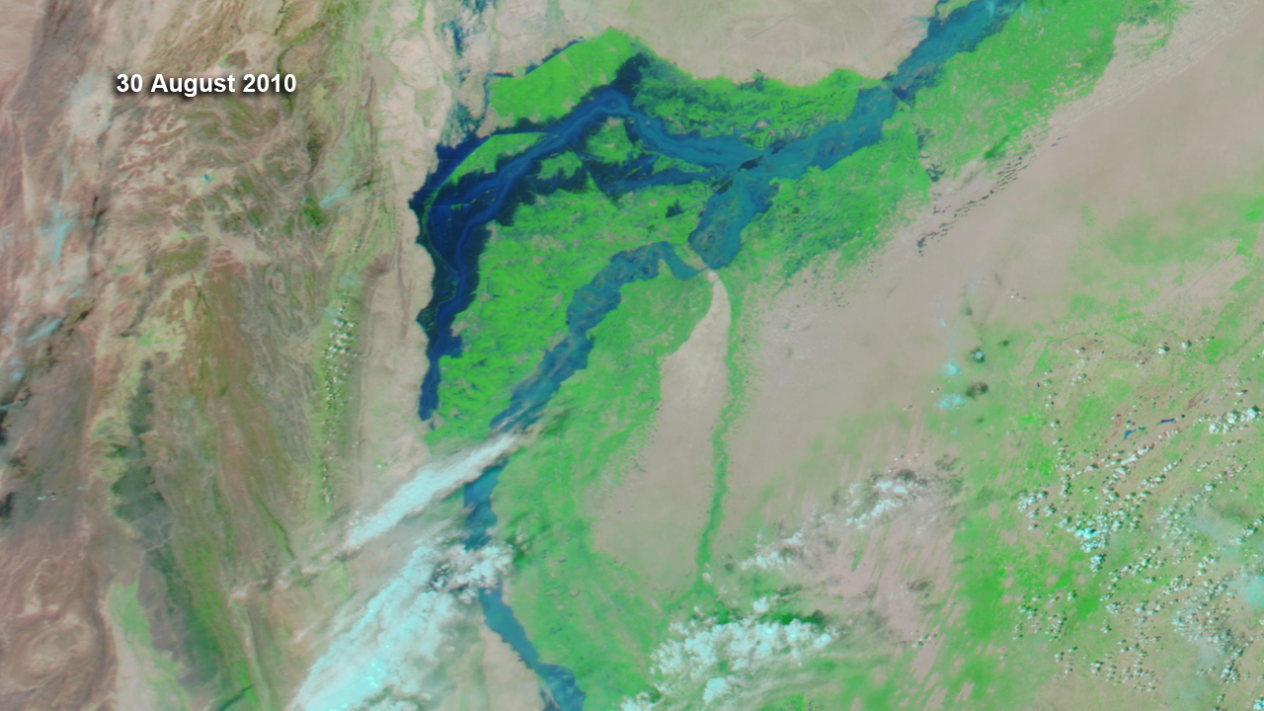
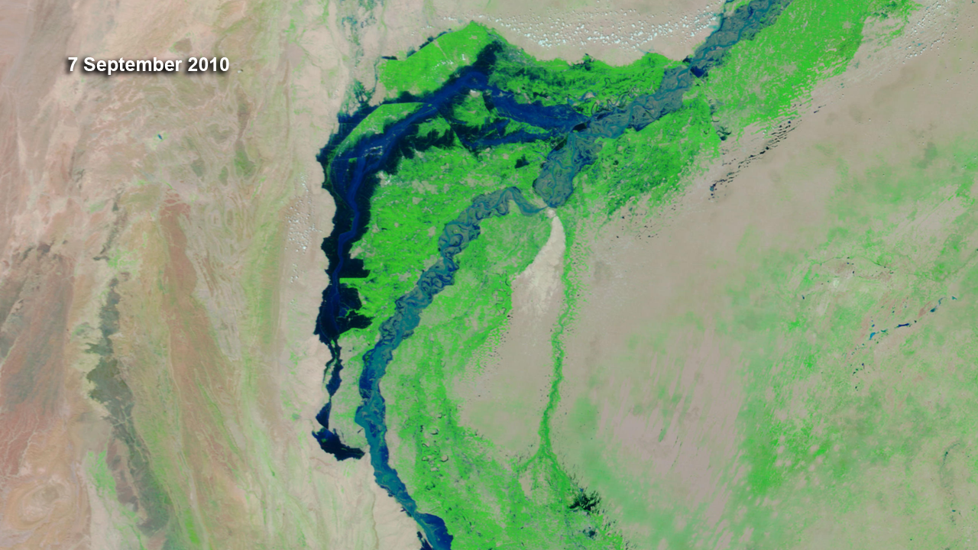
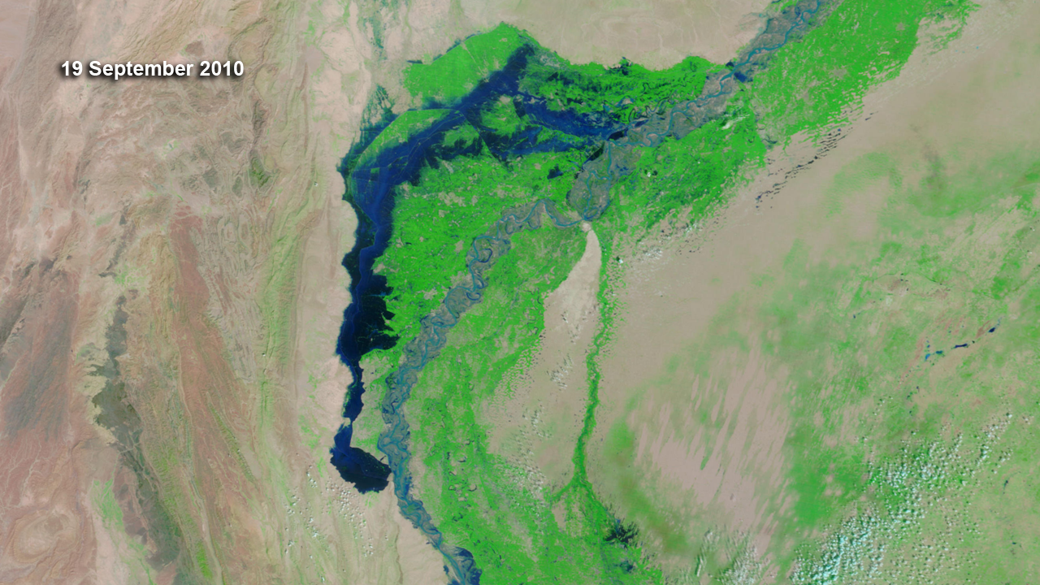
Notes:
Indus River Flooding, Sindh Province
This image series shows the progression of floodwaters across the Sindh province in southern Pakistan from July 31-September 19, 2010. Canals, diverging south and westward from the Guddu and Sukkur Barrages, helped channel floodwaters to nearby farmland, west of the Indus. What appears to be an old riverbed, sprouting westward from the Indus between the Guddu and Sukkur Barrages, continued filling with water until reaching Hamal Lake around August 27th. Filling Hamal, floodwaters continued southward, following the path of the Main Nara Valley Drain, finally reaching Lake Manchar. Unfortunately, not all of the floodwater was diverted away from Sindh’s residents; millions of Pakistanis were displaced from their homes as water levels continued to breach their levees.
Images acquired by the Moderate Resolution Imaging Spectroradiometer (MODIS) instruments onboard the Terra and Aqua satellites.
References: National Public Radio, August 23, 2010

Slide 7
9 July 2010
MODIS
UNOSAT Flood Map
Notes:
2010 Pakistan Flood Analysis: The Big Picture
Some blamed La Niña, while others faulted inadequate flood-prevention plans for the devastation left behind by the 2010 Pakistan Floods. In either case, the coming together of international partners allowed rapid humanitarian response efforts to take place.
The importance of international partnership lies within the craftsmanship of the map on the right, a mosaic of shared satellite data pieced together by UNITAR’s Operational Satellite Application Programme (UNOSAT). The map provides flood analysis based on a time series of satellite data recorded between July 28-September 16, 2010. With the support from several other partners, UNOSAT was able to provide emergency response maps to humanitarian communities during the floods.
Often times, those assessing flood extent on land are unable to map an entire area before water levels change again. Satellites, however, offer a unique perspective from space and provide data across large geographic areas nearly every day.
Consider the image on the left, taken by the Moderate Resolution Imaging Spectroradiometer (MODIS) instrument onboard the Terra satellite. Within seconds, MODIS was able to capture this incredible scene, some 705 kilometers (438 miles) from Earth’s surface; an image that would allow millions—across the globe—to see the big picture.
Image credit: NASA; European Space Agency; Japan Aerospace Exploration Agency; Japan’s Ministry of Economy, Trade, and Industry; Canadian Space Agency; United States Geological Survey; ESRI Web Map Service; DMC International Imaging Ltd.
Satellite credit: ENVISAT ASAR IP (HH); ALOS PALSAR (FBD & WB1); RADARSAT-2; UK DMC2; Worldview-1; QuickBird2; GeoEye-1; MODIS Aqua & Terra; Landsat-7 Imagery; Aster GDEM
Reference: United Nations Institute for Training and Research (UNITAR); UNITAR’s Operational Satellite Application Programme (UNOSAT)

