Slide 1
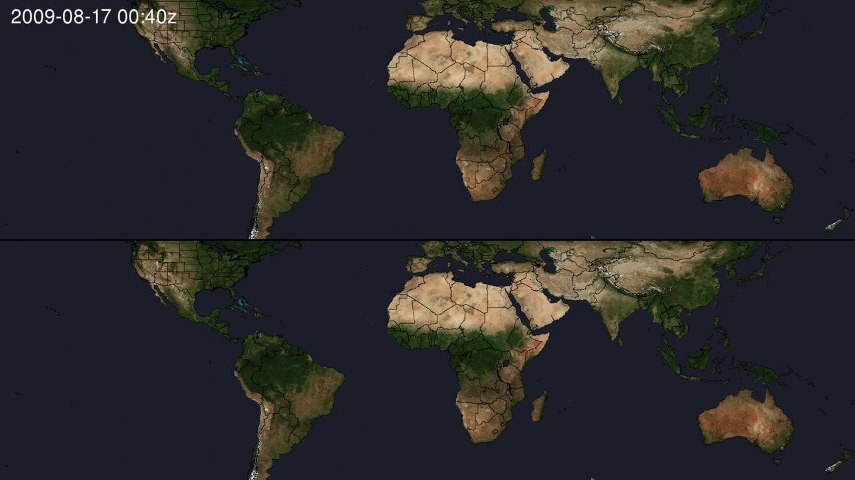
Notes:
Cloud Optical Thickness Comparison
GEOS-5 and MODIS cloud optical thickness comparison, August 2009.
NASA’s Global Modeling and Assimilation Office (GMAO) works to maximize the impact of NASA’s satellite observations in weather and climate analysis and prediction through integrated Earth system modeling and data assimilation.
This visualization compares cloud optical thickness from a GMAO simulation using the Goddard Earth Observing System Model, Version 5 (GEOS-5) [top] to observations from the Moderate Resolution Imaging Spectroradiometer (MODIS) onboard Aqua and Terra [bottom], August 17-26, 2009. A cloud's optical thickness is a measure of attenuation of the light passing through the atmosphere due to the scattering and absorption by cloud droplets. Clouds do not absorb visible wavelengths of sunlight; rather, clouds scatter and reflect most visible light. Here, light blue shades indicate areas where there are low cloud-optical-thickness values, while red and orange shades indicate high values (i.e., greater attenuation caused by the scattering and absorption from cloud droplets). The higher a cloud's optical thickness, the more sunlight the cloud is scattering and reflecting.

