Slide 1
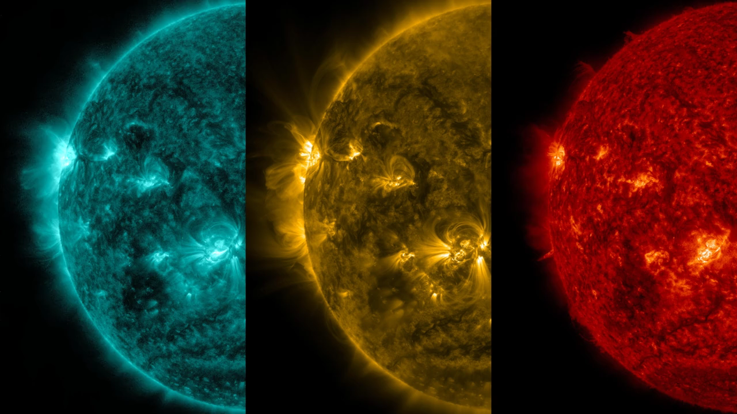
Notes:
The sun emitted a significant solar flare, peaking at 6:11 pm EDT on May 5, 2015. NASA’s Solar Dynamics Observatory, which watches the sun constantly, captured an image of the event. Solar flares are powerful bursts of radiation. Harmful radiation from a flare cannot pass through Earth's atmosphere to physically affect humans on the ground, however -- when intense enough -- they can disturb the atmosphere in the layer where GPS and communications signals travel.
This flare is classified as an X2.7-class flare. X-class denotes the most intense flares, while the number provides more information about its strength. An X2 is twice as intense as an X1, an X3 is three times as intense, etc.

