Slide 1
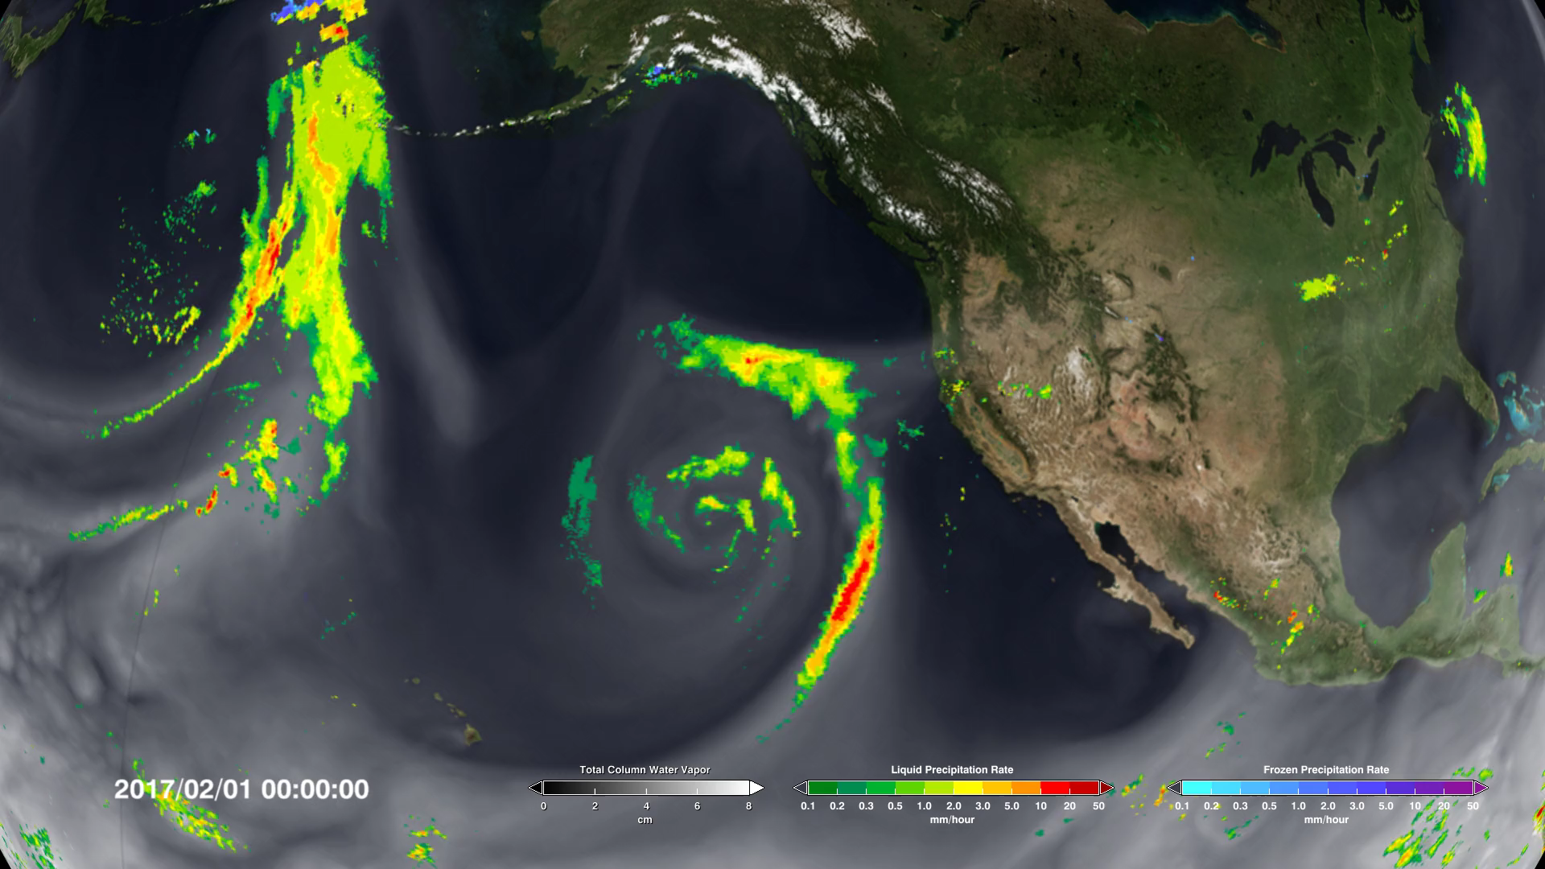
Notes:
California Gets Slammed Again
California has been experiencing a drought since 2012, but the first months of 2017 have brought some relief in the form of torrential rains. These rains have been brought to California in a series of atmospheric rivers, long narrow channels of water vapor in the atmosphere that reach from tropical latitudes to the coast of California. These channels bring rainfall to the state when they are disrupted by atmospheric conditions over California's eastern mountains.
This visualization of atmospheric water vapor and precipitation during the first three months of February shows the successive atmospheric rivers and the resulting rainfall by combining precipitation data from the Global Precipitation Measurement (GPM) mission's Integrated Multi-satellitE Retrievals (IMERG) with water vapor data from the Goddard Earth Observing System Model (GEOS).
For more information visit:
svs.gsfc.nasa.gov/vis/a000000/a004500/a004555/

