Slide 1
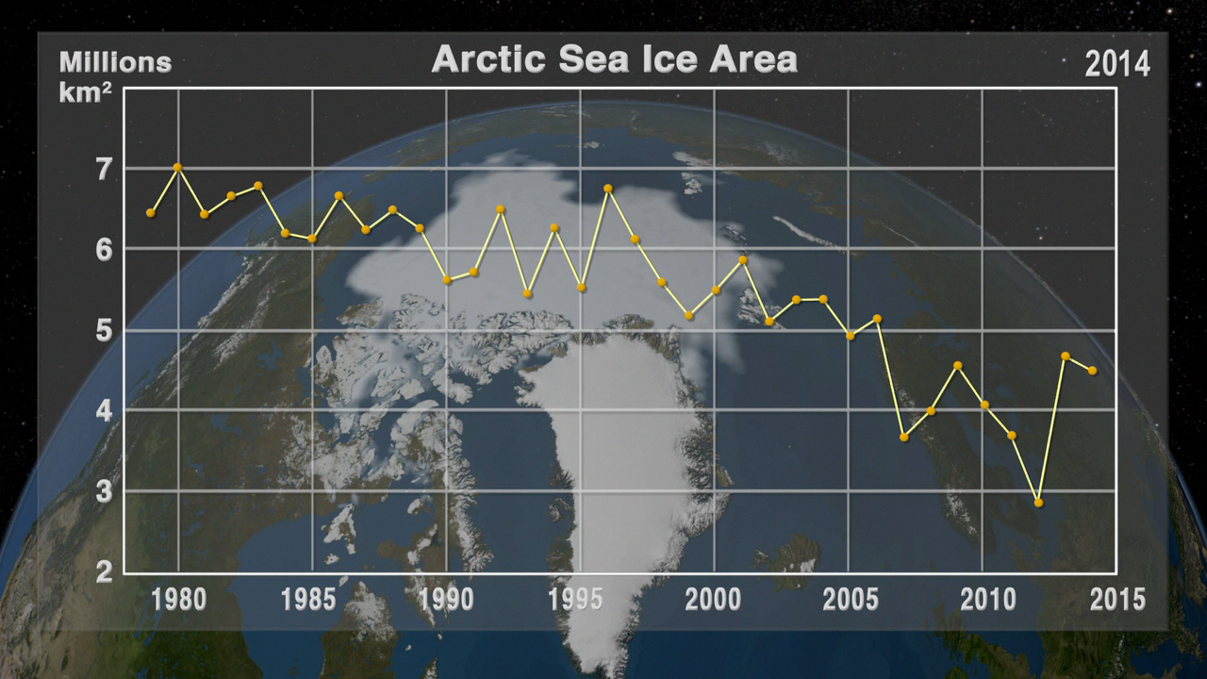
Notes:
Satellite-based passive microwave images of the sea ice have provided a reliable tool for continuously monitoring changes in the Arctic ice since 1979. Every summer the Arctic ice cap melts down to what scientists call its "minimum" before colder weather begins to cause ice cover to increase. The ice parameters derived from satellite ice concentration data that are most relevant to climate change studies are sea ice extent and sea ice area. This graph displays the area of the minimum sea ice coverage each year from 1979 through 2014. In 2014, the Arctic minimum sea ice covered an area of 4.527 million square kilometers.
This visualization shows the expanse of the annual minimum Arctic sea ice for each year from 1979 to 2014 as derived from SSMI data. A semi-transparent graph overlay shows the area in million square kilometers for each year's minimum day. The date shown in the upper right corner indicates the current year being displayed.

