Slide 1
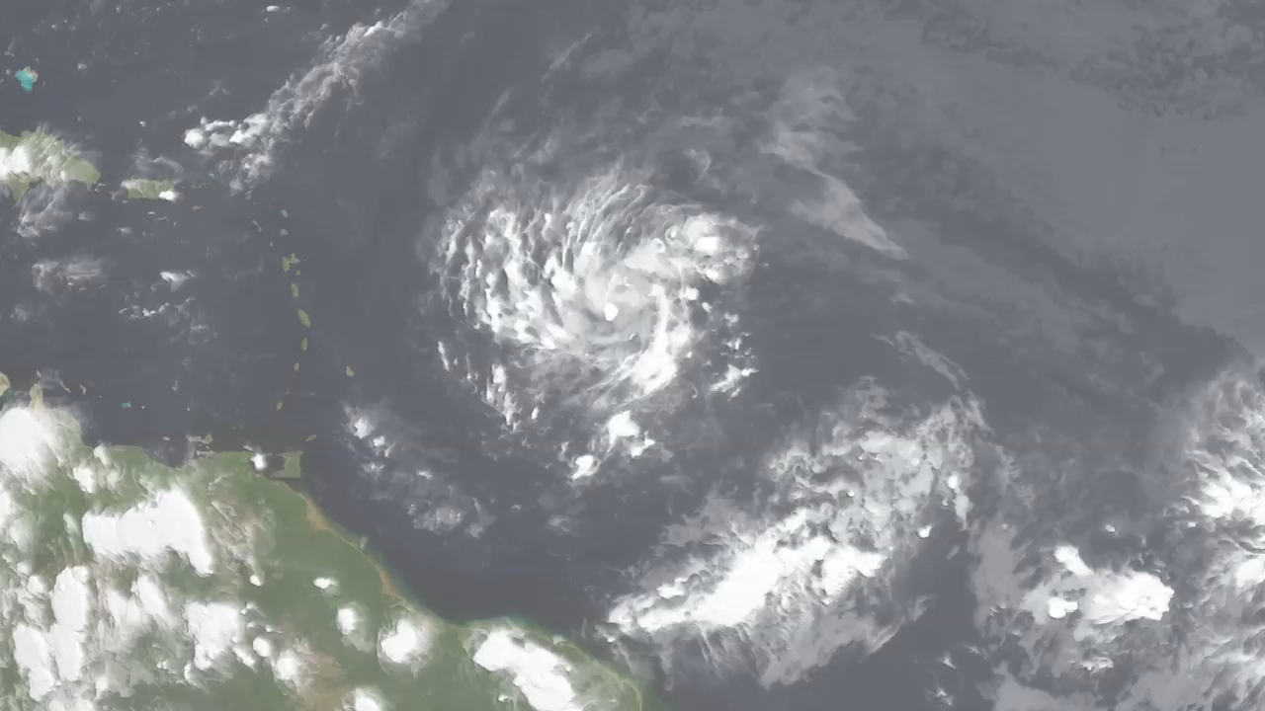
Notes:
The Rainmaker
Each year hurricanes cause billions of dollars in damage across the US. In August of 2011, Hurricane Irene roared up the densely populated East Coast dumping large amounts of rain on major US cities. Floodwaters inundated roadways, communities, beaches, homes, and more from North Carolina to New England until the storm finally fizzled out over the Northern Atlantic. This visualization shows the spiraling storm as it trekked up the East Coast. Rainfall amounts were measured by the Tropical Rainfall Measuring Mission (TRMM) from August 17-29, 2011.
SVS Animation 3852 - Hurricane Irene

