Slide 1
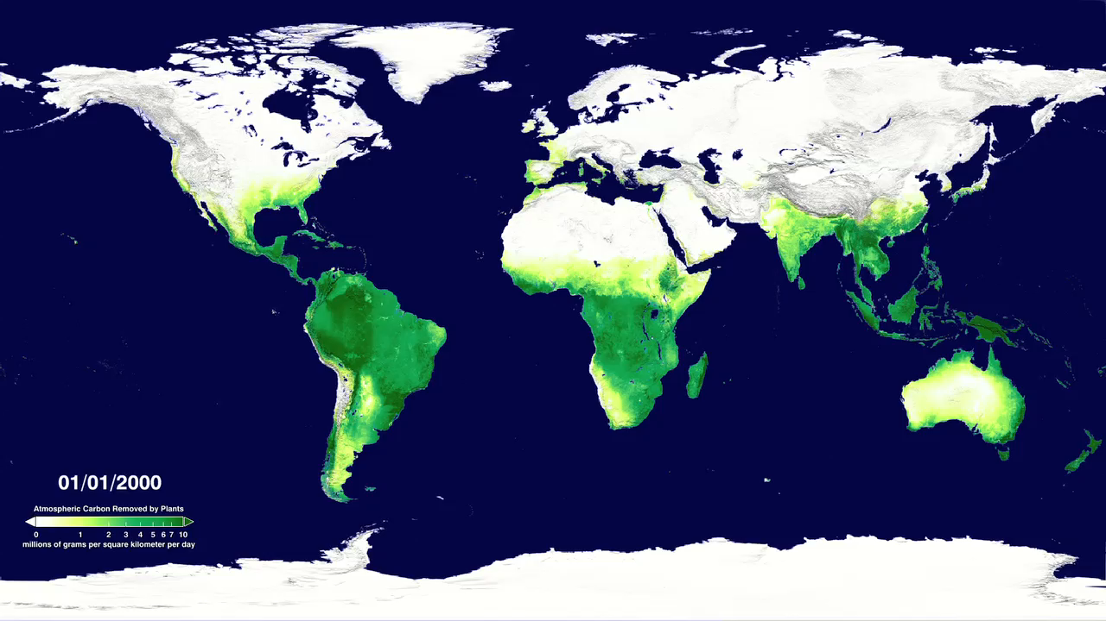
Notes:
HOW MUCH CARBON DO PLANTS TAKE FROM THE ATMOSPHERE? SVS CATALOG 3764
Terra - MODIS
Plant life converts atmospheric carbon dioxide into biomass through photosynthesis, a process called 'fixing'. This is one of the main ways in which carbon dioxide is removed from the atmosphere and is a major part of the carbon cycle. The amount of carbon removed is called the gross primary productivity (GPP), and the change in GPP due to rising global temperatures is very important factor in the response of the Earth to climate change.
Data from the MODIS instrument on NASA's Terra satellite has been recently used to calculate the GPP for the whole world for the last 10 years. This animation shows a time sequence of GPP on land as measured by MODIS during the years 2000 through 2009. Two things to note are the year-long productivity of the tropical regions and the large seasonal productivity in the northern hemisphere. A close look at the animation also reveals major urban areas for which the productivity is negligible.

