Slide 1
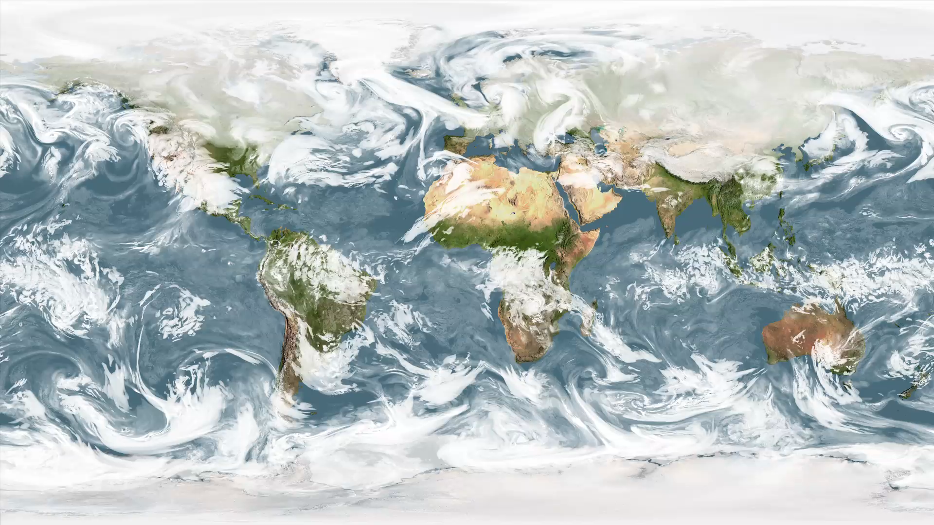
Notes:
What’s Up with Clouds?
From space, streaks of white clouds can be seen swirling across Earth’s surface. If you stare long enough, you’ll notice distinct patterns in the direction clouds move at certain latitudes. These patterns are a result of the tropics receiving more energy than they emit and the polar regions emitting more energy than they receive. This latitudinal heat imbalance drives atmospheric circulation and subsequently causes weather. In this animation the intertropical convergence zone (ITCZ) is visible as a narrow band of clouds along the equator. Above and below the ITCZ, open cell cumulous clouds propagate westward. Most striking are the large swirls moving eastward located between 30–60º latitude, often referred to as mid-latitude cyclones. This visualization shows a simulation of clouds from February 2-22, 2010 using the GEOS-5 model.
SVS Animation 3723 - NCCS Hyperwall Show: GEOS-5 Modeled Clouds at 5-km Resolution (Flat Map)

