Slide 1
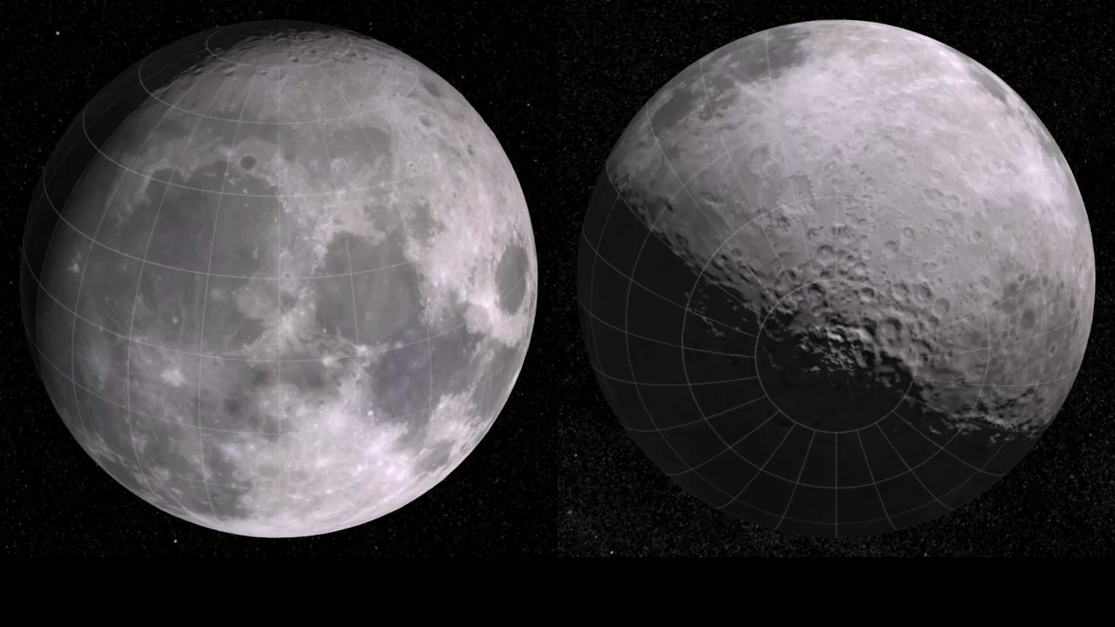
Notes:
LRO Ground Track - One Sidereal Month
The animation depicts LRO's ground track over a period of 27.3 days (348 orbits) or one sidereal month, the amount of time it takes the Moon to turn once on its axis, relative to the stars. This is two days shorter than the synodic month, the period of the Moon's phases. The difference arises from the motion of the Earth. While the Moon is orbiting the Earth, the Earth is carrying them both around the Sun, changing the Sun's direction relative to the stars.
Each LRO orbit is separated from the previous one by about one degree of longitude. On the Moon's surface near the equator, this corresponds to a spacing of 30 kilometers (19 miles), but the orbits converge near the poles; at 84 degrees N or S latitude, the ground distance is only 10% of the distance at the equator. At all latitudes, later LRO orbits will fill in the gaps left by earlier ones. Orbits in the latter half of the month depicted in this animation are seen to form a cross-hatch pattern that begins to fill in the gaps left during the first half of the month.
Credit: NASA/Goddard Space Flight Center Scientific Visualization Studio
Source: http://svs.gsfc.nasa.gov/vis/a000000/a003400/a003453/
Short description:
This animation depicts LRO's ground track over a period of 27.3 days (348 orbits) or one sidereal month, the amount of time it takes the Moon to turn once on its axis, relative to the stars.

