Slide 1
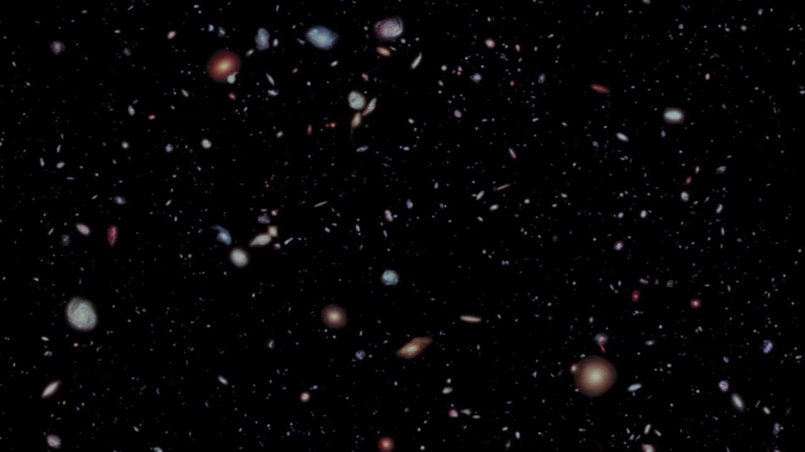
Notes:
The Hubble eXtreme Deep Field
This visualization depicts a flight through the HXDF galaxies. Using measured and estimated distances for approximately 3,000 galaxies, astronomers and visualizers constructed a three-dimensional model of the galaxy distribution. The camera traverses through the thirteen-billion-light-year dataset and ends in blackness, not because more distant galaxies do not exist, but because such galaxies have not yet been observed.

